Slide 1
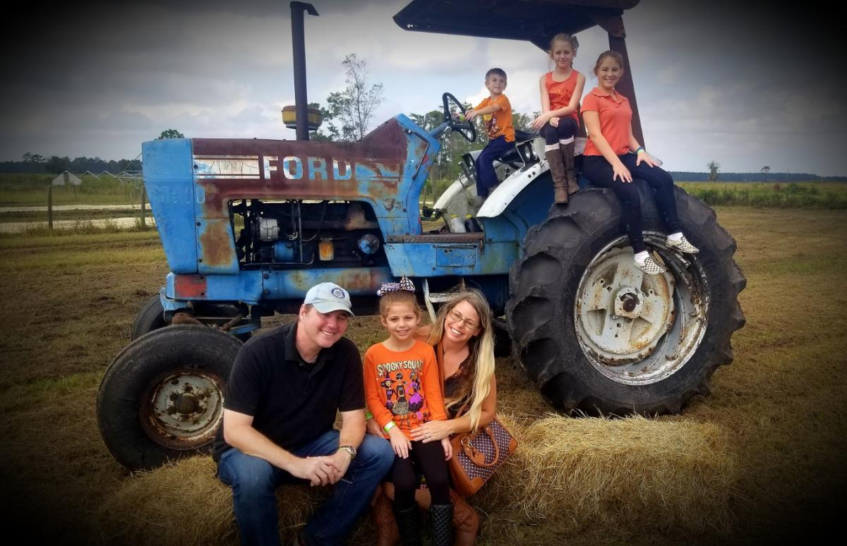
Meet Mrs. Seaman, M.Ed.
Favorites:
Favorite School Subjects: ASL, Russian, Linguistics , Robotics, all things Gifted
Artists: Pablo Picasso & Thomas Kinkade
Hobbies: Sports (baseball, gymnastics, swim, cheerleading, horseback riding), beach trips, traveling, spending time with family (3 daughters, 1 son,
& husband)
About Me:
I grew up in Maryland and earned a Bachelors in
Deaf Studies from Towson University
and a double Masters in Deaf
Education and Special Education.
I am very passionate about Gifted Education, robotics, and linguistics. I am fluent in American Sign Language and spent 5 years teaching at a school for the Deaf.
This will be my 17th year teaching. This year I will be at Tocoi Creek High School and Picolata Crossing Elementary School.
Gifted Students:
Through real world application, I will support learners in a variety of ways. Each student is linked to a Schoology GROUP (elementary) or COURSE (high school). I will meet with elementary gifted students in person weekly. All of my gifted students are also able to message and interact with me via weekly postings and monthly surveys (high school). At the high school level, there will be dedicated Gifted Toro Time where students can meet on various topics related to their Gifted Educational Plan (EPs). Students can also meet with me one-on-one or small group. I will be reaching out to students through Schoology in the coming weeks.
Brandie.Seaman@stjohns.k12.fl.us
“We must have perseverance and above all confidence in ourselves. We must believe that we are gifted for something and that this thing must be attained.”
-Marie Curie
Developing a Partnership and Goal Setting…
Effective communication is essential for building partnerships. Working together to assist you and your child is of high importance. Throughout this school year, I hope to emphasize the importance of original, creative, and flexible thinking, encouraging students in areas such as leadership and cooperative learning, which will further assist in developing responsible citizens.

