Slide 1
Chapter 16
Today’s Challenges: Security vs. Liberty, Cyber Crime, and White-Collar Crime

Slide 2
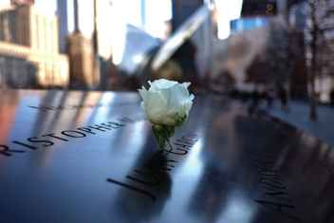
Learning Objective 1
Summarize the three federal laws that have been particularly influential on our nation’s counterterrorism strategies.
Jewel Samad/AFP/Getty Images
Notes:
In 2015, a white rose is placed on the name of one of the victims of the September 11, 2001, terrorist attacks at a memorial in New York City. Why does large scale terrorist activity often make citizens of the targeted country more willing to trade certain freedoms for greater security against future attacks?
Jewel Samad/AFP/Getty Images

Slide 3
Security vs. Liberty
National security and privacy
Congress passed the Foreign Intelligence Surveillance Act (FISA) in 1978.
The Antiterrorism and Effective Death Penalty Act (AEDPA) hampers terrorist organizations by cutting off their funding.
The Patriot Act

Slide 4
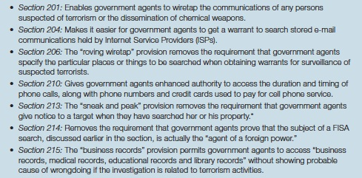
Security vs. Liberty
Notes:
Figure 16.1 The Patriot Act and Electronic Surveillance
Under Title II of the Patriot Act, the following sections greatly expanded the ability of federal intelligence operatives and law enforcement agents to conduct electronic surveillance operations on suspected terrorists.
* In 2012, this rule was revised to require notice within thirty days of the search in most circumstances.

Slide 5
Learning Objective 2
Explain why private expectations are so important to the federal government’s metadata surveillance operations.
Win McNamee/Getty Images
Notes:
Protesting outside the Justice Department in Washington, D.C., this woman believes that the federal government should not be allowed to collect information about the telephone habits of U.S. citizens without first obtaining permission from a court. Do you agree with her? Why or why not?
Win McNamee/Getty Images

Slide 6
Security vs. Liberty
Revelation that NSA had been monitoring cell phone and Internet activity of about 113 Americans without probable cause or a warrant from the FISA court
Government agents can search and seize, without a warrant, information voluntarily disclosed to third parties.
Smith v. Maryland (1979) held that a defendant had no expectation of privacy when he voluntarily turned over phone numbers to a third party.

Slide 7
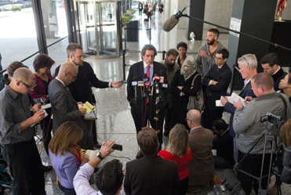
Learning Objective 3
Distinguish verbal threats that are protected by the Constitution from verbal threats that can be prosecuted as “true threats.”
Brian Kersey/Getty Images
Notes:
Thomas Durkin, attorney for Mohammed Hamzah Khan, addresses the media on October
9, 2014, in Chicago. Khan was arrested by federal agents while boarding a flight to the Middle East, where he allegedly planned to join an extremist terrorist organization. If you were Khan’s attorney, how would you argue that the act of boarding an airplane should never be a crime? What is your opinion of such an argument?
Brian Kersey/Getty Images

Slide 8
Security vs. Liberty
True threat law
In Virginia v. Black (2003), the Supreme Court held that the act of burning a cross was not enough to constitute a crime, and that the state must also prove that the act was done to place a specific victim “in fear of bodily harm or death.”
Finding and capturing “known wolves”

Slide 9
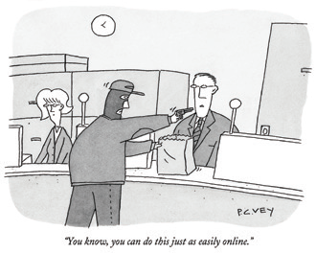
Learning Objective 4
Outline the three major reasons why the Internet is conducive to the dissemination of child pornography.
P. C. Vey/The New Yorker Collection/Cartoonbank.com

Slide 10
Cyber Crime
Cyber crime is any criminal activity occurring via a computer in the virtual community of the Internet.
Child pornography
Speed
Security
Anonymity

Slide 11
Cyber Crime
Cyberattack: attempt to damage or disrupt computer systems or electronic networks operated by computers
Infrastructure security

Slide 12
Cyber Crime
Cyber fraud
Theft of personal information
Cyber theft
Identity theft
Phishing

Slide 13
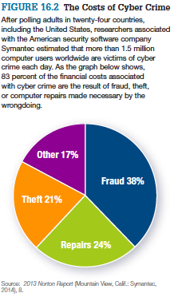
Cyber Crime
Notes:
FIGURE 16.2 The Costs of Cyber Crime
After polling adults in twenty-four countries, including the United States, researchers associated with the American security software company Symantec estimated that more than 1.5 million computer users worldwide are victims of cyber crime each day. As the graph below shows, 83 percent of the financial costs associated with cyber crime are the result of fraud, theft, or computer repairs made necessary by the wrongdoing.
Source: 2013 Norton Report (Mountain View, Calif.: Symantec, 2014), 8.

Slide 14
Cyber Crime
Cyberstalking
Harassing a person through the Internet and putting that person in reasonable fear for his or her safety
Cyberbullying
Willful and repeated emotional harm inflicted through electronic devices

Slide 15
Learning Objective 5
Describe the three following forms of malware: a) botnets b) worms and (c) viruses.
Nathan Alliard/Getty Images

Slide 16
Cyber Crime
Hacker
Person who breaks into another person’s computer
Malware
Any program that is harmful to a computer or computer user
Botnets
Networks of computers that have been appropriated by hackers without the knowledge of their owners
Worms
A program that is capable of reproducing itself as it spreads from one computer to the next
Viruses
Able to reproduce itself, but must be attached to an infested host file in order to travel

Slide 17
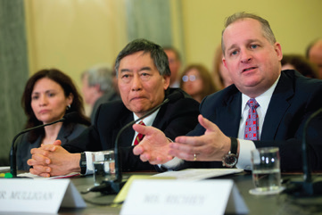
Learning Objective 6
Explain how the Internet has contributed to piracy of intellectual property.
Bloomberg via Getty
Notes:
Target Corp. executive vice president John Mulligan, right, testifies before the U.S. Congress following a security breach that allowed hackers to steal financial and personal data from tens of millions of consumers. Why does this type of cyber crime fall into the category of identity theft, as described earlier in the section?
Bloomberg via Getty

Slide 18
Cyber Crime
Pirating intellectual property
Intellectual property is the products that result from intellectual, creative processes
Includes piracy of books, films, music, and software
An estimated 43% of all software is pirated

Slide 19
Cyber Crime
Cyber forensics
Officers cannot put yellow tape around the computer screen or dust the Web site.
Digital evidence is stored or transmitted by an electronic device.
Cyber sleuthing
Tools to bypass technology employed by cyber criminals
Jurisdictional challenges

Slide 20
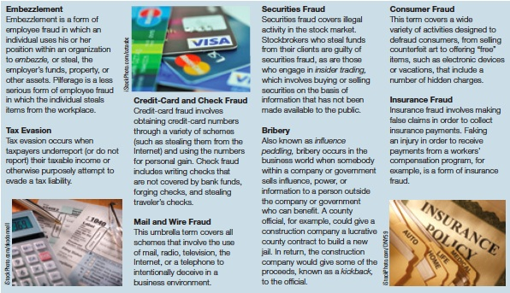
Learning Objective 7
Indicate some of the ways that white-collar crime is different from violent or property crime.
Notes:
FIGURE 16.4 White-Collar Crimes

Slide 21
White-Collar Crime
What is white-collar crime?
Covers a broad range of illegal acts involving “lying, cheating, or stealing”
Not an official category of criminal behavior
Different techniques
Have legal access to the place the crime occurs
Are spatially separated from the victim
Behave in a manner that is superficially legitimate

Slide 22
White-Collar Crime
Three main techniques of white-collar criminals to commit crime
Deception
Abuse of trust
Concealment and conspiracy
Victims of white-collar crime:
Sometimes the victims are obvious; in other instances however, they are a little more difficult to define.
Can be one person, multiple people, society, or the environment

Slide 23
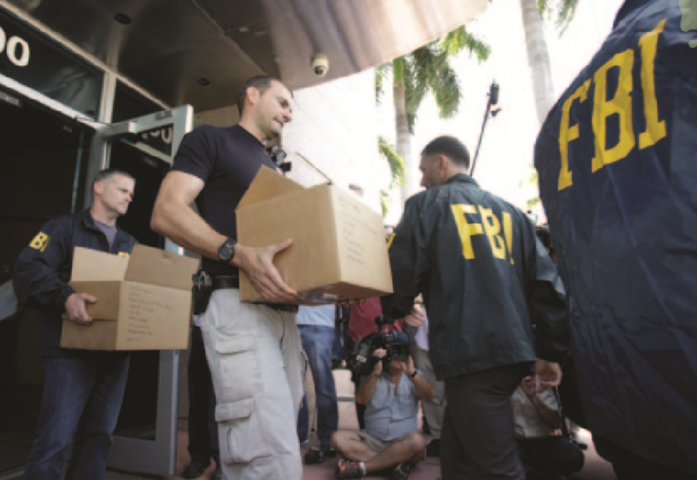
Learning Objective 8
Explain the concept of corporate violence.
Notes:
I took this photo from page 351 of Siegel.
Fraud may occur in both public and private organizations. Here Federal agents load a van with boxes of evidence taken from the headquarters of the Confederation of North, Central American and Caribbean Association Football (CONCACAF) in Miami Beach, Florida. Swiss prosecutors opened criminal proceedings into FIFA’s awarding of the 2018 and 2022 World Cups, after seven soccer officials were arrested after probe of “rampant, systemic, and deep-rooted” corruption in the organization.

Slide 24
Corporate Violence
Corporate violence
Physical harm to individuals or the environment that occurs as the result of corporate policies or decision making
Administrative laws attempt to control the actions of these corporations.
The U.S. Department of Justice is often given responsibility for prosecution.

