Slide 1
Chapter 15
The Juvenile Justice System

Slide 2
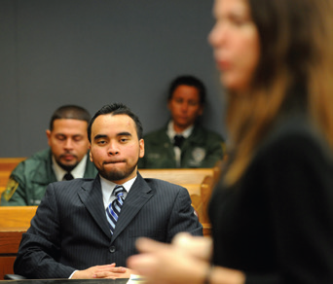
Learning Objective 1
Describe the child- saving movement and its relationship to the doctrine of parens patriae.
Peter Andrew Bosch/Miami Herald/MCT via Getty Images
Notes:
In 2015, a Florida judge reduced the sentence of Ronald Salazar, shown here, from life without parole to forty years for raping and killing his sister when he was fourteen years old.
Peter Andrew Bosch/Miami Herald/MCT via Getty Images

Slide 3
The Evolution of American Juvenile Justice
Parens patriae holds that the state has not only a right, but also a duty to care for children who are neglected, delinquent, or in some other way disadvantaged.
Child savers:
Wealthy, civic minded citizens who were concerned with the welfare of disadvantaged children
Argued that the state has a responsibility to take control of children who exhibit criminal tendencies or had been neglected by their parents
Instrumental in opening the House of Refuge in 1825

Slide 4
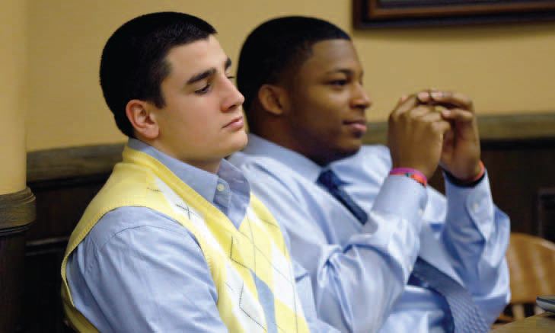
Learning Objective 2
List the four major differences between juvenile courts and adult courts.
AP Photo/Keith Srakocic, Pool

Slide 5
The Evolution of American Juvenile Justice
The Illinois Juvenile Court:
Established in 1899
Different from adult court
No juries
Different terminology
No adversarial relationship
Confidentiality
All states had juvenile courts by 1945.

Slide 6
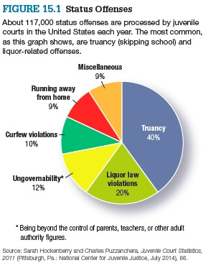
The Evolution of American Juvenile Justice
Notes:
Figure 15.1 Status Offenses
About 117,000 status offenses are processed by juvenile courts in the United States each year. The most common, as this graph shows, are truancy (skipping school) and
liquor-related offenses.
Source: Sarah Hockenberry and Charles Puzzanchera, Juvenile Court Statistics, 2011 (Pittsburgh, Pa.: National Center for Juvenile Justice, July 2014), 66.

Slide 7
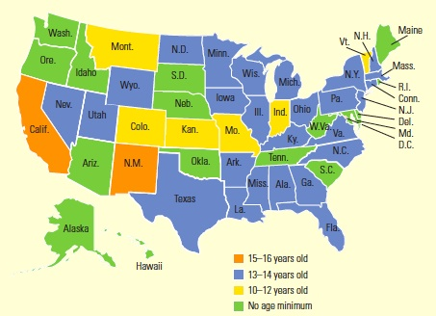
Learning Objective 3
Identify and briefly describe the single most important U.S. Supreme Court case with respect to juvenile justice.
AP Photo/Mark Duncan
Source: Patrick Griffin, et al., Trying Juveniles as Adults: An Analysis of State Transfer Laws and Reporting (Washington, D.C.: Office of Juvenile Justice and Delinquency Prevention, September 2011).
Notes:
FIGURE 15.2 The Minimum Age at Which a Juvenile Can Be Tried as an Adult
Source: Patrick Griffin, et al., Trying Juveniles as Adults: An Analysis of State Transfer Laws and Reporting (Washington, D.C.: Office of Juvenile Justice and Delinquency Prevention, September 2011).

Slide 8
The Evolution of American Juvenile Justice
In re Gault (1967)
The Supreme Court held that juveniles are entitled to many of the same due process rights granted to adult offenders.
The right to advance notice of charges
The right to counsel
The right to confront and cross-examine witnesses
The privilege against self-incrimination

Slide 9
The Evolution of American Juvenile Justice
Other important Supreme Court decisions affecting juveniles
In re Winship (1970): “beyond a reasonable doubt” standard
Breed v. Jones (1975): double jeopardy applied concerning adult court
McKeiver v. Pennsylvania (1971): no right to jury trial

Slide 10
Learning Objective 4
Describe the reasoning behind recent U.S. Supreme Court decisions that have lessened the harshness of sentencing outcomes for violent juvenile offenders.

Slide 11
Determining Delinquency Today
The culpability question
Juvenile behavior
Diminished guilt
Roper v. Simmons (2005): diminished culpability; forbids those offenders who committed their crime while under the age of 18 from being put to death
Graham v. Florida (2010): juveniles who commit crimes that do not involve murder may not be sentenced to life
Miller v. Alabama (2012): banned life without parole mandatory sentences for juveniles
Sentencing issues

Slide 12
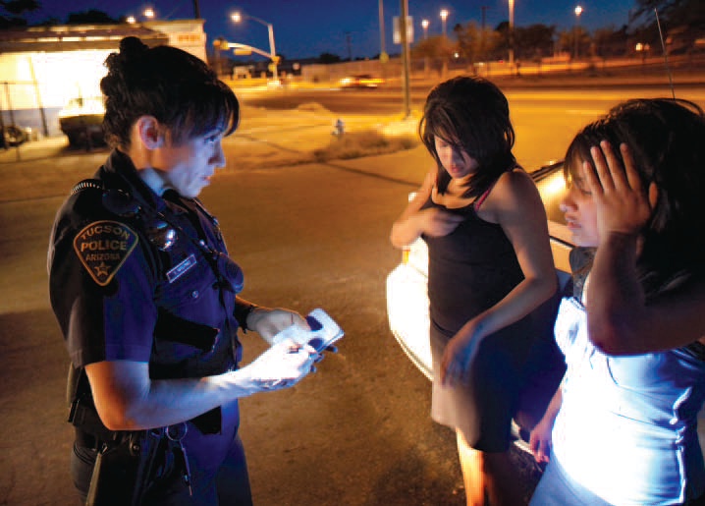
Learning Objective 5
Explain how law enforcement’s emphasis on domestic violence has influenced female juvenile arrest patterns.
Photo by Scott Olson/Getty Images
Notes:
A police officer interviews two teenage girls who were involved in a fight in Tucson, Arizona. Do you think that law enforcement is likely to treat girls more harshly than boys for this type of misbehavior? Why?
Photo by Scott Olson/Getty Images

Slide 13
Trends in Juvenile Delinquency
Delinquency by the numbers
2013 statistics show juvenile were responsible for:
7 percent of all murder arrests
9 percent of all aggravated assault arrests
15 percent of all rapes
15 percent of all weapons arrests
20 percent of all robbery arrests
16 percent of all Part I property crimes
8 percent of all drug offenses

Slide 14
Trends in Juvenile Delinquency
Rising arrests for females
Family-based delinquency
Research shows that police are much more likely to make arrests in situations involving domestic violence now than a decade ago.
A large percentage of female juvenile arrests for assault arise out of family disputes, and those are arrests that until relatively recently would not have been made.
School violence and bullying
Safety in schools
Bullied students

Slide 15
Learning Objective 6
Describe the one variable that always correlates highly with juvenile crime rates.
Cheryl E. Davis/Shutterstock

Slide 16
Factors in Juvenile Delinquency
Age-crime relationship
The older a person is, the less likely he or she will exhibit criminal behavior.
Aging out
Substance abuse
Child abuse and neglect
Gangs

Slide 17
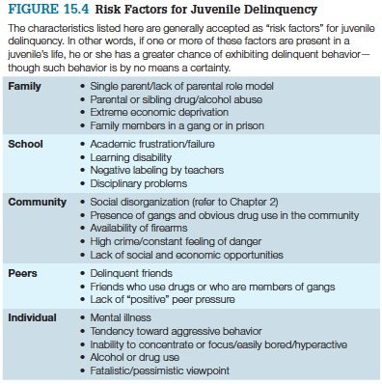
Factors in Juvenile Delinquency

Slide 18
Factors in Juvenile Delinquency
Youth gang—a group of three or more persons who:
Self-identify as an entity separate from the community by clothing, vocabulary, hand-signals, and names
Engage in criminal activity
Reasons for joining gangs:
Identity
Protection
Fellowship
Criminal activity
Intimidation

Slide 19
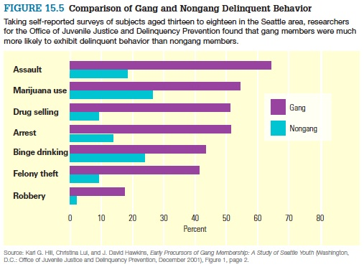
Factors in Juvenile Delinquency
Notes:
FIGURE 15.5 Comparison of Gang and Nongang Delinquent Behavior
Taking self-reported surveys of subjects aged thirteen to eighteen in the Seattle area, researchers for the Office of Juvenile Justice and Delinquency Prevention found that gang members were much more likely to exhibit delinquent behavior than nongang members.
Source: Karl G. Hill, Christina Lui, and J. David Hawkins, Early Precursors of Gang Membership: A Study of Seattle Youth (Washington, D.C.: Office of Juvenile Justice and Delinquency Prevention, December 2001), Figure 1, page 2.

Slide 20
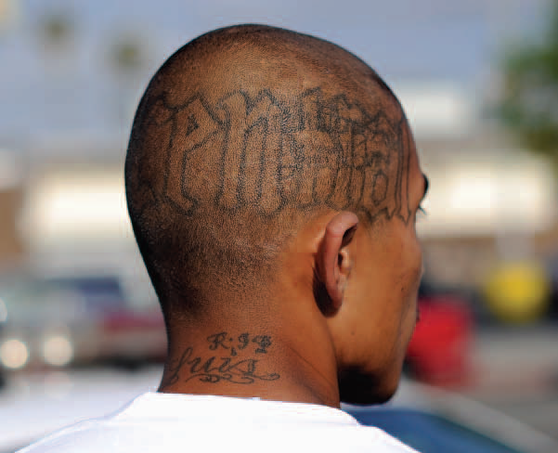
Learning Objective 7
List the factors that normally determine what police do with juvenile offenders.
Kevork Djansezian/Getty Images

Slide 21
First Contact: The Police and Pretrial Procedures
Police exercise low-visibility decision making when working with juveniles.
Factors that impact discretion
Nature of the offense; past criminal history
Attitude of the offender
Willingness of parents to take disciplinary action
Race and gender of offender; setting of offense
Arrests and minority youth
Failing the “attitude test”
Those who are polite and apologetic generally have a better chance for release.

Slide 22
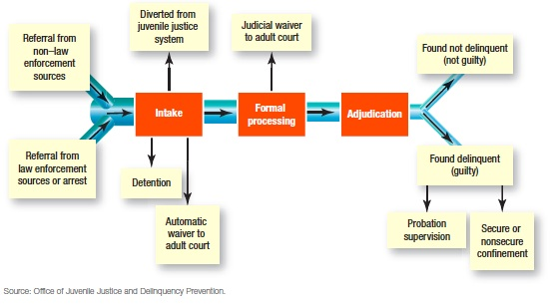
Learning Objective 8
Describe the four primary stages of pretrial juvenile justice procedure.
Notes:
FIGURE 15.6 The Juvenile Justice Process
This diagram shows the possible tracks that a young person may take after her or his first contact with the juvenile justice system (usually a police officer).
Source: Office of Juvenile Justice and Delinquency Prevention.

Slide 23
First Contact: The Police and Pretrial Procedures
The four primary pretrial stages:
Intake: court decides to file a petition, release, or put juvenile under supervision
Pretrial diversion: probation, treatment and aid, or restitution
Transfer: automatic waiver; prosecutorial waiver to adult criminal court
Detention: temporary custody; detention hearing within 24 hours

Slide 24
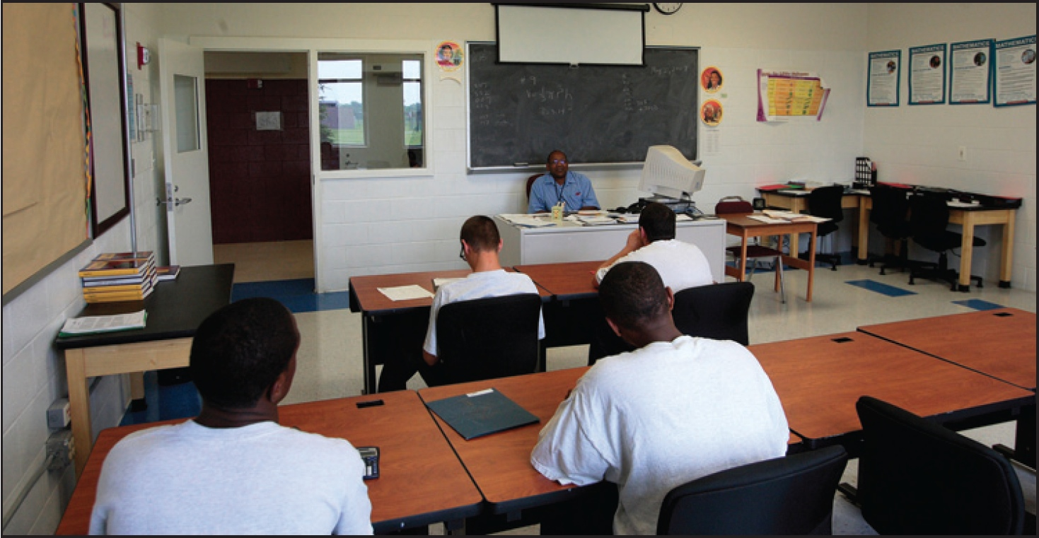
Learning Objective 9
Explain the distinction between an adjudicatory hearing and a disposition hearing.
AP Photo/Columbus Dispatch, James D. DeCamp
Notes:
AP Images/Columbus Dispatch, James D. DeCamp

Slide 25
Trying & Punishing Juveniles
Adjudication hearing
The process by which the court determines whether there is sufficient evidence to support the petition
Detention hearing
The hearing in which the appropriate sanctions for the delinquent or status offender is determined
Predisposition report

Slide 26
Trying & Punishing Juveniles
Juvenile corrections is based on graduated sanctions.
Probation
Residential treatment programs
Foster care programs, group homes, family group homes, rural programs
Secure confinement
Aftercare programs

