Slide 1
Chapter 14
The Prisoner Experience and Prison Reentry

Slide 2
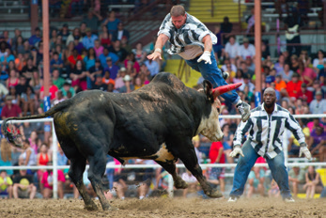
Learning Objective 1
Explain the concept of the prison as a total institution.
Cooper Neill/Getty Images
Notes:
An inmate is struck by a bull during the “Guts and Glory” event at the Louisiana State Penitentiary’s annual Angola Prison Rodeo.

Slide 3
Prison Culture
Goffman suggested that prison cultures are unique because prisons are total institutions that encompass every aspect of an inmate’s life.
Prisoner cannot leave institution or have any meaningful interaction with outside communities.
Others arrange every aspect of daily life, and prisoners must follow schedule in same manner.
Inmates create argot, or their own language.
Inmates create their own economy.
Inmates establish methods of determining power.

Slide 4
Prison Culture
Prisonization process

Slide 5
Prison Culture
Adapting to prison culture:
Doing time: follow the rules; do what is necessary to speed up their release.
Jailing: establish themselves in the power structure of prison culture.
Gleaning: work to improve themselves to prepare to return to society.
Disorganized criminals: have mental impairments or low levels of intelligence and find it impossible to adapt to prison culture.

Slide 6
Learning Objective 2
Describe a risk run by corrections officials who fail to provide adequate medical care to the inmates under their control.

Slide 7
Prison Culture
Brown v. Plata (2011)
Needless suffering or death
Risk of infectious disease transmission for inmates and staff
“A prison that deprives prisoners of basic sustenance, including adequate medical care, is incompatible with the concept of human dignity and has no place in civilized society.”

Slide 8
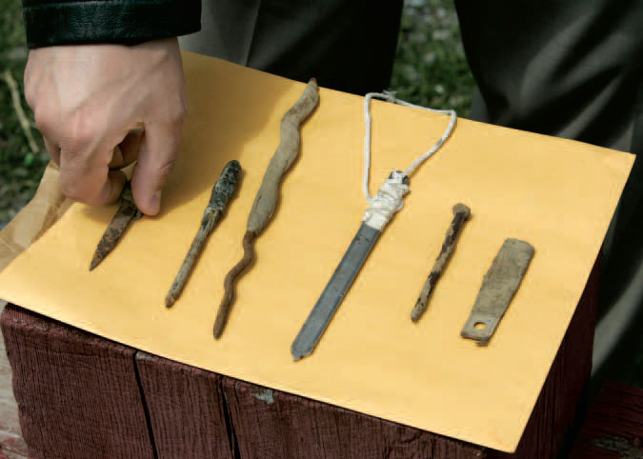
Learning Objective 3
Indicate some of the reasons for violent behavior in prisons.
AP Photo/David Duprey
Notes:
A correctional official displays a set of homemade knives, also known as shivs, made by inmates at Attica Correctional Facility in Attica, New York. What are some of the reasons that violence flourishes behind bars?
AP Images/David Duprey

Slide 9
Prison Violence
According to Bowker, violence in prison exists because:
It establishes the prison hierarchy
It provides a deterrent against being victimized
It enhances self-image
In the case of rape, it gives sexual relief
It is a means of acquiring material goods

Slide 10
Prison Violence
Deprivation model
Stressful and oppressive conditions of prison life lead to aggressive behavior
Relative deprivation
The gap between what is expected in a certain situation and what is achieved

Slide 11
Prison Violence
Riots
Prison rape
Race and ethnicity
Separate worlds
Prison segregation
Prison gangs and security threat groups

Slide 12
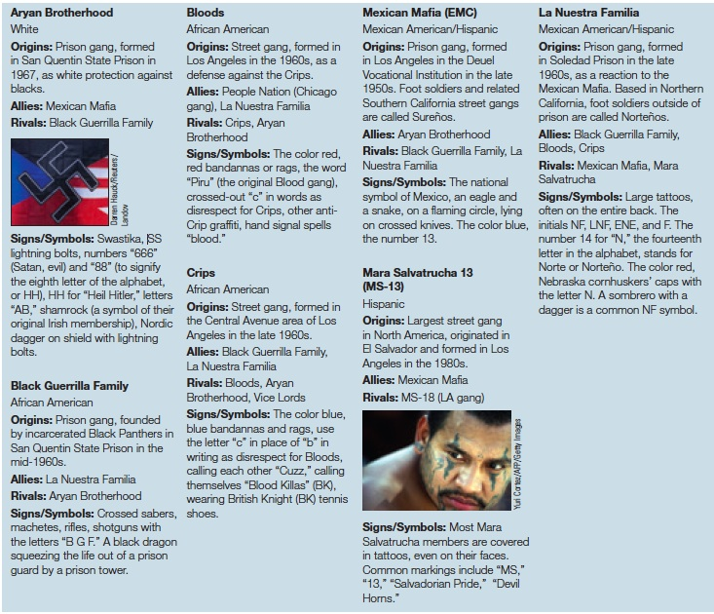
Prison Violence
Sources: “Gangs or Us,” at www.gangsorus.com/index.html; and “Prison Gang Profiles,” at www.insideprison.com/prison_gang_profiles.asp.
Notes:
FIGURE 14.3 The Top Prison Gangs in the United States
Certain prison gangs, such as the Crips and the Bloods, are offshoots of street gangs and gained influence behind bars because so many of their members have been incarcerated. Others, such as the Aryan Brotherhood and the Mexican Mafia, formed in prison and expanded to the streets. Listed here are seven of the most dangerous gangs operating in the American prison system today.
Sources: “Gangs or Us,” at www.gangsorus.com/index.html; and “Prison Gang Profiles,” at www.insideprison.com/prison_gang_profiles.asp.

Slide 13
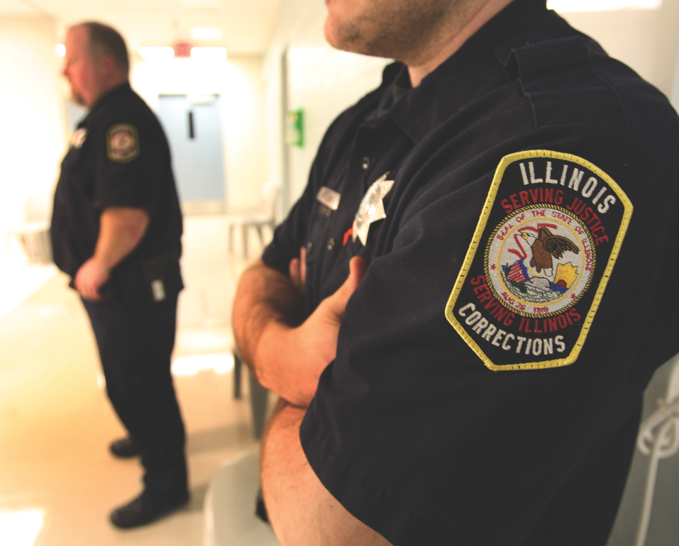
Learning Objective 4
List the three goals of prison disciplinary strategies.
John Smierciak/MCT/Landov
Notes:
In high-security prisons, correctional officers such as these two at the supermax prison in Tamms, Illinois, monitor even the most mundane of inmate activities, including
working, exercising, eating, and showering. How might this constant surveillance
contribute to tension between correctional officers and prisoners?
John Smierciak/MCT/Landov

Slide 14
Correctional Officers & Discipline
Six general categories of correctional officers:
Block officers: supervision of cell blocks containing as many as 400 inmates
Work detail officers: supervision of inmate details
Industrial shop and school officers: maintenance and security functions in workshop/educational programs
Yard officers: work on the prison yard
Tower guards: isolated; silent post above grounds facility
Administrative building assignments: security at prison gates; visitation; liaisons for civilians

Slide 15
Correctional Officers & Discipline
Three general goals of discipline
Ensure safe and orderly environment.
Instill respect for authority of correctional officers and administrators.
Teach values and respectful behavior that influence the inmate’s attitude after release from prison.

Slide 16
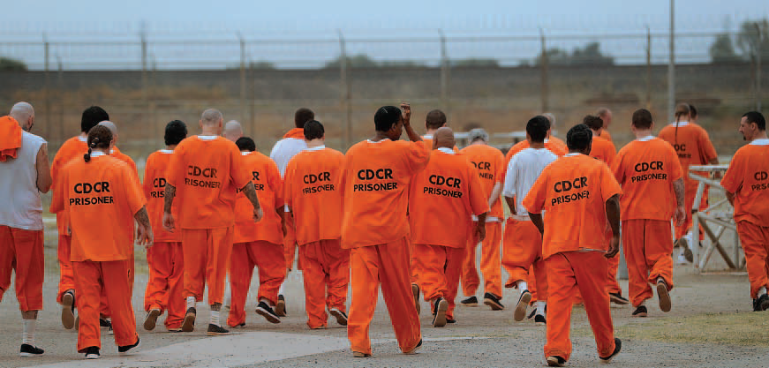
Learning Objective 5
Describe the hands-off doctrine of prisoner law and indicate the two standards used to determine if prisoners’ rights have been violated.
Noah Berger/Bloomberg via Getty Images

Slide 17
Correctional Officers & Discipline
Use of force
Whitley v. Albers (1986)
Legitimate security differences:
Acting in self-defense
Acting to defend the safety of a 3rd person
Upholding the rules of the institution
Preventing a crime
Preventing an escape effort
The “malicious and sadistic” Standard

Slide 18
Correctional Officers & Discipline
“Hands-off” doctrine: care of inmates should be left to prison officials
Not the place of judges to intervene in penal administrative matters
Estelle v. Gamble (1976)
Deliberate indifference standard: prison officials are aware of harmful conditions, but fail to take steps to remedy those conditions
Wilson v. Seiter (1991)
Identifiable human needs standard: prisoner must show institution denied him/her of basic humans needs, i.e., food, warmth, and exercise

Slide 19
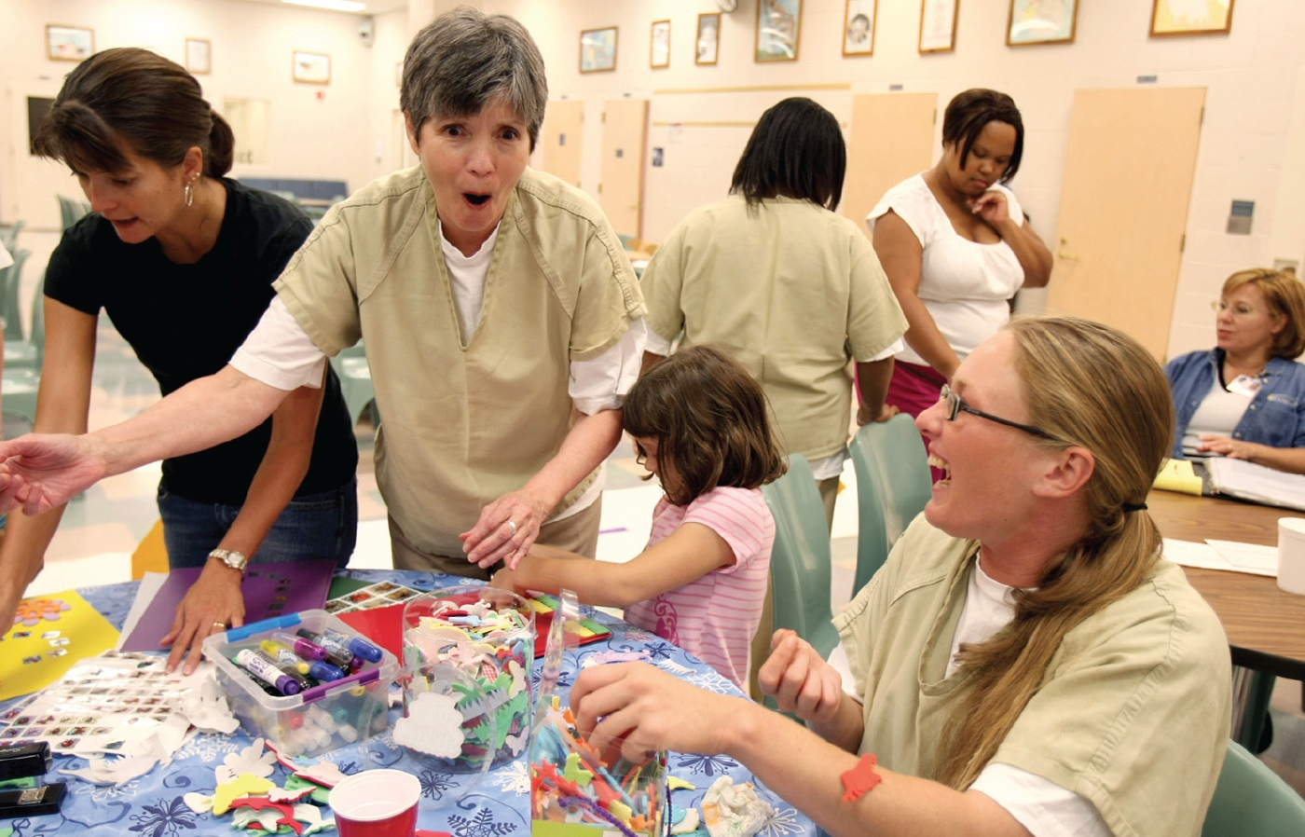
Learning Objective 6
Explain the aspects of imprisonment that prove challenging for incarcerated mothers and their children.
AP Photo/Whitney Curtis
Notes:
Female inmates at the Women’s Eastern Reception, Diagnostic and Correctional Center in Vandalia, Missouri, visit with their daughters and granddaughters. Why is it difficult for many mothers behind bars to see their children?
AP Images/Whitney Curtis

Slide 20
Inside a Women’s Prison
An estimated 7 out of 10 female inmates have at least one minor child.
1.7 million American children have a mother who is incarcerated.
Female inmates are often housed at a great distance from their children.

Slide 21
Inside a Women’s Prison
Pseudo-families
Inmates play specific roles of family members.
Sexual violence and prison staff
Sexual victimization is high in women’s prisons.

Slide 22
Learning Objective 7
Contrast parole, expiration release, pardon, and furlough.
Notes:
This is from page 314 in Siegel: Inmates can be paroled despite multiple failures. Arthur Scott, who was paroled in March 2014, after serving time on his 22nd auto theft conviction, stands in front of an Oakland, California, Toyota dealership on Tuesday, June 24, 2014. Scott, determined to stay out of jail and currently working while taking vocational classes, says he had stolen more than five cars from the dealership. For him, stable housing was critical. Each time he was released, he found himself homeless or in a halfway house with other men who did drugs and he would get re-arrested within days.

Slide 23
Return to Society
Forms of release:
Parole: two-thirds of inmates leave on parole
Expiration release: inmate has served the maximum amount of time on the initial sentence
Pardon: form of executive clemency
Furlough: temporary release from prison for vocational or educational training

Slide 24
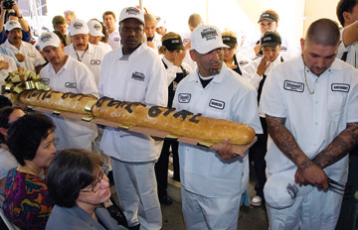
Learning Objective 8
Explain the goal of prisoner reentry programs.
AP Images/Damian Dovarganes
Notes:
Homeboy Industries, which operates this bakery in downtown Los Angeles, provides former gang members and recently released ex-convicts with job training opportunities and other reentry programs. Why is finding employment such an important part of the desistance process?
AP Images/Damian Dovarganes

Slide 25
Return to Society
Challenges of reentry
Housing can be difficult to secure.
Criminal past limits the ability to find employment.
Economic barriers can be complicated by the physical and mental conditions of the freed convict.

Slide 26
Return to Society
Reentry programs:
Promote desistance
Focus on the transition from prison to the community
Involve a treatment curriculum that continues after release
Work release programs
Halfway houses
Second chance legislation
Expungement
“Ban the box”

Slide 27
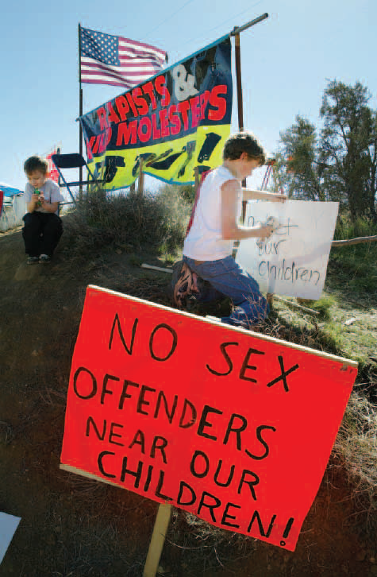
Learning Objective 9
Indicate typical conditions for release for a paroled child molester.
AP Photo/Francis Specker
Notes:
Residents of Phelan, California, protest the opening of a proposed group home for sex
offenders in their neighborhood. What are some of the reasons that community members fear the nearby presence of freed sex offenders? Are these fears justified? Why or why not?
AP Images/Francis Specker

Slide 28
Return to Society
Typical conditions of release:
No contact with children under 16
Continued psychiatric treatment
Permission to change residences
Must maintain a certain distance from schools/parks
Cannot own toys that could lure children
Cannot have job that involves interacting with children

Slide 29
Return to Society
Sex offender notification law
Active notification: authorities directly notify the community or community representatives
Passive notification: information on sex offenders is made open and available for public scrutiny
Civil confinement laws

