Slide 1
Chapter 13
Prisons and Jails

Slide 2
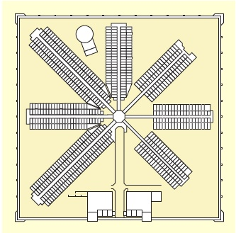
Learning Objective 1
Contrast the Pennsylvania and New York penitentiary theories of the 1800s.
Notes:
FIGURE 13.1 The Eastern Penitentiary
As you can see, the Eastern Penitentiary was designed in the form of a “wagon wheel,” known today as the radial style. The back-to-back cells in each “spoke” of the wheel faced
outward from the center to limit contact between inmates.

Slide 3
A Short History of American Prisons
The Pennsylvania System
Silence and in-cell labor
Constant solitary confinement (the separate system)
Human contact only with visiting clergy
The New York System
Solitary confinement leads to insanity in inmates.
Inmates are allowed to work together, while maintaining silence (the congregate system).

Slide 4
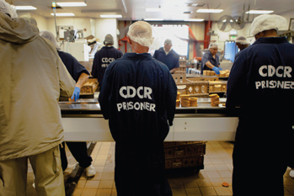
Learning Objective 2
Explain the three general models of prisons.
Sam Hodgson/Bloomberg via Getty Images
Notes:
About 2.2 million inmates are incarcerated in the United States, including these prisoners working in the bakery of the Richard J. Donovan Correctional Facility in San Diego, California.
Sam Hodgson/Bloomberg via Getty Images

Slide 5
A Short History of American Prisons
Three general models of prisons:
The custodial model—prisoners are incarcerated for incapacitation, deterrence, and retribution.
The rehabilitation model—stresses individual treatment.
The reintegration model—correctional institutions are training ground for the inmate to prepare for existence in the community.

Slide 6
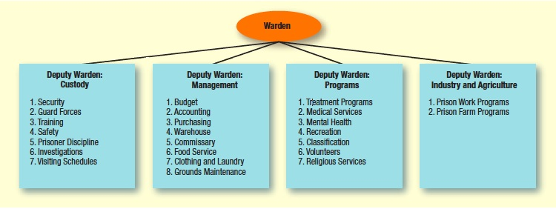
Learning Objective 3
Describe the formal prison management system, and indicate the three most important aspects of prison governance.
Notes:
FIGURE 13.3 Organizational Chart for a Typical Correctional Facility

Slide 7
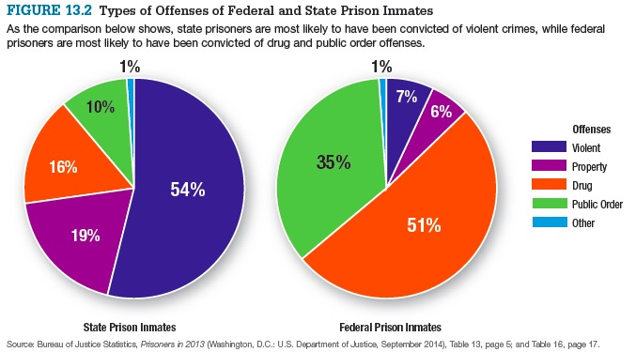
Prison Organization and Management

Slide 8
Prison Organization and Management
Formal prison management
Chain of command
May lack continuity of purpose
Governing prison populations
Order
The absence of misconduct, such as murder, assault, and rape
Amenities
Comforts that make life “livable,” such as clean living conditions and good food
Services
Programs designed to improve inmates’ prospects upon release

Slide 9
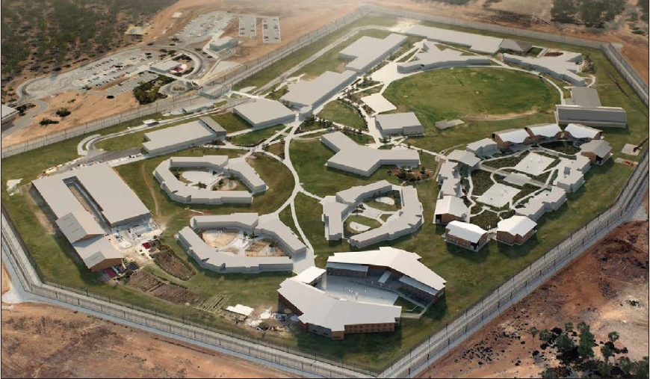
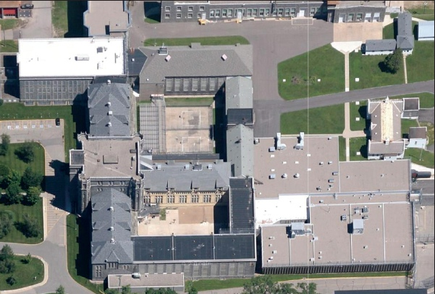
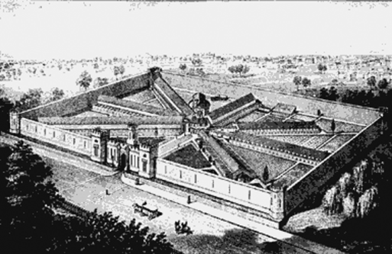
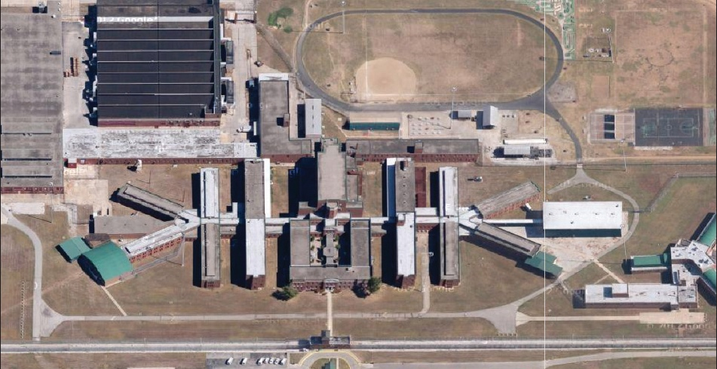
Learning Objective 4
List and briefly explain the four types of prisons.
Acacia Prison, Western Australia Department of Corrective Services
St. Cloud Minnesota State Prison,
© 2013 Google Maps
Courtesy Eastern State Penitentiary, PA
Federal Correctional Institution, Terre Haute,
© 2013 Google Maps

Slide 10
Prison Organization and Management
Classification process
Process that provides the best “fit” for each inmate based on:
The seriousness of the crime committed
The risk of future criminal or violent conduct
The need for treatment and rehabilitation programs

Slide 11
Prison Organization and Management
“Supermax” prisons
Prisons reserved for the “worst of the worst”
Controlled environment
Relatively rare
Maximum-security prisons
Violent and repeat offenders; those with conduct disorders
Fortresses, watchtowers, and armed guards

Slide 12
Prison Organization and Management
Medium-security prisons
House less dangerous inmates than maximum security
Less restrictive security than maximum security, usually fences instead of walls
Provides rehabilitative programming
Minimum-security prisons
Designed for inmates who are a low-security risk, such as non-violent and first-time offenders
Gives inmates more freedom to move about the facility
Similar to college campuses

Slide 13
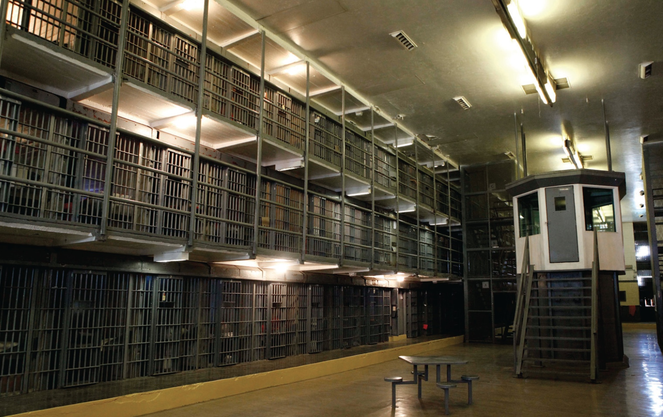
Learning Objective 5
List the factors that have caused the prison population to grow dramatically in the last several decades.
AP Photo/Matt York
Notes:
What security measures can you identify from this photo of a cell block at Arizona State Prison in Florence?
AP Images/Matt York

Slide 14
Inmate Population Trends
Factors in prison growth:
Increased probability of incarceration
Inmates serving more time for each crime
Federal prison growth
Rising incarceration rates for women

Slide 15
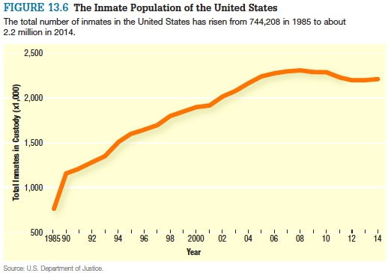
Inmate Population Trends

Slide 16
Inmate Population Trends
Decarceration
Corrections attempt at cutting costs through reduction of inmate populations
Methods
Decreasing probability that nonviolent offenders will be sentenced to prison
Increasing the rate of release of nonviolent offenders
Decreasing the rate of imprisonment for probation and parole violators

Slide 17
Learning Objective 6
Indicate some of the consequences of our high rates of incarceration.
Getty Images
Notes:
Immigration detainees exercise at the federal Adelanto Detention Center in Adelanto, California. Why have efforts to enforce immigration law increased the inmate population at federal prisons, while having little or no impact on the inmate populations of state prisons?
Getty Images

Slide 18
Inmate Population Trends
Social repercussions exist for communities and the families that make up those communities.
After release from prison or jail, offenders suffer from higher rates of physical and mental health problems.
Offenders are more likely to struggle with addiction, unemployment, and homelessness once released from prison or jail.

Slide 19
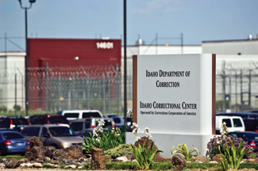
Learning Objective 7
Describe the arguments for and against private prisons.
AP Images/Charlie Litchfield, File
Notes:
In 2014, the state of Idaho took over management of the Idaho Correctional Center—
located south of Boise—from the Corrections Corporation of America. The private prison had been beset by problems such as inmate violence, gang activity, understaffing, and contract fraud. How can state corrections departments ensure that private prisons are operating properly?
AP Images/Charlie Litchfield, File

Slide 20
The Emergence of Private Prisons
For privatization:
Cost efficiency
Competitive bidding
Labor costs
Less red tape
Overcrowding and outsourcing
Quality of service
Against privatization:
Safety concerns
Financial concerns
Philosophical concerns

Slide 21
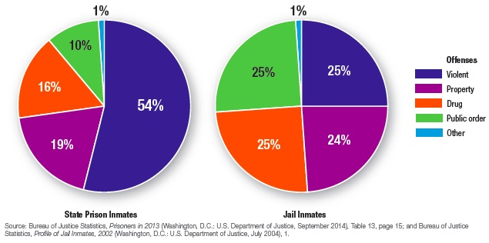
Learning Objective 8
Summarize the distinction between jails and prisons, and indicate the importance of jails in the American corrections systems.

Slide 22
Jails
Operated by county and city governments
Hold mostly inmates from the local community
House those who are awaiting trial or have recently been arrested, in addition to convicts
Generally hold inmates who have been found guilty of minor crimes and are serving sentences of less than a year
Due to smaller budgets, tend to focus only on the necessities of safety, food, and clothing

Slide 23
Prisons
Operated by the federal and state governments
Hold inmates who may have lived quite far away before being arrested
House only those who have been convicted of a crime
Generally hold inmates who have been found guilty of serious crimes and received sentences of longer than one year
Often offer a wide variety of rehabilitation and educational programs for long-term prisoners

Slide 24
Jails
Jail administration:
The burden of jail management
Sheriffs may view the jail as a lower priority than crime prevention and control.
The challenges of overcrowding
Living conditions are often miserable.
The wide variety of persons incarcerated in jails makes management difficult.

Slide 25
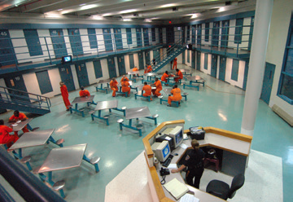
Learning Objective 9
Explain why the U.S. Supreme Court upheld the practice of strip searching all jail inmates, including those who have not been charged with a crime.
Photo courtesy Bergen County Sheriff’s Office, Bergen, NJ
Notes:
Photo courtesy Bergen County Sheriff’s Office, Bergen, NJ

Slide 26
Jails
Jail officials routinely strip search new entrants to:
Detect lice and other contagious medical conditions.
Look for evidence of gang membership like tattoos.
Prevent smuggling of drugs or weapons.

Slide 27
Jails
The U.S. Supreme Court has ruled that jail authorities may, using their discretion, conduct strip searches whenever they see fit, even if the inmate is not suspected of committing a crime, and there is no evidence that he or she is carrying contraband.
The Court pointed out that people detained for minor offenses may turn out to be the most dangerous criminals.

