Slide 1
Chapter 12
Probation, Parole, and Intermediate Sanctions

Slide 2
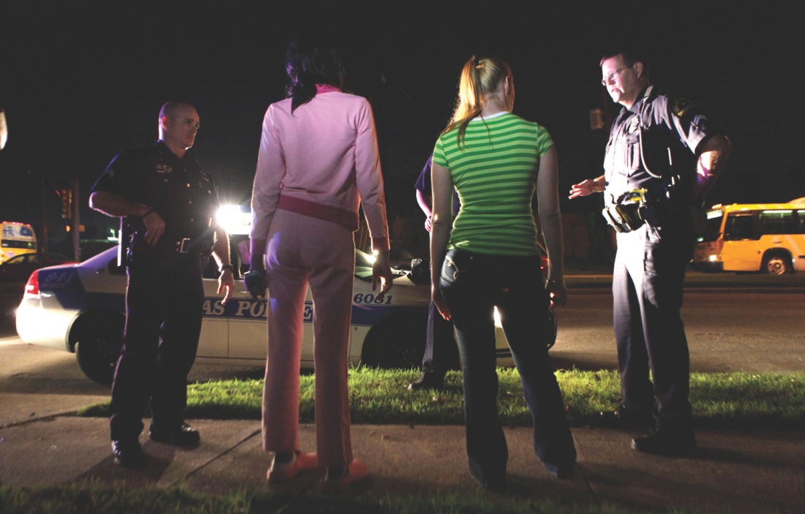
Learning Objective 1
Explain the justifications for community-based corrections programs.
AP Photo/LM Otero, File
Notes:
In Dallas, street prostitutes such as the two shown here are often treated as crime victims
and offered access to treatment and rehabilitation programs. How might society benefit if such offenders are kept out of jail or prison through these kinds of diversion programs?
AP Images/LM
Otero, File

Slide 3
The Justification for Community Corrections
Reintegration
Preparing offenders to return to the community with incentives to follow the rules of society
Diversion
Diverting those who qualify away from prison and jail and toward community-based corrections and intermediate sanctions
The “low-cost alternative”
The lack of funds is a strong motivator for recent expansion of community-based corrections.

Slide 4
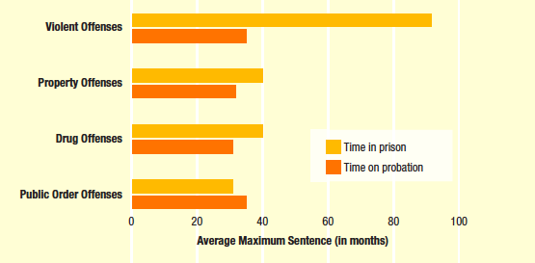
Learning Objective 2
Explain several alternative sentencing arrangements that combine probation with incarceration.
Source: Bureau of Justice Statistics, Felony Defendants in State Courts, 2009—Statistical Tables (Washington, D.C.: U.S. Department of Justice, December 2013), Table 25, page 30; and Table 27, page 31.

Slide 5
Probation: Doing Time in the Community
Sentencing and probation:
Probation is a criminal sanction in which a convict is allowed to remain in the community rather than be imprisoned, as long as she or he follows certain conditions set by the court
Suspended sentences—defendant is not required to serve the sentence
Alternative sentencing choices
Split sentences: e.g., shock probation; jail time and probation
Shock incarceration: jail time, but must petition for probation
Intermittent incarceration: work in a jail, workhouse, or government facility on weekends

Slide 6
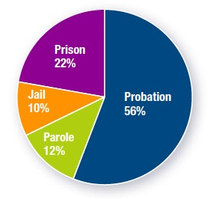
Learning Objective 3
Specify the conditions under which an offender is most likely to be denied probation.
Source: Bureau of Justice Statistics, Correctional Populations in the United States, 2013 (Washington, D.C.: U.S. Department of Justice, December 2014), Table 1, page 2.
Notes:
FIGURE 12.1 Probation in American Corrections
As you can see, the majority of convicts under the control of the American corrections system are on probation.
Source: Bureau of Justice Statistics, Correctional Populations in the United States, 2013 (Washington, D.C.: U.S. Department of Justice, December 2014), Table 1, page 2.

Slide 7
Probation: Doing Time in the Community
Offenders are most likely denied probation if they:
Are convicted on multiple charges
Were on probation or parole at the time of arrest
Have two or more prior convictions
Are addicted to narcotics
Seriously injured the victim of the crime
Used a weapon in the commission of the crime

Slide 8
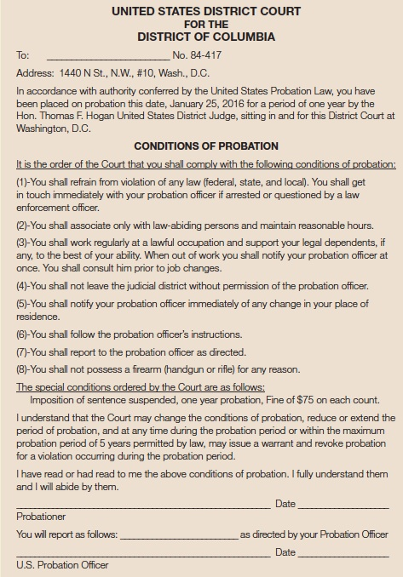
Learning Objective 4
Describe the three general categories of conditions placed on a probationer.

Slide 9
Probation: Doing Time in the Community
Conditions of probation:
Standard conditions
Imposed on all probationers
Punitive conditions
Designed to reflect the seriousness of the offense and increase punishment
Treatment conditions
Designed to help the offender with issues that may contribute to criminal activity
Failure to comply may result in revocation

Slide 10
Probation: Doing Time in the Community
The role of the probation officer:
Conducting the presentence investigation (investigative officers)
Supervising offenders (line officers)
Centralized versus decentralized probation services
The ideal relationship between probationer and probation officer is based on trust.
In the absence of trust, this relationship is based on authority.

Slide 11
Probation: Doing Time in the Community
Revocation of probation:
Probation ends in one of two ways.
The probationer successfully fulfills the conditions of the sentence.
Probationer misbehaves and probation is revoked.

Slide 12
Probation: Doing Time in the Community
The revocation process
The preliminary hearing
The revocation hearing
The revocation sentencing
Probationer rights
Mempa v. Ray (1967)
Morrisey v. Brewer (1972)
Gagnon v. Scarpelli (1973)

Slide 13
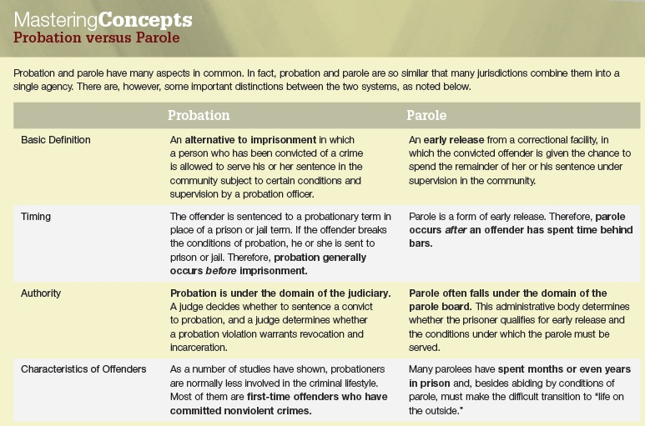
Learning Objective 5
Explain the main differences between probation and parole.

Slide 14
The Parole Picture
Probation
The offender is sentenced to a probationary term in place of a prison or jail term.
Therefore, probation generally occurs before imprisonment.
Parole
Parole is a form of early release.
Therefore, parole occurs after an offender has spent time behind bars.

Slide 15
The Parole Picture
Probation
If the offender breaks the conditions of probation, he or she is sent to prison or jail.
Parole
In many ways, parole supervision is similar to probation supervision.
Violation of conditions may result in revocation and return to prison.
About a quarter of parolees return to prison before the end of their parole period, most because they were convicted of a new offense or had their parole revoked.

Slide 16
The Parole Picture
Probation
Under the domain of the judiciary
A judge decides whether to sentence a convict to probation, and a judge determines whether a probation violation warrants revocation and incarceration.
Parole
Parole often falls under the domain of the parole board.
This administrative body determines whether the prisoner qualifies for early release and the conditions under which the parole must be served.

Slide 17
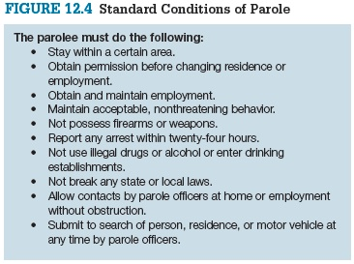
The Parole Picture

Slide 18
Discussion Questions
Discuss the effectiveness of parole as well as probation.
Do you believe that probation deters criminals from committing crimes? If yes, why and if no, why not?
What about parole? Do you think it is more or less effective, and under what circumstances?

Slide 19
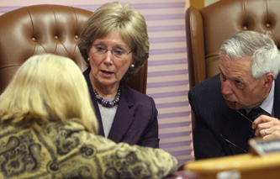
Learning Objective 6
Explain which factors influence the decision to grant parole.
AP Images/Jim Cole
Notes:
Parole board members discuss the case of thirty-two-year-old Jeffrey Dingman at the state prison in Concord, New Hampshire. In 2014, the board paroled Dingman, who had spent nearly two decades behind bars for helping his older brother kill their parents
in 1996. Do you think the age of the offender at the time of his or her offense should be taken into consideration as part of the parole decision? Why or why not?
AP Images/Jim Cole

Slide 20
The Parole Picture
Roles of the parole board:
To decide which offenders should be placed on parole
To determine the conditions of parole and aid in the continuing supervision of the parolee
To discharge the offender when the conditions of parole have been met
If a violation occurs, to determine whether parole privileges should be revoked

Slide 21
The Parole Picture
The parole board uses a number of criteria to determine release
The nature and circumstances of the underlying offense and the offender’s current attitude toward it
The offender’s prior criminal record
The offender’s attitude toward the victim and the victim’s family members
The offender’s physical, mental, and emotional health
The offender’s behavior behind bars, including his or her participation in programs for self-improvement

Slide 22
Learning Objective 7
Contrast day reporting centers with intensive supervision probation.
Scott Keeler/Tampa Bay Times/ZUMAPRESS.com/Newscom
Notes:
In Pinellas County, Florida, Judge Dee Anna Farnell congratulates graduates of her drug court program. How does society benefit when an offender successfully completes a drug
court program rather than being sent to prison or jail?
Scott Keeler/Tampa Bay Times/ZUMAPRESS.com/Newscom

Slide 23
The Parole Picture
Judicially administered intermediate sanctions
Fines
Community service
Restitution
Forfeiture
Pretrial diversion programs

Slide 24
Intermediate Sanctions
Day reporting centers
Tools to reduce jail and prison overcrowding
Offenders allowed to remain in community
Intensive supervision probation
More restrictive alternative to regular probation
Higher levels of face-to-face contact between offenders and officers
Frequent modes of control, such as urine tests for drugs

Slide 25
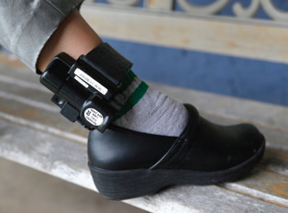
Learning Objective 8
List the three levels of home monitoring.
AP Images/Wilfredo Lee
Notes:
Offenders who are confined to their homes are often monitored by electronic devices like this one, which fits around the ankle. What are some of the benefits of electronic monitoring as an intermediate sanction?
AP Images/Wilfredo Lee

Slide 26
Intermediate Sanctions
Levels of home monitoring:
Curfew
Home detention
Home incarceration
Types of electronic monitoring:
Programmed contact
Continuously signaling

Slide 27
Learning Objective 9
Summarize the paradox of community corrections
Los Angeles County Probation Department
Notes:
Explain the possible connection between higher levels of surveillance by probation
and parole officers and greater numbers of probationers and parolees being incarcerated.
Los Angeles County Probation Department

Slide 28
Intermediate Sanctions
The “quicksand effect” of increased surveillance
The more effectively offenders are controlled, the more likely they are to be caught violating the terms of their conditional release.

