Slide 1
Chapter 11
Punishment and Sentencing

Slide 2
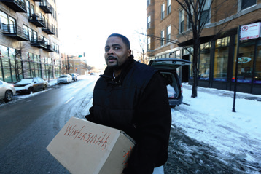
Learning Objective 1
List and contrast the four basic philosophical reasons for sentencing criminals
Nancy Stone/MCT/Newscom
Notes:
Reynolds Wintersmith, sentenced to life in prison without parole on a nonviolent drug charge, spent twenty years behind bars before being freed by presidential clemency in 2014.
Nancy Stone/MCT/Newscom

Slide 3
The Purpose of Sentencing
Philosophical reasons for sentencing
Retribution
Wrongdoer has freely chosen to violate society’s rules and must be punished.
Just deserts: proportioned to the crime
Deterrence: punishment and prevention
General: by punishing one person, others will be discouraged from committing a similar crime.
Specific: an individual, after being punished once, will not want to repeat the act and be punished again.

Slide 4
The Purpose of Sentencing
Incapacitation
Selective: longer sentences are given to individuals based on their propensity to reoffend.
Collective: all offenders have similar imprisonment for similar criminal activity.
Rehabilitation
Humane goal of punishment
Crime viewed as “social phenomenon” and criminals as being able to be “treated” and possibly “cured”
Restorative justice
Attempts to repair the damage a crime did to the victim (e.g., apology, restitution, monies)

Slide 5
The Purpose of Sentencing
Restorative justice
Dispute resolution and focus on needs of community
Attempts to repair damage to victim, victim’s family, and society
Five components
Offender involvement
Victim involvement
Victim-offender interaction
Community involvement
Problem-solving practices

Slide 6
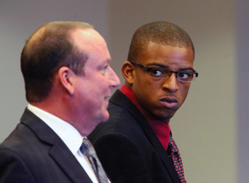
Learning Objective 2
Contrast indeterminate and determinate sentencing.
AP Images/Orlando Sentinel, George Skene, Pool
Notes:
In March 2014, former Florida A&M University band member Jessie Baskin, right, pleaded guilty to manslaughter and was sentenced to nearly a year in jail for his role in the hazing death of drum major Robert Champion. How does the theory of deterrence justify Baskin’s punishment?
AP Images/Orlando Sentinel, George Skene, Pool

Slide 7
The Structure of Sentencing
Indeterminate sentencing
Penal codes set a minimum and maximum time that a person must spend in prison
Parole
Determinate sentencing
Offender serves exactly the amount sentenced

Slide 8
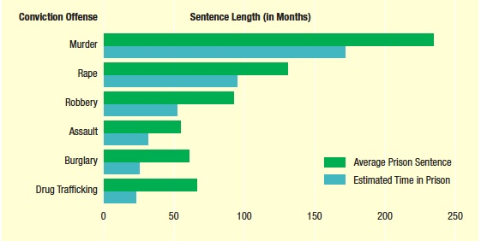
Learning Objective 3
Explain why there is a difference between a sentence imposed by a judge and the actual sentence carried out by the prisoner.
Source: Bureau of Justice Statistics, National Corrections Reporting Program: Sentence Length of State Prisoners, by Offense, Admission Type, Sex, and Race (January 20, 2011), “Table 9: First Releases from State Prison, 2008,” at bjs.ojp.usdoj.gov/index.cfm?ty=pbdetail&iid=2056.
Notes:
Source: Bureau of Justice Statistics, National Corrections Reporting Program: Sentence Length of State Prisoners, by Offense, Admission Type, Sex, and Race (January 20, 2011), “Table 9: First Releases from State Prison, 2008,” at bjs.ojp.usdoj.gov/index.cfm?ty=pbdetail&iid=2056.

Slide 9
The Structure of Sentencing
Three branches of sentencing authority
Legislative sentencing authority
Indeterminate sentencing
Determinate sentencing
Truth in sentencing
Administrative sentencing authority
Parole and parole board
Judicial sentencing authority
Capital punishments
Imprisonment
Probation
Fines

Slide 10
Learning Objective 4
State who has input into the sentencing decision and list the factors that determine a sentence.
AP Photo/Dante Smith/Coshocton Tribune
Notes:
After Jason Householder, left, and John Stockum were convicted of criminal damaging for throwing beer bottles at a car, municipal court judge David Hostetler of Coshocton, Ohio, gave them a choice: jail time or a walk down Main Street in women’s clothing. As you can see, they chose the dresses. What reasons might a judge have for handing down this sort of “creative” sentence?
AP Images/Dante Smith/Coshocton Tribune

Slide 11
The Structure of Sentencing
The sentencing process:
The presentence investigative report
Recommendations from the prosecutor and defense attorney
The role of the jury
Factors of sentencing:
Seriousness of the crime
Aggravating and mitigating circumstances
Judicial philosophies

Slide 12
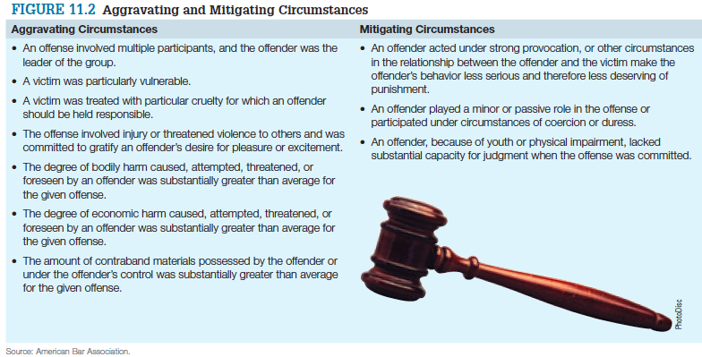
The Structure of Sentencing

Slide 13
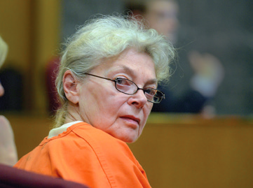
Learning Objective 5
Explain some of the reasons why sentencing reform has occurred.
AP Images/Rich Pedroncelli
Notes:
A judge in Pontiac, Michigan, gave seventy-five-year-old Sandra Layne a harsher sentence than
required by state guidelines for the second-degree murder of her seventeen-year-old grandson.
How might a woman’s gender work against her in sentencing situations involving family-related
violent crimes?
AP Images/Rich Pedroncelli

Slide 14
Inconsistencies in Sentencing
Three ways disparity occurs:
Offenders receive similar sentences for different crimes of unequal seriousness.
Offenders receive different sentences for similar crimes.
Mitigating or aggravating circumstances have a disproportionate effect on sentencing.

Slide 15
Inconsistencies in Sentencing
Sentencing discrimination
Gender, race, economic standing
Race has an impact on length of sentence.
Women and sentencing
Women convicted of crimes are less likely to go to prison than their male counterparts.
Chivalry effect: the idea that women should be treated more leniently than men.

Slide 16
Learning Objective 6
Identify the arguments for and against the use of victim impact statements during sentencing hearings.
AP Images
Notes:
In 2013, an Arizona jury found Jodi Arias guilty of first degree murder for killing Travis
Alexander, her ex-boyfriend. Arias stabbed Alexander twenty-seven times, slashed his throat,
and, after he had already died, shot him. During the sentencing phase of the trial, Steven
Alexander, Travis’s brother (see photo), gave a VIS as part of the prosecution’s argument that
Arias should receive the death penalty.
AP Images

Slide 17
Sentencing Reform
Sentencing guidelines
Requires judges to dispense legislatively determined sentences based on factors such as the seriousness of crime/offenders priors
State sentencing guidelines
Minnesota: first to create a Sentencing Guidelines Commission; has become a model for other states
Federal sentencing guidelines
Sentencing Reform Act for federal sentencing
Judicial departures

Slide 18
Inconsistencies in Sentencing
Mandatory sentencing guidelines
Limit judge’s power to deviate from determinate sentencing laws by setting firm standards for certain crimes.
Reforming mandatory minimum sentencing
Expand judicial discretion.
Limit habitual offender “triggers.”
Repeal or revise mandatory minimum sentences.
Reform “three-strikes” legislation.
Notes:
Note: Recent U.S. Supreme Court effectively guts three-strikes laws.
http://www.mintpressnews.com/supreme-court-strikes-down-unconstitutional-three-strikes-law/207222/

Slide 19
Sentencing Reform
Victim impact statements (VIS)
Crime Victims’ Rights Act allows victims the right to be heard during sentencing process.
Most controversial in death penalty cases
Gives survivors a voice in the process
Can be considered prejudicial
The role of the victim’s “social value”

Slide 20
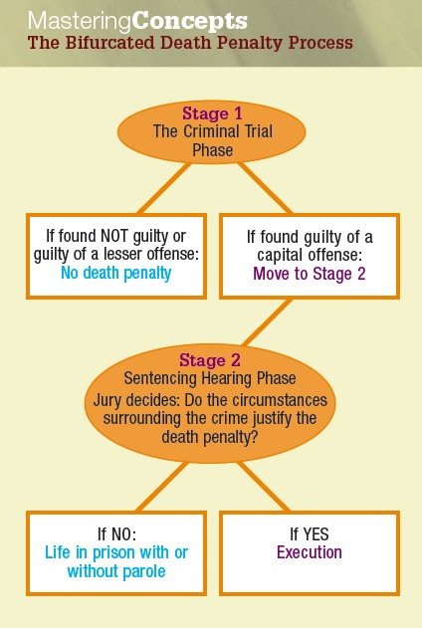
Learning Objective 7
Identify the two stages that make up the bifurcated process of death penalty sentencing.

Slide 21
Capital Punishment- The Ultimate Sentence
Furman v. Georgia (1972)
States have adopted a two-part process for conviction and sentencing.
The criminal trial phase
Jury determines guilt or innocence of the defendant for a crime determined to be punishable by death.
The sentencing hearing phase
Jury considers all aggravating and mitigating circumstances to decide if the death sentence is warranted.

Slide 22
Learning Objective 8
Explain why the U.S. Supreme Court abolished the death penalty for juvenile offenders.
AP Images
Notes:
This photo shows the death chamber at the Southern Ohio Correctional Facility in Lucasville, Ohio—site of convicted murderer Dennis McGuire’s January 2014 execution. During the lethal
injection process, which took twenty-six minutes, McGuire choked several times and appeared to clench his fists in discomfort. Do you think that offenders convicted of capital crimes are entitled to a pain-free execution? Why or why not?
AP Images

Slide 23
Capital Punishment
Roper v. Simmons (2005)
Under the evolving standards of decency test, executing people who were under 18 when they committed their crime amounted to cruel and unusual punishment.
Ended the execution of those who committed crimes as juveniles.
The Roper ruling required 72 convicted murderers in 12 states to be resentenced.

Slide 24
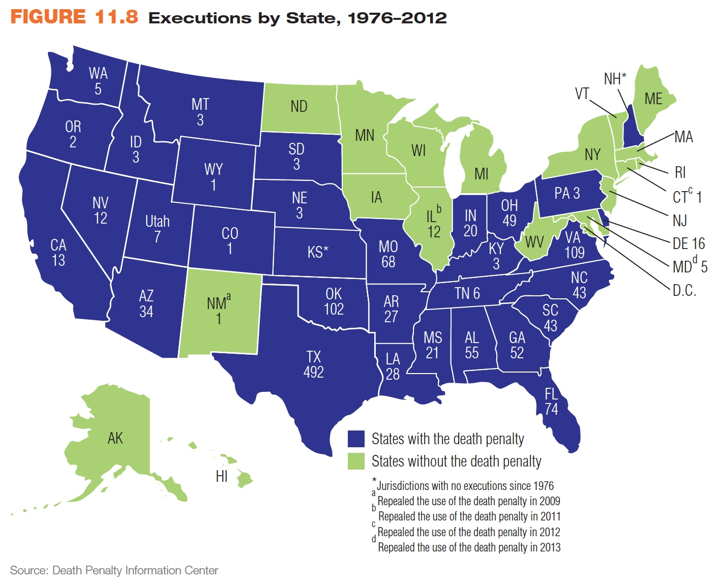
Learning Objective 9
Describe the main issues in the death penalty debate.
© Cengage Learning. All Rights Reserved.

Slide 25
Capital Punishment
The debate over capital punishment
Deterrence
Does it deter crime?
Fallibility
Does the system make mistakes?
Arbitrariness
Is it arbitrary?
Discrimination
Is it fairly applied?

Slide 26
Discussion Questions: The Death Penalty
Discuss the death penalty as it relates to Timothy McVeigh of the Oklahoma City Bombings. Did he deserve the death penalty? Why or why not?
Discuss the death penalty as it relates to the Boston Bombing defendant, who is still alive. Does he deserve the death penalty? Why or why not?

Slide 27
Capital Punishment
The future of the death penalty
Decline in executions
Life-without-parole alternative
Plummeting murder rates
High costs
Public opinion
Support is stronger among older, white people.
Support is not as strong in younger generations and members of minority groups.

