Slide 1
Chapter 10
The Criminal Trial

Slide 2
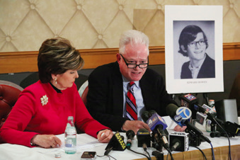
Learning Objective 1
Identify the basic protections enjoyed by criminal defendants in the United States.
Rob Kim/Getty Images
Notes:
Nearly three dozen alumni of the Horace Mann preparatory school in New York City, including the man showed here with his attorney, claim that they were sexually molested by a music teacher from the 1960s to the 1990s. Because the state’s statute of limitation bans prosecution of such crimes after the accuser turns twenty-three years old, in 2013 the Bronx district attorney’s office decided not to pursue any criminal charges against the alleged abuser. What are the arguments for and against
statutes of limitations in sexual abuse cases?
Rob Kim/Getty Images

Slide 3
Special Features of Criminal Trials
Speedy trial
Required by the Sixth Amendment
Barker v. Wingo (1972)
All 50 states have their own speedy-trial statutes.
Role of the jury
The Sixth Amendment guarantees “an impartial jury.”
Duncan v. Louisiana (1968)
Unanimity – most states require a unanimous verdict

Slide 4
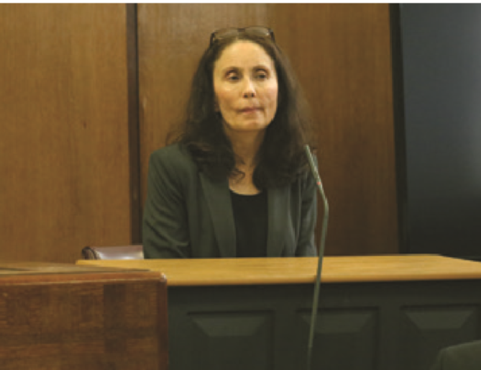
Learning Objective 2
Explain what “taking the Fifth” really means.
Jefferson Siegel/NY Daily News via Getty Images
Notes:
In 2014, Gigi Jordan was convicted of manslaughter for intentionally killing her eight-year-old son in a Manhattan hotel room four years earlier.

Slide 5
Special Features of Criminal Trials
The privilege against self-incrimination
Provided for in the Fifth Amendment
No person “shall be compelled in any criminal case to be a witness against himself.”
Adamson v. California (1947)
The decision to “take the fifth” should not prejudice the jury.
Witnesses may be granted immunity for testimony.

Slide 6
Special Features of Criminal Trials
The defendant is innocent until proven guilty.
Burden of proof is on the state (prosecutor).
Beyond a reasonable doubt
In re Winship (1970) applicable to juvenile court

Slide 7
Learning Objective 3
List the requirements normally imposed on potential jurors.
John Tlumacki/The Boston Globe via Getty Images
Notes:
John Tlumacki/The Boston Globe via Getty Images

Slide 8
Jury Selection
Defendants are entitled to a jury of “peers.”
Eligible persons are selected from a Master List, or jury pool, and must be:
A United States citizen
Over 18 years of age
Free of felony convictions
Of the necessary good health to serve
Sufficiently intelligent to understand the issues in the trial
Able to read, write, and comprehend English, with the exception of New Mexico

Slide 9
Learning Objective 4
Contrast challenges for cause and peremptory challenges during voir dire.
AP Photo/CJ Gunther, Pool
Notes:
A Boston jury waits to be dismissed after finding Christian K. Gerhartsreiter guilty of kidnapping
his seven-year-old daughter during a supervised visit. Why is it important for a defendant to
be tried by a jury of her or his “peers”?
AP Images/CJ Gunther, Pool

Slide 10
Jury Selection
Master jury list or jury pool lists eligible jurors from the community.
Venire: group of citizens from which the jury is selected
Voir dire: preliminary questions the trial attorneys ask potential jurors to determine whether they have a connection with the defendant or witnesses

Slide 11
Jury Selection
There are two ways jurors are excluded:
Challenges for cause
The attorney must provide a sound, legally justifiable reason why a juror cannot serve.
Peremptory challenges
The attorney can remove a juror without showing and supporting reason or cause.
Batson v. Kentucky (1986)

Slide 12
Jury Selection
Race and gender issues in jury selection
Baston v. Kentucky (1986)
Defendant must make prima facie case of discrimination during venire.
Defendant must show that she or he is a member of a recognizable racial group and members of the same group were removed from the jury pool.
Defendant must show these facts and other relevant circumstances raise possibility that prosecutor removed prospective jurors solely because of race.
Prosecutors must prove that its peremptory challenges were race neutral.
J.E.B. v. Alabama ex rel. T.B. (1994) extended Batson ruling to cover gender bias.

Slide 13
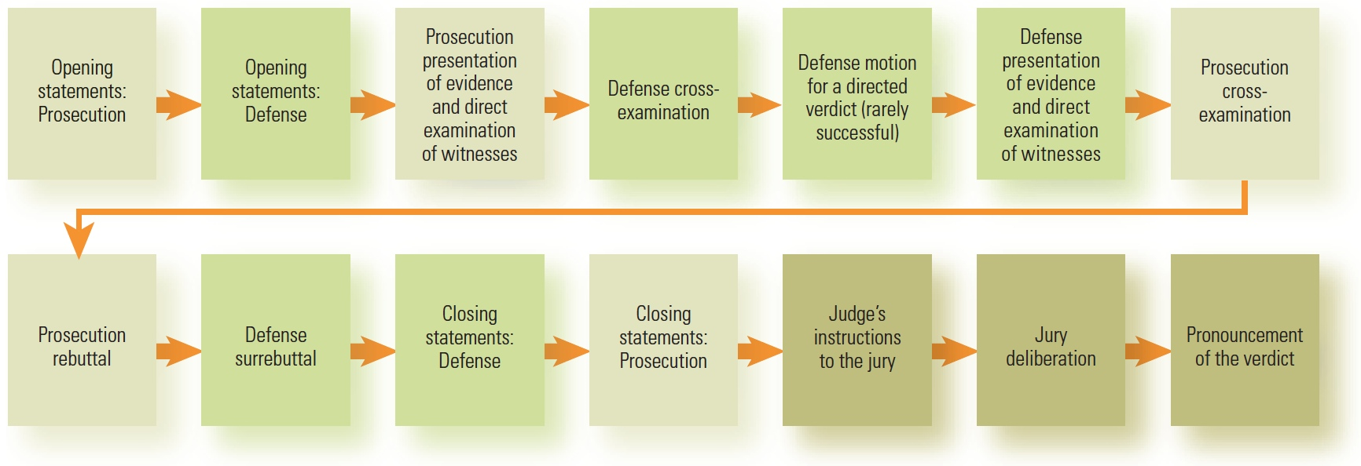
Learning Objective 5
List the standard steps in a criminal jury trial.
© Cengage Learning. All Rights Reserved.

Slide 14
Steps of Criminal Jury Trial
Opening statements
Presentation of prosecution’s case
Cross examination
Motion for directed verdict
Presentation of defendant’s case
Rebuttal and surrebuttal
Closing arguments
Jury instructions
Jury deliberation
The verdict

Slide 15
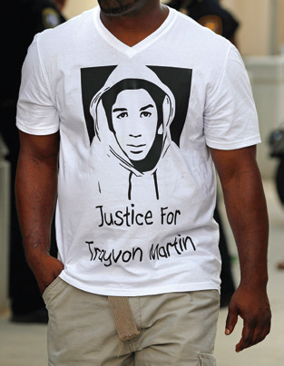
Learning Objective 6
Explain the difference between testimony and real evidence, between lay witnesses and expert witnesses, and between direct and circumstantial evidence.
Ron T. Ennis/Fort Worth Star-Telegram/MCT via Getty Images
Notes:
Review the list of information concerning Trayvon Martin that was barred by the judge during
the murder trial of George Zimmerman (p. 328). Do you agree that this evidence would have
unfairly prejudiced the jury against Martin, whose likeness is reproduced on a tee shirt in this
photo? Explain your answer.
Ron T. Ennis/Fort Worth Star-Telegram/MCT via Getty Images

Slide 16
Evidence
Real evidence
Presented to the court in the form of exhibits; includes any physical items
Testimonial evidence
Statements made by competent witnesses
Lay witnesses versus expert witnesses
Expert witnesses may base their opinions on three types of information
Facts or data of which they have personal knowledge
Material presented at trial
Secondhand information given to the expert outside the courtroom

Slide 17
Evidence
Direct versus circumstantial evidence
Direct: witnessed by person giving testimony
Circumstantial: indirect evidence that does not establish the fact in question but only a degree of likelihood of the fact

Slide 18
Evidence
Relevant evidence
Proves or disproves a fact in question
Prejudicial evidence
May be excluded if it will tend to distract the jury from the main issues of the case, mislead the jury, or cause jurors to decide the issue on an emotional basis

Slide 19
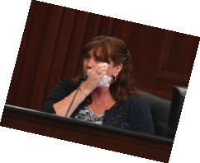
Learning Objective 7
Identify the primary method that defense attorneys use in most trials to weaken the prosecution’s case against their client.
AP Images/The Florida Times-Union, Bob Mack, Pool
Notes:
AP Images/The Florida Times-Union, Bob Mack, Pool

Slide 20
The Trial
Prosecution’s case
Direct examination of witnesses
Not allowed to ask leading questions
Cross-examination
Confrontation clause
Questioning witnesses
Redirect examination
Hearsay
Many exceptions

Slide 21
The Trial
Defense strategies:
Motion for a directed verdict
Create reasonable doubt
Present an alibi defense
Present an affirmative defense
Self-defense
Insanity
Duress
Entrapment

Slide 22
Discussion Question
Discuss the four affirmative defenses and determine which ones will be more likely to be accepted by the court.
Locate a case for each type of defense.
Debate whether any should be eliminated from use within the criminal justice system.

Slide 23
The Trial
Rebuttal by prosecution
Surrebuttal by defense
Closing arguments
Summarizes presentation; each side argues for their case one more time
Includes major points that support case and emphasizes shortcoming of the opposing party’s case

Slide 24
Learning Objective 8
Delineate circumstances in which a criminal defendant may in fact be tried a second time for the same act.
AP Images/Mark Lennihan
Notes:
AP Images/Mark Lennihan

Slide 25
The Final Steps of the Trial and Postconviction Procedures
Double jeopardy
Guarantee against being tried for a second time for the same crime
Does not preclude a civil suit
A hung jury is not an acquittal for double jeopardy.
One state’s prosecution will not prevent a different state or the federal government from prosecuting the same crime.

Slide 26
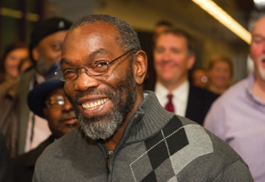
Learning Objective 9
List the five basic steps of an appeal.
AP Images/Phil Long
Notes:
After spending nearly forty years behind bars, Ricky Jackson was freed from the Ohio corrections system when a key witness admitted that Cleveland police detectives had coerced him into identifying Jackson as a murder suspect in 1975. Should prosecutors be disciplined for mistakenly bringing charges against innocent defendants such as Jackson, pictured here on November 20, 2014, following his release? Why or why not?
AP Images/Phil Long

Slide 27
The Final Steps of the Trial and Postconviction Procedures
Appeals
The defendant can appeal only if they show the trial court acted improperly on a question of law.
Wrongful convictions
Five most common reasons for wrongful convictions later overturned by DNA
Eyewitness misidentification
False confessions
Faulty forensic evidence
False informant testimony
Law enforcement misconduct
Habeas corpus

Slide 28
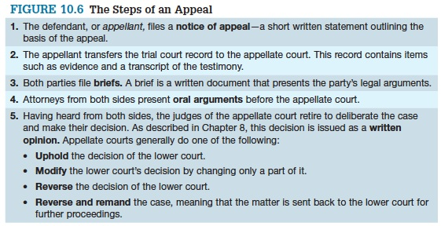
The Final Steps of the Trial and Postconviction Procedures

