Slide 1
Chapter 9
Pretrial Procedures: The Adversary System in Action

Slide 2
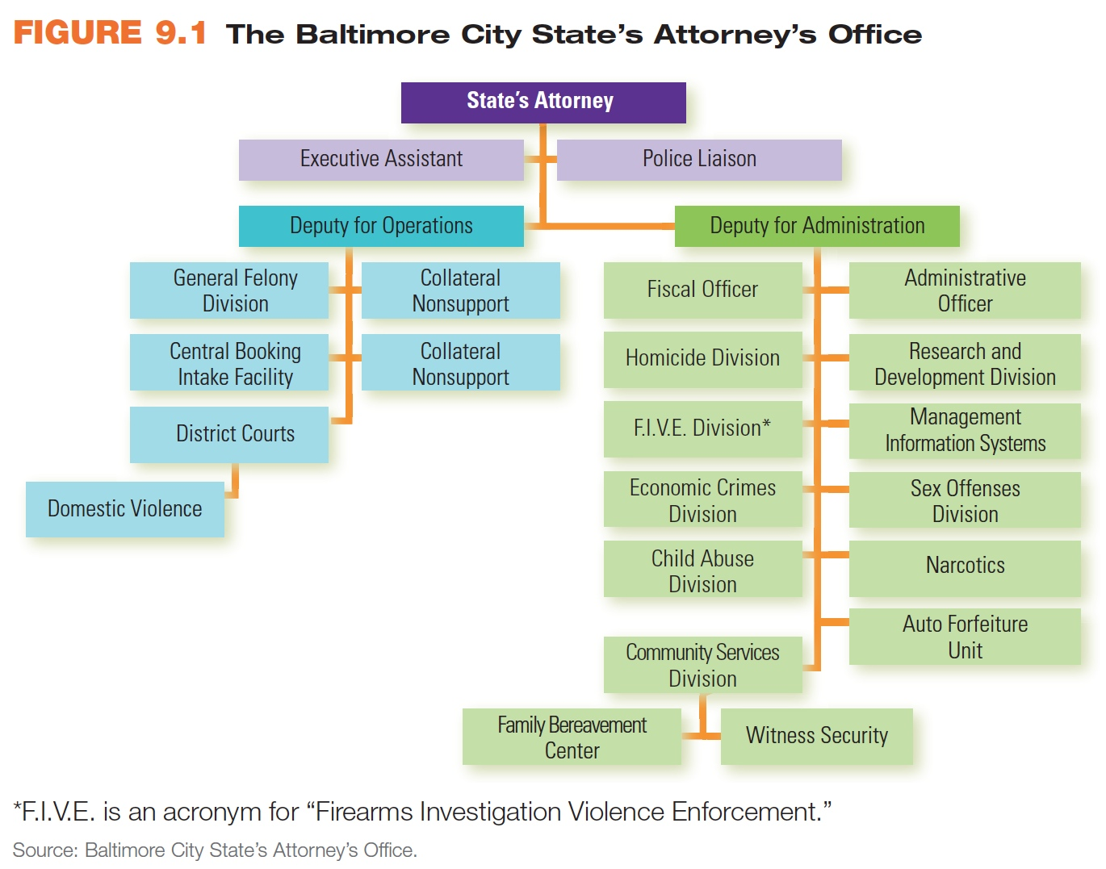
Learning Objective 1
List the different names given to public prosecutors and indicate the general powers that they have.
© Cengage Learning. All Rights Reserved.

Slide 3
The Prosecution
Public prosecutor in federal cases is the U.S. attorney.
Criminal cases are tried by public prosecutors, who are employed by the government.
Referred to as prosecuting attorneys, district attorneys, county attorneys, or city attorneys.
The attorney general is the chief law enforcement officer in any state.
Each jurisdiction has a chief prosecutor who is appointed, or more often, elected.

Slide 4
The Prosecution
Chief prosecutors often have numerous assistant prosecutors.
Prosecutors act as officers of the law during criminal trials.
During the pretrial period, prosecutors have the discretion to determine:
Whether a suspect will be charged with a crime
The level of charges to be brought against the suspect
If and when to stop the prosecution

Slide 5
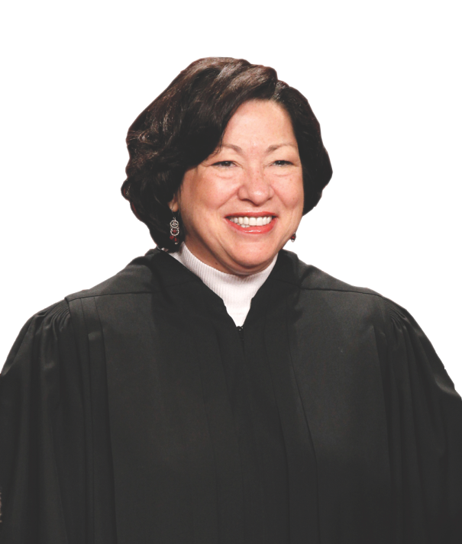
Learning Objective 2
Contrast the prosecutor’s roles as an elected official and as a crime fighter.
AP Photo/Pablo Martinez Monsivais
Notes:
Give several reasons why experience as a prosecutor would make someone such as United States Supreme Court justice Sonia Sotomayor a more effective judge.
AP Images/Pablo Martinez Monsivais

Slide 6
The Prosecution
The prosecutor as an elected official:
Must answer to the voters
Are subject to community pressure
May use office as a political stepping-stone
The prosecutor as a crime fighter
Often seen as a law enforcement agent
Police-prosecutor conflict
Victim’s rights

Slide 7
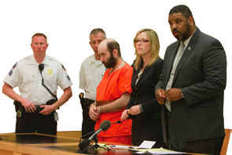
Learning Objective 3
Delineate the responsibilities of defense attorneys.
Jesse Ward/The New York Times/Redux Pictures
Notes:
Defense attorneys Pierre Bazile, right, and Jennifer McCann appear with their client Levi Aron at the State Supreme Court in Brooklyn in New York.
Jesse Ward/The New York Times/Redux Pictures

Slide 8
The Defense Attorney
Provides legal representation to criminal defendants during the court process
Investigates the incident for which the defendant has been charged
Communicates with the prosecutor, which includes negotiating plea bargains
Prepares the case for trial, and submits defense motions, including motions to suppress evidence
Represents the defendant at trial
Negotiates a sentence, if the client has been convicted
Determines whether to appeal a guilty verdict

Slide 9
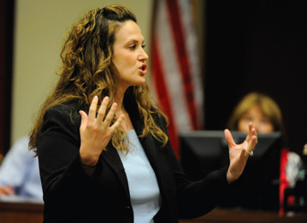
Learning Objective 4
Explain why defense attorneys must often defend clients they know to be guilty.
Andy Cross/The Denver Post via Getty Images
Notes:
Public defender Megan Downing makes a point to the jury during a trial in Brighton, Colorado. What would be the benefits and drawbacks of allowing an indigent defendant to choose her or his public defender rather than being assigned one by the court system?
Andy Cross/The Denver Post via Getty Images

Slide 10
The Defense Attorney
The criminal justice system would not be able to function if lawyers refused to represent clients they knew to be guilty.
The most important role for a defense attorney is to advocate for his or her client.

Slide 11
The Defense Attorney
Defense counsel programs
Assigned counsel
Contracting attorney programs
Public defender programs
Effectiveness of public defenders
An indigent defendant must accept the public defender provided by the court system.
Conviction rates of defendants with private counsel versus public funded attorneys are generally the same
Three-quarters of public defender programs exceed their recommended caseload level

Slide 12
The Defense Attorney
Attorney-client privilege
Defense attorney must do utmost to serve a client even if client confesses guilt to attorney
United States v. Zolin (1989) – defense attorneys may disclose contents of conversation with client if information concerns a crime yet to be committed

Slide 13
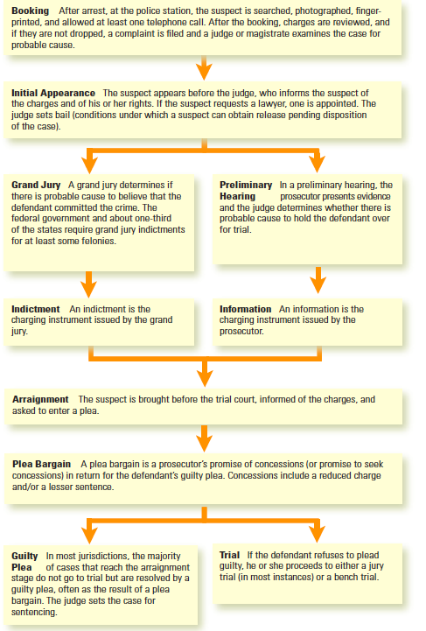
Learning Objective 5
Identify the steps involved in the pretrial criminal process.

Slide 14
Pretrial Detention
The initial appearance is the first step after arrest
Charges are heard and constitutional rights are explained
Eligibility for bail is determined
The amount or conditions set by the court intended to ensure that the defendant will appear for further criminal proceedings

Slide 15
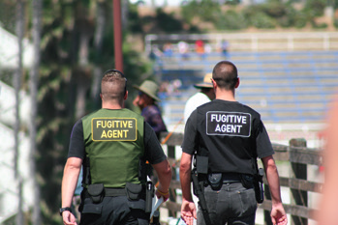
Learning Objective 6
Indicate the three influences on a judge’s decision to set bail.
Chris Johnson/Getty Images/RF
Notes:
If a defendant “skips” bail by failing to appear at trial, the bail bond agent sometimes will hire a fugitive-recovery agent to find the defendant and return him or her to court. Are there any circumstances under which a fugitive-recovery agent should be allowed to use deadly force in apprehending a runaway defendant? Explain your answer.
Chris Johnson/Getty Images/RF

Slide 16
Pretrial Detention
Bail is provided for under the Eighth Amendment but is not guaranteed.
Judges may be influenced by:
Uncertainty
Risk
Overcrowded jails

Slide 17
Pretrial Detention
Gaining pretrial release
Release on recognizance (ROR)
Property bonds
Bail bond agents
Preventive detention
Bail Reform Act of 1984
False positives

Slide 18
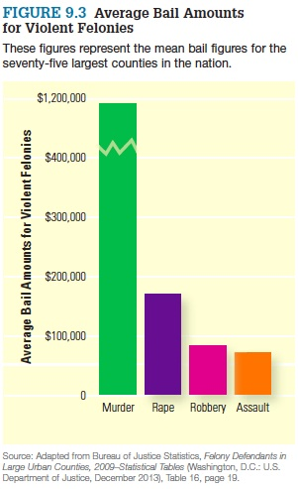
Pretrial Detention

Slide 19
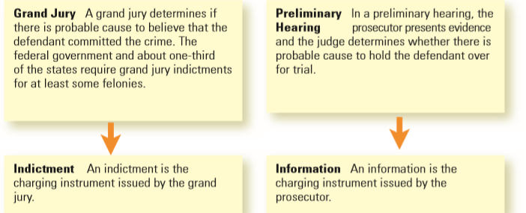
Learning Objective 7
Identify the main difference between an indictment and an information.

Slide 20
Establishing Probable Cause
Preliminary hearing process begins the discovery of information.
Defense attorneys are entitled to have access to any evidence in the possession of the prosecution relating to the case.
Discovery is the keystone in the adversary process.

Slide 21
Establishing Probable Cause
In many jurisdictions, the grand jury replaces the preliminary hearing.
The grand jury is a group of citizens called to decide whether probable cause exists in a case.
In other jurisdictions, prosecutors can provide an “information,” which replaces the police complaint as the formal charge against the defendant for the purpose of trial.

Slide 22
Establishing Probable Cause
Grand jury hears evidence presented by the prosecutor.
Photos, documents, tangible objects, witness testimony, and other items
If the grand jury finds probable cause exists, an “indictment” is presented.

Slide 23
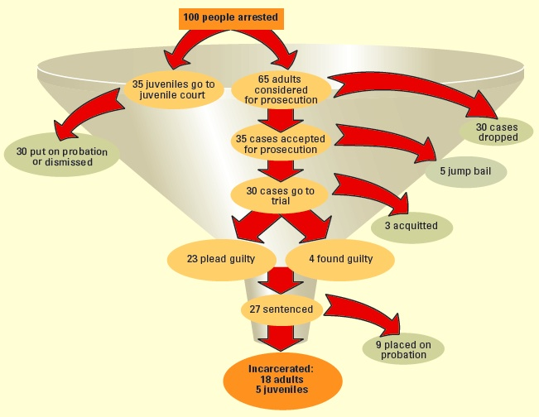
Learning Objective 8
Explain how a prosecutor screens potential cases.

Slide 24
The Prosecutorial Screening Process
Case attrition is the decision by the prosecutor not to prosecute the defendant (nolle prosequi).
Scarce resources
Screening factors
Sufficient evidence
Offense seriousness
Uncooperative or unreliable victims
Defendant who is willing to testify against other offenders

Slide 25
Common Pretrial Motions
Common pretrial motions
Motion to suppress evidence
Change of venue
Invalidate search warrant
Dismiss the case because of the delay in bringing it to trial
Motion to obtain evidence prosecution may be withholding

Slide 26
Discussion Questions
What are some reasons for why a change of venue should or could occur in a case?
What might invalidate a search warrant from a case?

Slide 27
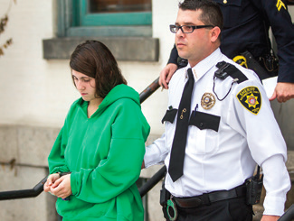
Learning Objective 9
Indicate why prosecutors, defense attorneys, and defendants often agree to plea bargains.
AP Images/PennLive.com, Christine Baker, File
Notes:
Why did Miranda Barbour, shown here being escorted out of a Sunbury, Pennsylvania, courtroom, agree to plead guilty to second degree murder for killing a man she met on Craigslist? What incentives might local prosecutors have had for accepting Barbour’s guilty plea and declining to seek her execution?
AP Images/PennLive.com, Christine Baker, File

Slide 28
Pleading Guilty
Plea bargaining
Process involving accused, defense counsel, and prosecutor
Works out mutually satisfactory disposition of case
The court must approve the plea bargain.

Slide 29
Pleading Guilty
Prosecutors and plea bargaining
Conviction; removes risk of jury or judge disagreeing with case presented by prosecutor, “saves” a questionable case; reduces resources spent on case
Defense attorneys and plea bargaining
Often best defense; may increase profit margins
Defendants and plea bargaining
Allows measure of control; lighter sentence
Victims and plea bargaining
Seek to be “reasonably heard”

Slide 30
Pleading Guilty
Strategies to induce plea bargain
The defense
Pretrial motions designed to weaken the state’s case
The prosecution
Horizontal overcharging
Vertical overcharging
Protecting the defendant
Boykin v. Alabama, Boykin form

Slide 31
Discussion Questions
You are the victim of a carjacking, which has traumatized you to the point that you fear even getting in your vehicle.
Give your opinion on the perpetrator of your crime plea bargaining your case. Would it feel fair to you, as the victim?
Discuss the advantages and disadvantages from a prosecutorial and a defense perspective.

Slide 32
Pleading Not Guilty
Pleading not guilty
Gain a more favorable plea bargain.
Challenge a crucial part of the evidence on constitutional grounds.
Submit one of the affirmative defenses.

