Slide 1
Chapter 8
Courts and the Quest for Justice

Slide 2
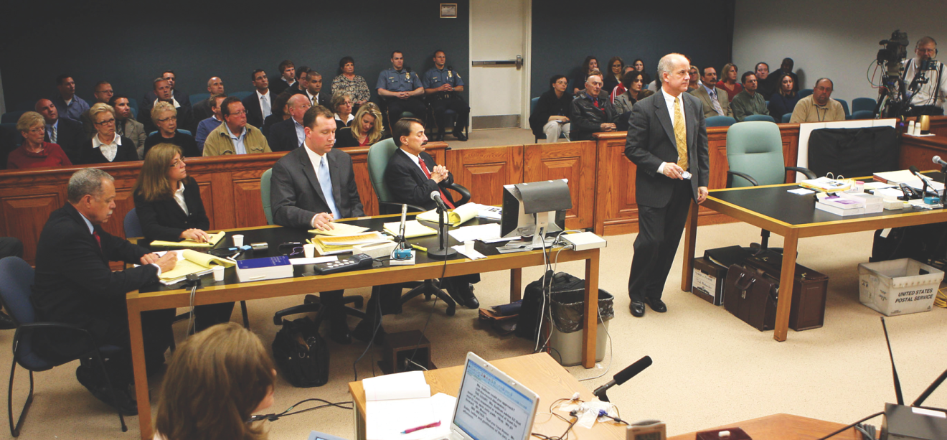
Learning Objective 1
Define and contrast the four functions of the courts.
AP Photo/The Press of Atlantic City, Dale Gerhard
Notes:
Why is it important that American criminal courtrooms, such as this one in Cape May, New Jersey, are places of impartiality and independence?
AP Images/The Press of Atlantic City, Dale Gerhard

Slide 3
Functions of the Court
Functions of the courts:
The due process function
To protect individuals from unfair advantages that the government enjoys in legal battles
The crime control function
Punishment and retribution
The rehabilitation function
Treatment
The bureaucratic function
Speed and efficiency

Slide 4
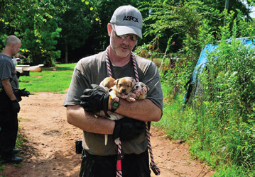
Learning Objective 2
Define jurisdiction and contrast geographic and subject-matter jurisdiction.
AP Images/ASPCA
Notes:
These puppies were rescued from a future in dogfighting during a federal investigation in Auburn, Alabama. Their owners were charged with violating federal dogfighting laws, and faced those charges in federal criminal court. Do you think that the federal government should have jurisdiction over a local activity like dogfighting? Why or why not? AP Images/ASPCA

Slide 5
American Judicial System
Jurisdiction:
Geographic jurisdiction
Federal versus state
State versus state
Multiple trials
Tribal jurisdiction
International jurisdiction
Subject-matter jurisdiction
Courts of general jurisdiction
Courts of limited jurisdiction

Slide 6
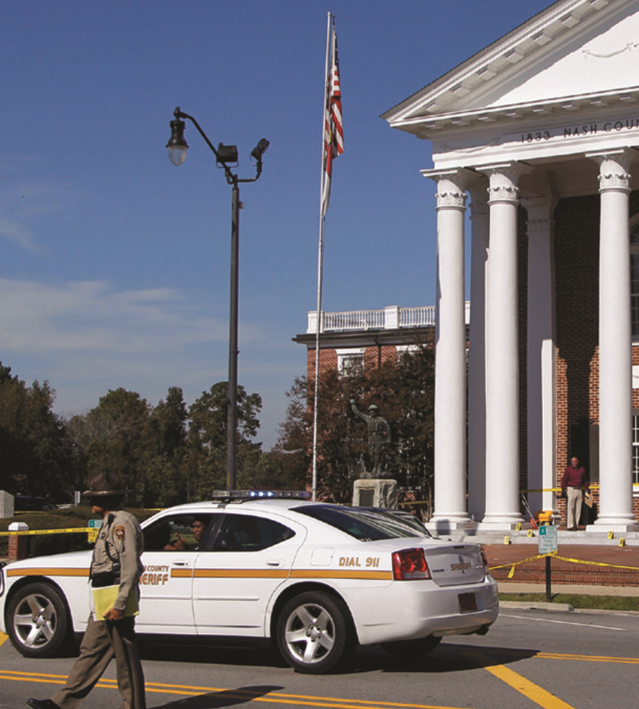
Learning Objective 3
Explain the difference between trial and appellate courts.

Slide 7
American Judicial System
Trial courts:
Have original jurisdiction
Are concerned with questions of fact
Appellate courts:
Courts of review
Hear appeals of one party
Reverses or remands case

Slide 8
Discussion Question Local Case
Locate a case in your local community that has been or is in the current appeals process.
What were or are the main issues within this case?
What was the result of the review of this case by the court and what was the end result?
What are the implications, if any, for local law enforcement?

Slide 9
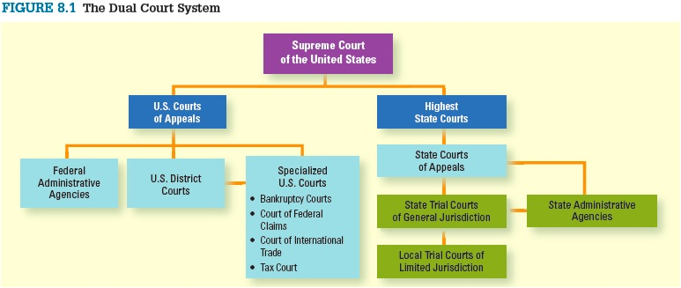
Dual Court System

Slide 10
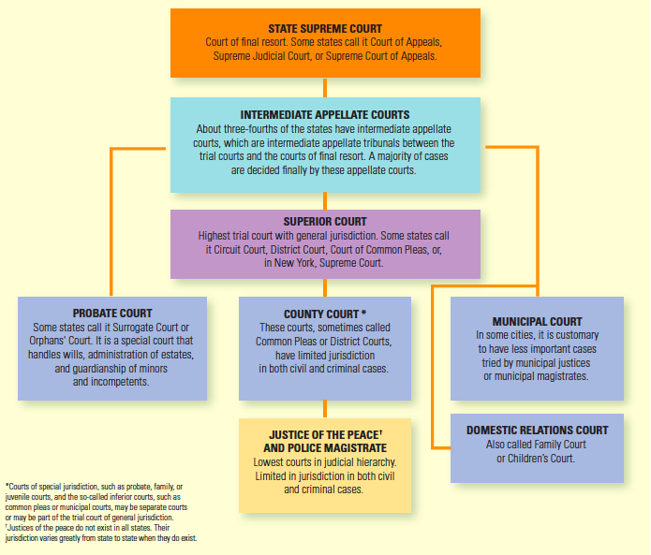
Learning Objective 4
Outline the several levels of a typical state court system.

Slide 11
State Court Systems
The state court system includes:
Lower courts, or courts of limited jurisdiction
Magistrate courts
Specialty courts
Trial courts of general jurisdiction
Appellate courts
The state’s highest courts

Slide 12
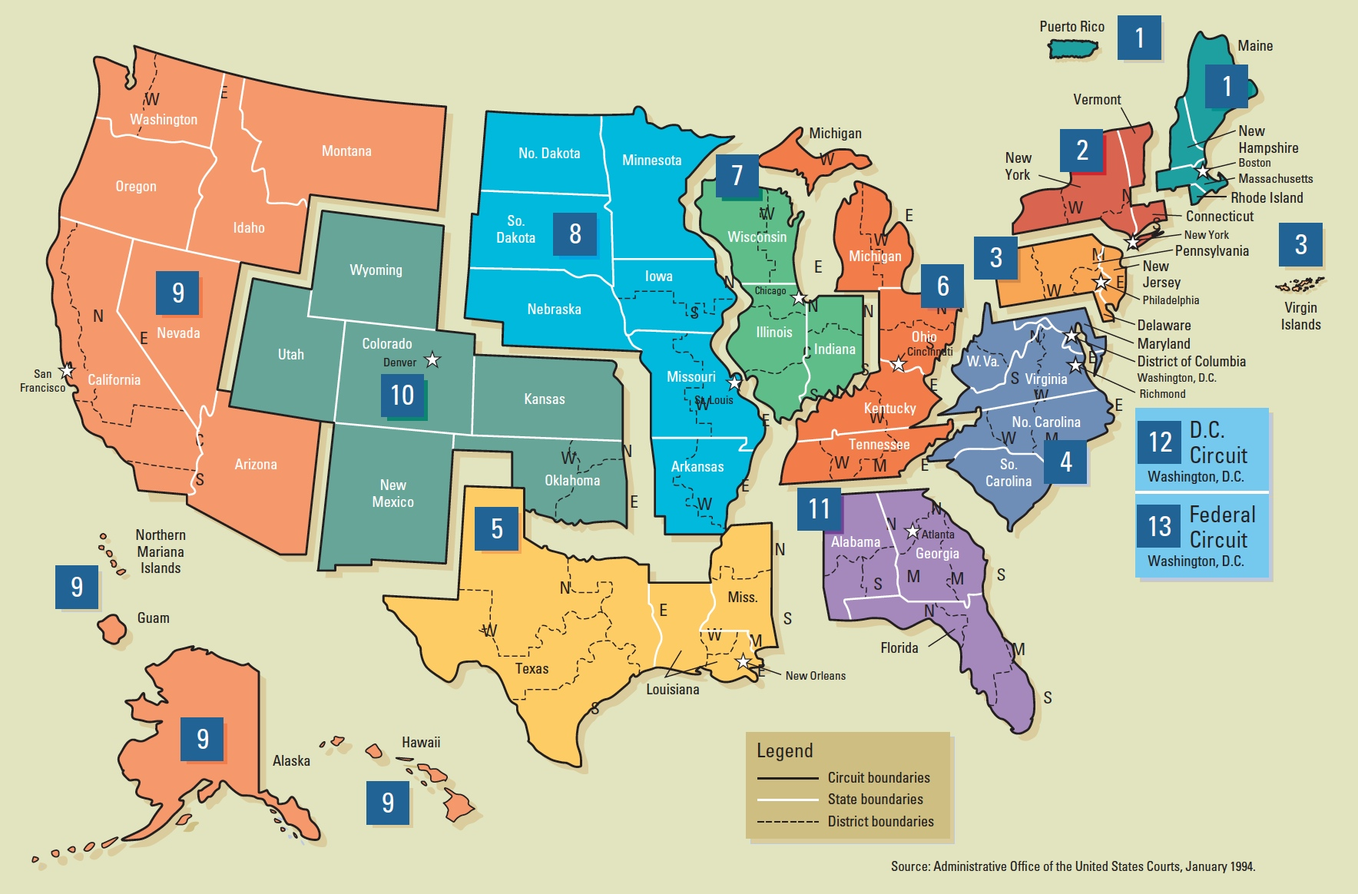
Learning Objective 5
Outline the federal court system.
© Cengage Learning. All Rights Reserved.

Slide 13
Federal Court System
Three-tiered model:
U.S. District Court
Courts in which cases involving federal law begin
A judge or jury decides the case.
U.S. Court of Appeals
Decisions are final unless further appeal is granted and pursued.
United States Supreme Court
Court of last resort

Slide 14
Discussion Question: A Supreme Court Case
Choose a recent or landmark Supreme Court case to discuss.
What are the facts of the case?
What courts did the case go through to be heard before it reached the Supreme Court?
What was the outcome of the case?

Slide 15
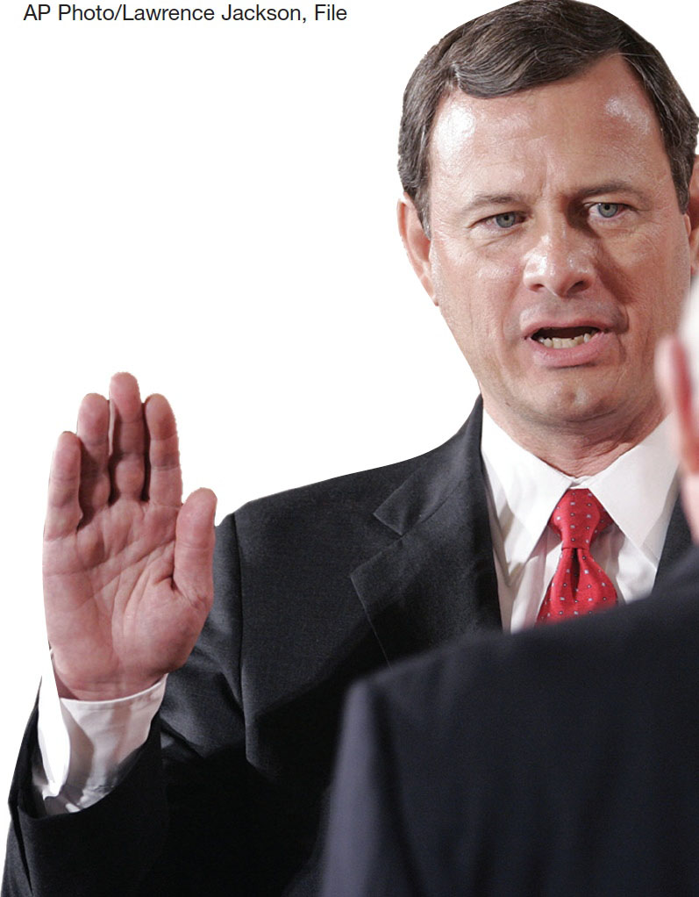
Learning Objective 6
Explain briefly how a case is brought to the Supreme Court.
Notes:
John G. Roberts, Jr., pictured here, is the seventeenth chief justice of the United States Supreme Court. What does it mean to say that Roberts and the eight associate members of the Court “make criminal justice
policy”? AP Images/Lawrence Jackson, File

Slide 16
Federal Court System
Judicial review
Statutory interpretation
Writ of certiorari
The Court’s decision is based on the written records, written arguments, and oral arguments.

Slide 17
Federal Court System
The United States Supreme Court normally does not hear any evidence.
Decisions are based on:
Written record of case
Written arguments submitted by attorneys
Oral arguments
Justices decide each case in conference, and then the senior justice on the majority side writes the opinion.
Concurring opinions
Dissenting opinions

Slide 18
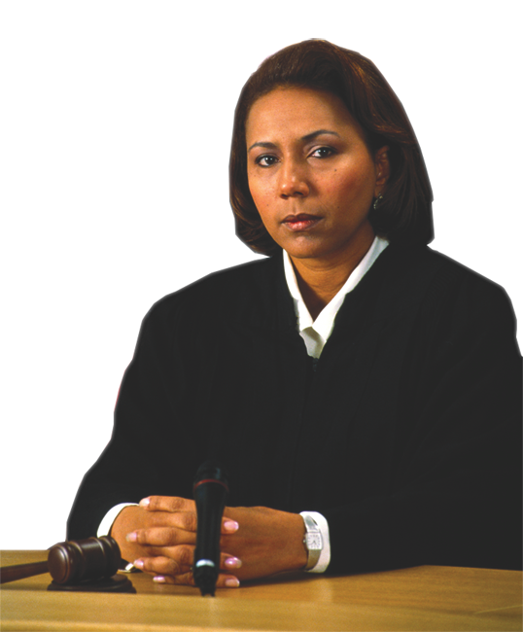
Learning Objective 7
Explain the difference between the selection of judges at the state level and at the federal level.
David Young-Wolff/Stone/Getty Images

Slide 19
Judges in the Court System
Selection of judges:
Federal court judges
Appointed by the President and confirmed by the Senate

Slide 20
Judges in the Court System
Selection of judges
State court judges
Election
Partisan elections
Nonpartisan elections
Based on two key factors
Independence
Accountability
Merit selection (The Missouri Plan)

Slide 21
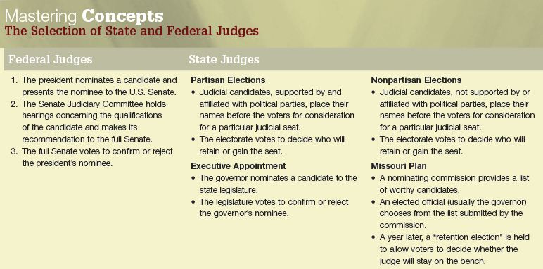
Judges in the Court System

Slide 22
Judges in the Court System
Lack of diversity on the bench
Past discrimination in law schools and “good old boy” system limit opportunities.
Benefits to diversity
People trust judges that look like them.
A variety of voices and perspectives are brought in.

Slide 23
Learning Objective 8
Describe one alternative, practiced in other countries, to the American method of choosing judges.
Notes:
Rita – It was hard to tell that this was the French flag and not just a red column and a blue column, so I put it in with a bit of the background included in the text so it stands out as a “whole” rather than two separate items. Gestalt psychology crops up from time to time.

Slide 24
Judges in the Court System
Comparative criminal justice
French judicial candidates must pass two exams.
Those who pass one test enter a two-year program at the École Nationale de la Magistrature, a judicial training academy, where they spend half their time in the classroom and half in the courtroom.
At the end of that period, they are subjected to another examination.

Slide 25
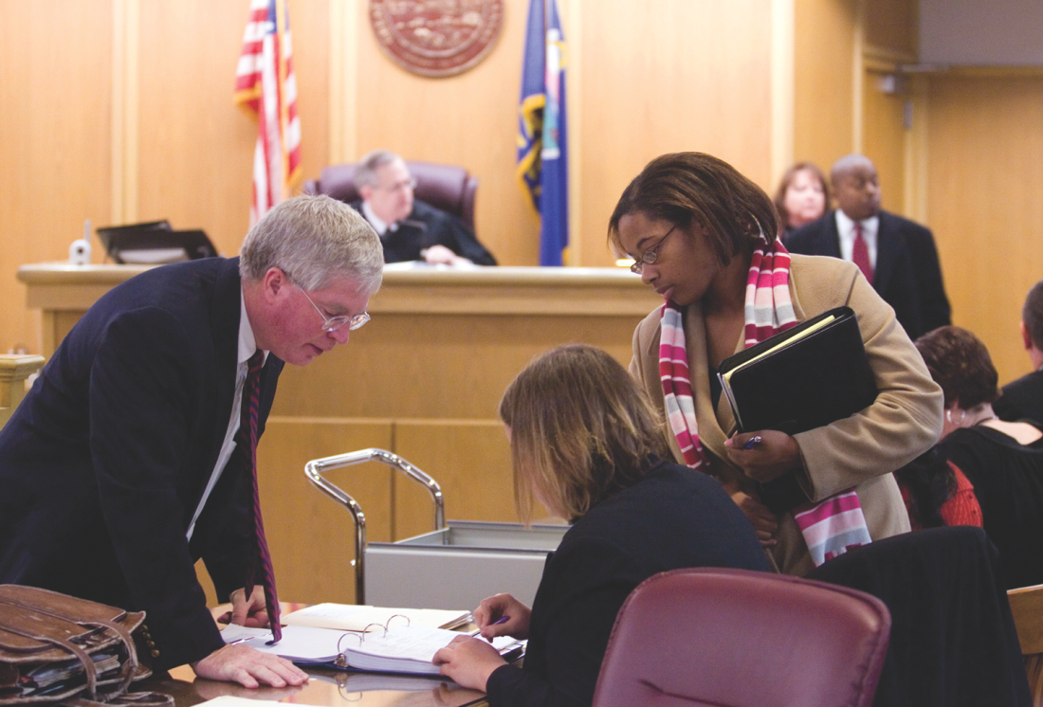
Learning Objective 9
List and describe the members of the courtroom work group.
Jaime Oppenheimer/MCT/Landov
Notes:
Three trial lawyers confer as the judge waits at the Sedgwick County Courthouse in Wichita, Kansas. How is working in a courtroom similar to working in a corporate office? How is it different? Jaime Oppenheimer/MCT/Landov

Slide 26
Courtroom Work Group
Judges
Prosecutors
Defense attorneys
Bailiffs
Maintain security and order in judge’s chambers and courtroom.
Clerks of the court
Take pleas, motions, and other matters made by the judge.
Court reporters
Record every word in the courtroom.

Slide 27
Discussion Question: Courtroom Work Group
Discuss the key players in the courtroom work group.
Could the court function without any of these personnel? Why or why not?
Could you see yourself in any of these positions?

Slide 28
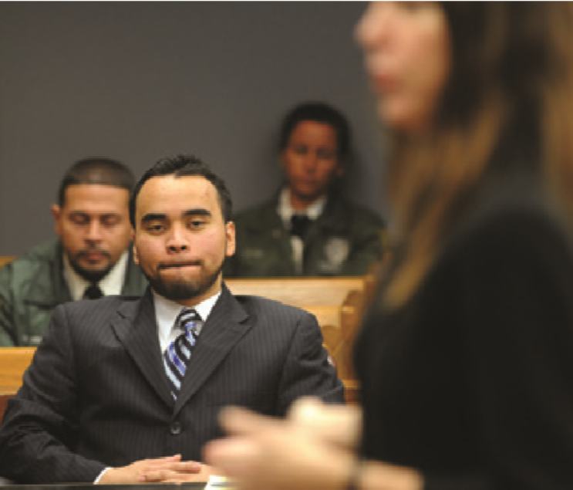
Learning Objective 10
List the three basic features of an adversary system of justice.
Notes:
In 2015, a Florida judge reduced the sentence of Ronald Salazar, shown here, from life without parole to forty years for raping and killing his sister when he was fourteen years old.
Rita – I pulled this from chapter 15, page 486.

Slide 29
The Adversary System
Three basic features of the adversary system
Neutral and passive decision maker, either judge or jury
Presentation of evidence from both parties
Highly structured set of procedures that must be followed in the presentation of evidence
Ritualized aggression
Truth vs. victory

