Slide 1
Chapter 7
Police and the Constitution: The Rules of Law Enforcement

Slide 2
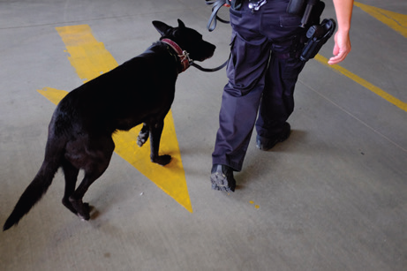
Learning Objective 1
Outline the four major sources that may provide probable cause.
Matthew Staver/Bloomberg via Getty Images
Notes:
The Supreme Court has ruled that the U.S. Constitution limits the ability of law enforcement to gather evidence of criminal behavior by using narcotics-sniffing police dogs. Matthew Staver/Bloomberg via Getty Images

Slide 3
The Fourth Amendment
Sources of probable cause:
  Personal observation
  Information
  Evidence
  Association

Slide 4
Discussion Question: Your Observation
Research the case of Jodi Arias.
  Discuss the four sources of probable cause in this case.

Slide 5
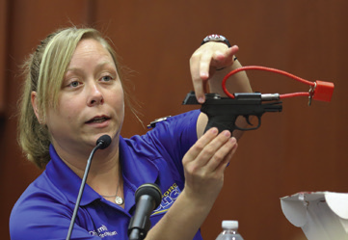
Learning Objective 2
Explain the exclusionary rule and the exceptions to it.
Gary W. Green/Orlando Sentinel/Getty Images
Notes:
Suppose that this gun—used by a defendant to murder a victim—was found as the result of an improper police search. Why might the exclusionary rule keep evidence of the gun’s existence out of court? What is your opinion of the exclusionary rule?
Gary W. Green/Orlando Sentinel/Getty Images

Slide 6
The Fourth Amendment
The exclusionary rule
  Prohibits the use of illegally obtained evidence in court
The fruit of the poisoned tree:
  Evidence obtained through illegally obtained evidence is also inadmissible.
Exceptions to the exclusionary rule
  “Inevitable discovery”
  “Good faith”

Slide 7
Learning Objective 3
List the four categories of items that can be seized by use of a search warrant.

Slide 8
Lawful Searches & Seizures
Privacy
  Reasonable expectation of privacy as established in Katz v. United States (1967)
  Two-pronged test
    Individual must prove he or she expected privacy.
    Society must recognize expectation as reasonable.
United States v. Jones (2012)
  Important roles that time and technology play in privacy

Slide 9
Lawful Searches & Seizures
Search warrant
  Court order that authorizes police to search a certain area.
  Must provide probable cause
  Must show specific information on the premises to be searched, suspects to be found and illegal activities taking place at the premises
  Must show items to be seized
  Issued by a neutral and nonbiased judge

Slide 10
Lawful Searches & Seizures
Seizure by use of a search warrant
  Items resulting from the crime
  Items that are inherently illegal for anyone to possess (with exceptions)
  Items that can be called “evidence” of the crime
  Items used in committing the crime

Slide 11
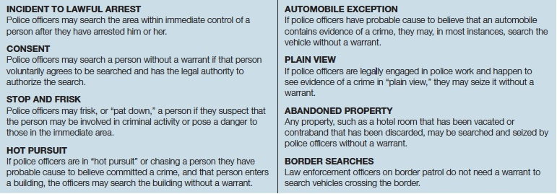
Learning Objective 4
Explain when searches can be made without a warrant.
Notes:
FIGURE 7.2 Exceptions to the Requirement That Officers Have a Search Warrant
In many instances, it would be impractical for police officers to leave a crime scene, go to a judge, and obtain a search warrant before conducting a search. Therefore, under the following circumstances, a search warrant is not required.

Slide 12
Lawful Searches & Seizures
Search incident to arrest
  United States v. Robinson (1973)
    The need for a police officer to find and confiscate any weapons a suspect may be carrying
    The need to protect any evidence on the subject’s person from being destroyed
  Chimel v. California (1969)
    Search area within suspect’s “immediate control”

Slide 13
Lawful Searches & Seizures
Searches with consent:
  Factors considered for a valid search include:
    The age, intelligence, and physical condition of the consenting subject
    Any coercive behavior by the police, such as the language used to request consent
    The length of the questioning and its location

Slide 14
Lawful Searches & Seizures
Searches of automobiles
  Arizona v. Gant (2009)
    Person being arrested is close enough to the car to grab or destroy evidence or a weapon inside the car.
    The arresting officer reasonably believes that the car contains evidence pertinent to the same crime for which the arrest took place.

Slide 15
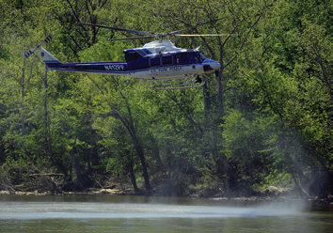
Learning Objective 5
Describe the plain view doctrine and indicate one of its limitations.
Ricky Carioti/The Washington Post/Getty Images
Notes:
Should law enforcement be able to use police helicopters such as the one shown here to determine if people are carrying out illegal behavior in their fenced-in back yards? Why or why not? Ricky Carioti/The Washington Post/Getty Images

Slide 16
Lawful Searches & Seizures
Plain view doctrine
  Coolidge v. New Hampshire (1971)
    The item is positioned within the officer’s view.
    The officer is legally in a position to notice the item.
    The discovery of the item is inadvertent.
    The officer immediately recognizes the illegal nature of the item.

Slide 17
Lawful Searches & Seizures
Cell phones and the Fourth Amendment
  Courts must decide if warrant is needed to track a suspect using cell phone records.
  In 2014, the U.S. Supreme Court unanimously ruled that officers need a warrant to search the contents of a cell belonging to suspects they have just arrested.

Slide 18
Learning Objective 6
Distinguish between a stop and a frisk, and indicate the importance of the case Terry v. Ohio.
Mark Richards/PhotoEdit
Notes:
A police officer frisks a suspect in San Francisco, California. What is the main purpose behind a frisk? When are police justified in frisking someone? Mark Richards/PhotoEdit

Slide 19
Stops and Frisks
Terry v. Ohio (1968)
  Established definition of “reasonable” suspicion in stop-and-frisk situations
  “Totality of circumstances” test – An officer must have “specific and articulable facts” to make a stop

Slide 20
Stops and Frisks
Stop:
  Takes place when an officer has reasonable suspicion that a criminal activity is about to take place
  Investigatory stop
Frisk:
  A protective measure
  Justified when the officer thinks the safety of police officers or other citizens might be endangered

Slide 21
Discussion Questions:
Terry v. Ohio
Research the case of Terry v. Ohio and then research another case regarding a stop and frisk.
  Justify the actions of the officer in your chosen case.
  Give your own perspective on the validity of the stop and frisk.

Slide 22


Learning Objective 7
List the four elements that must be present for an arrest to take place.
PhotoDisc
Notes:
PhotoDisc

Slide 23
Arrests
Arrest:
  Intent to arrest
  Authority to arrest
  Seizure or detention
  Understanding of the person that he/she has been arrested

Slide 24
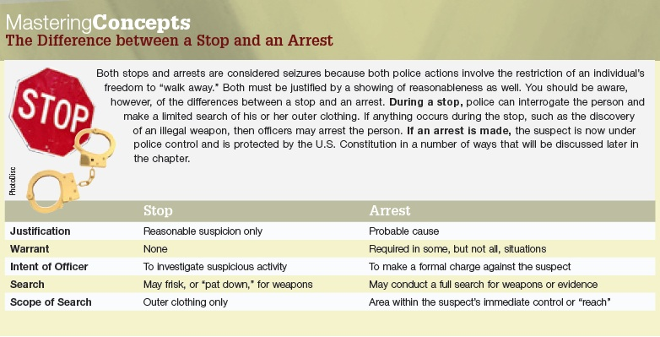
Arrests

Slide 25
Arrests
Arrests with a warrant
  Probable cause
  Knock and announce
  Exigent circumstances
Arrest without a warrant
  Offense is committed in the presence of the officer.
  Officer has probable cause to believe a suspect has committed a crime.
  Time lost obtaining a warrant would allow the suspect to escape/destroy evidence; officer has probable cause to make an arrest.

Slide 26
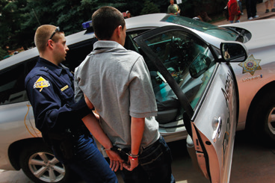
Learning Objective 8
Explain why the U.S. Supreme Court established the Miranda warnings.
Chris Hondros/Getty Images
Notes:
Study the details of this photo of an Aspen, Colorado, police officer and a suspect. Why must the officer “Mirandize” the suspect before asking him any questions, even if the officer never formally places the suspect under arrest? Chris Hondros/Getty Images

Slide 27
Miranda
Fifth Amendment guarantees protection against self-incrimination.
  Inherent coercion
  Applies when suspect is in custody
    Custodial interrogation

Slide 28
Learning Objective 9
Indicate situations in which a Miranda warning is unnecessary.

Slide 29
Miranda
Miranda is not required:
  When police do not ask suspect questions that are testimonial in nature
  When the police have not focused on a suspect and are questioning witnesses at the scene
  When a person volunteers information before being asked
  When the suspect has given a private statement to a friend or other acquaintance
  During a stop and frisk, when no arrest has been made
  During a traffic stop

Slide 30
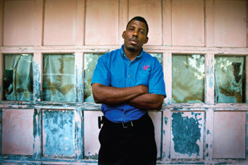
Learning Objective 10
List the three basic types of police identification.
Daniel Kramer/The New York Times/Redux Pictures
Notes:
Fort Bend County (Texas) authorities arrested Ronald Curtis for a string of robberies after a dog identified him by his smell, even though store videos showed that Curtis bore little resemblance to the suspect. What might be some of the drawbacks of using “scent” lineups, in which a police dog smells the crime scene and
is then expected to choose that same smell out of a group of suspects? Daniel Kramer/The New York Times/Redux Pictures

Slide 31
Identification Process
Basic types of police identification
  Showups
  Photo arrays
  Lineups
No Sixth Amendment right to counsel at showups and arrays
Nontestimonial evidence in booking process

