Slide 1
Chapter 5
Law Enforcement Today

Slide 2
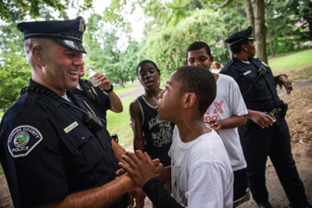
Learning Objective 1
List the four basic responsibilities of the police.
Andrew Burton/Getty Images
Notes:
Camden, New Jersey, police officers interact with residents during a day dedicated to cleaning up local parks. Andrew Burton/Getty Images

Slide 3
The Responsibilities of the Police
The basic responsibilities of the police include:
  Enforcing laws
  Providing services
  Preventing crime
  Preserving the peace

Slide 4
Discussion Questions:
Your Community
Locate a police department within your community.
  Discuss the four responsibilities of law enforcement as they apply to a local agency.
  How might this agency meet, or improve on, these four objectives?

Slide 5
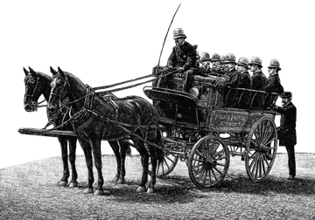
Learning Objective 2
Tell how the patronage system affected policing.
Corbis/Bettmann
Notes:
A horse-drawn police wagon used by the New York City Police Department, circa 1886. Why might this new form of transportation have represented a “revolution” for early American police forces? Corbis/Bettmann

Slide 6
History of American Policing
Night watch system—volunteers protecting their communities
Formal police departments established
  Sir Robert Peel
Philadelphia, Boston, and New York City integrated Peel’s principles

Slide 7
History of American Policing
The political era of policing (1840-1930)
  Called the patronage system, or the “spoils” system
  Bribery and political corruption were the hallmark of the era.

Slide 8
History of American Policing
Reform Era
  In 1929, the Wickersham Committee focused on two areas of American policing that were in need of reform:
    Police brutality
    “The corrupting influence of politics”
  Professional model of policing proposed by O.W. Wilson and August Vollmer

Slide 9
History of American Policing
Community Era—1960s
  Government funding for police-community programs
  Rethinking of policing concepts
  Interaction among officers and citizens working in partnership to prevent and fight crime

Slide 10
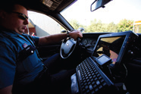
Learning Objective 3
Explain how intelligence-led policing works and how it benefits modern police departments.
Michael Hanson/New York Times/Redux

Slide 11
History of American Policing
Intelligence-led policing, also known as predictive policing (PredPol)
  Relies on data concerning the past crime patterns to predict future ones
  Predicts when and where crimes will occur
  Administrators will know where to disperse more effective small forces instead of using a blanket system.

Slide 12
Discussion Questions:
Intelligence-Led Policing
Discuss the use of intelligence-led policing and observing crime patterns.
  How might you gain information regarding suspects who sell drugs?
  How might you gather data on when the next burglary in a particular jurisdiction will occur?

Slide 13
History of American Policing
Counterterrorism
  Challenges
    Scarce resources
    Scrutiny
    Gathering Intelligence
  Fusion centers
  Evolving threats
  Use of technology

Slide 14
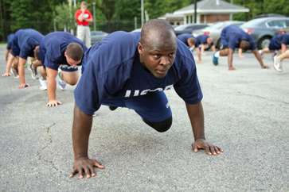
Learning Objective 4
Identify the differences between the police academy and field training as learning tools for recruits
Tom Williams/CQ Roll Call/Getty Images
Notes:
A recruit goes through an exercise routine at a police academy for the U.S. Capitol Police in Cheltenham, Maryland. Why are police academies an important part of the learning process for a potential police
officer?
Tom Williams/CQ Roll Call/Getty Images

Slide 15
Recruitment and Training
Basic requirements
  Background tests and checks
  Educational requirements

Slide 16
Recruitment and Training
The academy
  Run by police agencies and is a controlled, militarized environment
    Education about the laws of search, seizure, arrest, and interrogation
    How to use weapons
    Crime scenes
    Self-defense
    Many more aspects

Slide 17
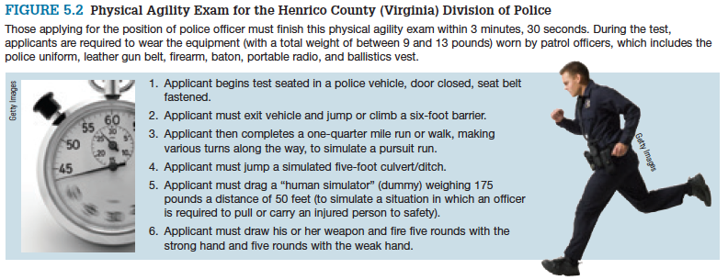
Recruitment and Training
Notes:
FIGURE 5.2 Physical Agility Exam for the Henrico County (Virginia) Division of Police
Those applying for the position of police officer must finish this physical agility exam within 3 minutes, 30 seconds. During the test, applicants are required to wear the equipment (with a total weight of between 9 and 13 pounds) worn by patrol officers, which includes the police uniform, leather gun belt, firearm, baton, portable radio, and ballistics vest.
Getty Images

Slide 18
Recruitment and Training
The field
  Not as controlled of an environment as academy
  Supervised by a field training officer
  Where the recruit actually learns how to be an officer

Slide 19
Learning Objective 5
Explain how consent decrees make law enforcement agencies more diverse.
Notes:
A female member of the Miami (Florida) Police Department provides security during a public event. Joe Raedle/Getty Images

Slide 20
Women & Minorities in Policing
Antidiscrimination laws/affirmative action
  Consent decrees
  Recruiting challenges

Slide 21
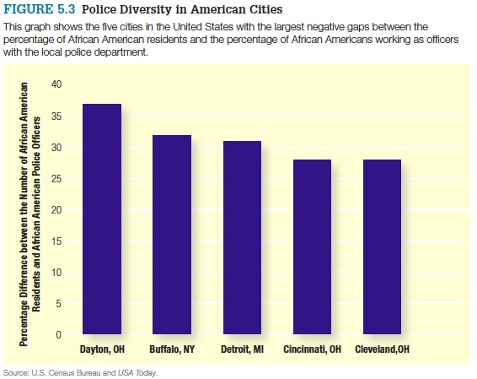
Members of Minority Groups in Local Law Enforcement, 1987–2007
Notes:
Figure 5.3 Police Diversity in American Cities
This graph shows the five cities in the United States with the largest negative gaps between the percentage of African American residents and the percentage of African Americans working as officers with the local police department.
Source: U.S. Census Bureau and USA Today.

Slide 22
Learning Objective 6
Describe the challenges facing women who choose law enforcement as a career.
Joe Raedle/Getty Images
Notes:
A female member of the Miami (Florida) Police Department provides security during a public event. Joe Raedle/Getty Images

Slide 23
Women & Minorities in Policing
Women officers
  Added scrutiny
  Tokenism
  Sexual harassment
Minority officers
  Double marginality
Benefits of a diverse police force

Slide 24
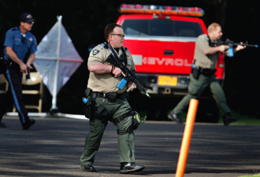
Learning Objective 7
Indicate some of the most important law enforcement agencies under the control of the Department of Homeland Security.
AP Images/The Register-Guard, Brian Davies
Notes:
Lane County (Oregon) sheriff’s deputies take part in an “active shooter” training exercise to protect local grade school students. Why do sheriffs’ departments and municipal police agencies often find themselves policing the same geographical areas? AP Images/The Register-Guard, Brian Davies

Slide 25
Public & Private Law Enforcement
Municipal law enforcement agencies
Sheriffs and county law enforcement
State police and highway patrols
Federal law enforcement agencies

Slide 26
Public & Private Law Enforcement
The Department of Homeland Security:
  U.S. Customs and Border Protection (BCP)
  U.S. Immigration and Customs Enforcement (ICE)
  U.S. Secret Service
  U.S. Coast Guard
  Transportation Security Administration (TSA)
  Federal Emergency Management (FEMA)

Slide 27
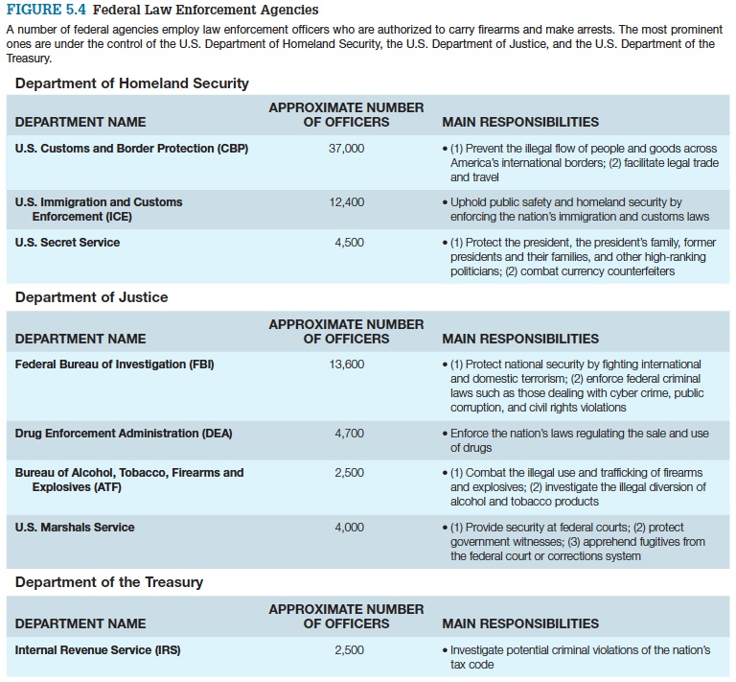
Public & Private Law Enforcement

Slide 28
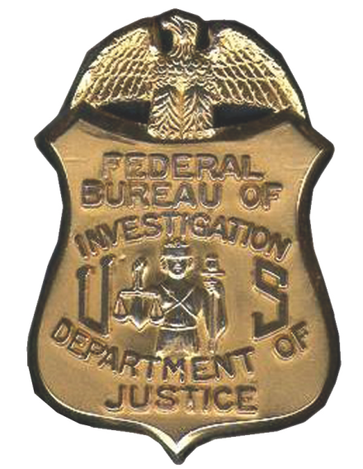
Learning Objective 8
Identify the duties of the FBI.
fbi.gov
Notes:
NEED NEW PIC – ONE IN TEXT IS SIDEWAYS AND HAS FONT NEAR IT. PAGE 158.

Slide 29
Public & Private Law Enforcement
The Federal Bureau of Investigation:
  One of the primary investigative agencies in the United States
  Has jurisdiction over nearly 200 federal crimes, including kidnapping, extortion, numerous white collar crimes, and bank robbery
  Uniquely positioned to combat worldwide criminal activity

Slide 30
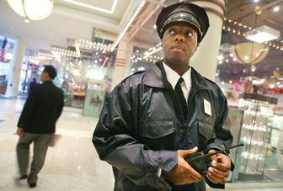
Learning Objective 9
Analyze the importance of private security today.
Mario Tama/Getty Images News/Getty Images
Notes:
A private security guard patrols the Manhattan Mall in New York City. Why is being visible such an important aspect of many private security jobs? Mario Tama/Getty Images News/Getty Images

Slide 31
Public & Private Law Enforcement
Over $300 billion in revenues each year
Over 10,000 U.S. private security firms
1.9 million people employed in private security each year
The function of private security is to deter crime rather than stop it.
Secondary policing is the work done by off-duty officers when they “moonlight” for private security firms.

