Slide 1
Chapter 4
Inside Criminal Law

Slide 2
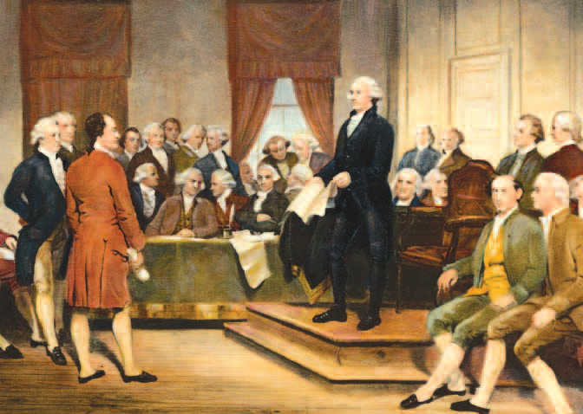
Learning Objective 1
List the four written sources of American criminal law.
Bettmann/Corbis
Notes:
George Washington, standing at right, presided over the constitutional convention of 1787. The convention resulted in the U.S. Constitution, the source of a number of laws that continue to form the basis of our criminal justice system today. Bettmann/Corbis

Slide 3
American Criminal Law
Constitutional law
The U.S. Constitution and the various state constitutions
Statutory law
Laws and ordinances passed by Congress and state legislatures: federal laws are enacted by Congress; state laws are enacted by state legislatures.
Administrative law
Regulations; created by agencies such as the federal Food and Drug Administration
Case law
Court decisions
Basis for stare decisis

Slide 4
American Criminal Law
Statutory law:
Applied The Model Penal Code in 1962; defines general principles of criminal responsibility
Legal supremacy; the Supremacy Clause of the U.S. Constitution makes federal law the “supreme law of the land”
Ballot initiatives; direct democracy for writing or rewriting criminal statutes

Slide 5
Learning Objective 2
Explain precedent and the importance of the doctrine of stare decisis.
Joe Raedle/Getty Images
Notes:
Joe Raedle/Getty Images

Slide 6
American Criminal Law
Stare decisis: to stand on decided cases
Judges are obligated to follow precedents established within their jurisdiction.
The U.S. Supreme Court is not required to always follow its own precedent, though it often does.

Slide 7
Learning Objective 3
Explain the two basic functions of criminal law.
Chris Butler/Idaho Statesman/MCT via Getty Images

Slide 8
Purpose of Criminal Law
Protect and punish: the legal function of the law
Maintain social order by protecting citizens from criminal harm
Harms to individual citizens’ physical safety/property
Harms to society’s interests collectively
Maintain and teach: the social function of the law
Expressing public morality
Teaching societal boundaries

Slide 9
Learning Objective 4
Delineate the elements required to establish mens rea (a guilty mental state).
Camilo Torres/Shutterstock.com

Slide 10
Elements of a Crime
Corpus delicti (body of the crime) consists of:
Guilty act: actus reus
Mental state: mens rea
Concurrence
Link between the act and the legal definition of the crime
Any attendant circumstances
The harm done by the crime

Slide 11
Elements of a Crime
Actus reus
Legal duty
Plan or attempt

Slide 12
Elements of a Crime
Mens rea
Categories of mens rea
Purposely
Knowingly
Negligence
Recklessness

Slide 13
Elements of a Crime
Degrees of crime
First degree murder
Second degree murder
Types of manslaughter

Slide 14
Learning Objective 5
Explain how the doctrine of strict liability applies to criminal law.

Slide 15
Elements of a Crime
Strict liability
Protects public
Protects minors
Eliminates the possibility that wrongdoers could claim ignorance or mistake to absolve themselves of responsibility
With strict liability, the defendant is guilty regardless of his or her state of mind at the time of the act

Slide 16
Elements of a Crime
Accomplice liability
Person may be charged with and convicted of crime when he or she did not actually commit the crime, but acted as an accomplice
Can be convicted without intent, e.g., felony murder
May require dual intent to aid person who committed the crime and to provide help that would lead to the commission of the crime

Slide 17
Elements of a Crime
Concurrence
The guilty act and the guilty intent must occur together.
Causation
The criminal act caused the harm suffered.
Attendant circumstances
Requirements of proof and intent
Hate crimes
Harm
Damages resultant from the criminal act.
Inchoate offenses are conduct deemed criminal without actual harm being done.

Slide 18
Learning Objective 6
List and briefly define the most important excuse defenses for crimes.
Reuters/Eduardo Munoz
Notes:
In 2014, Kerry Kennedy exits a White Plains, New York, courtroom after a jury acquitted her of driving while impaired. Several years earlier, Kennedy drove her car into another vehicle because, she claims, she mistakenly took a sleeping pill instead of her thyroid medication. Why do you think Kennedy was able to successfully raise the involuntary intoxication defense? Reuters/Eduardo Munoz

Slide 19
Criminal Law Defenses
Excuse defenses:
Infancy
Youthful offenders cannot understand the consequences of their actions.
Insanity
A person cannot have the state of mind to commit the crime if she/he did not know the act was wrong, or did not understand the quality of the act.
Intoxication
Mistake of law/fact

Slide 20
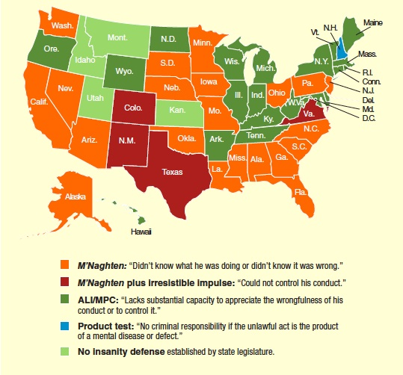
Learning Objective 7
Discuss a common misperception concerning the insanity defense in the United States.

Slide 21
Criminal Law Defenses
Insanity defense is only raised in approximately 1% of felony trials.
Successful only one out of four times it is raised
Difficult to prove insanity under the law
M’Naghten rule, ALI/MPC test, irresistible-impulse test
“Guilty but mentally ill”: passed in several states
Insanity vs. competence

Slide 22
Learning Objective 8
Describe the four most important justification criminal defenses.

Slide 23
Justification Defenses
Duress
The defendant is threatened with serious bodily harm, which induces him/her to commit the crime.
Self-defense
The defendant must protect himself/herself from injury by another.
Duty to retreat: “stand your ground” statutes vs. duty to retreat
Necessity
Circumstances required the defendant to commit the act.
Entrapment
The defendant claims to have been induced by police to commit the act.

Slide 24
Discussion Questions: George Zimmerman
What defense was used by George Zimmerman?
Do you agree with the defense stated by the attorney in charge of Zimmerman?
How could the prosecution have better addressed this defense?

Slide 25
Learning Objective 9
Distinguish between substantive and procedural criminal law.
John Moore/Getty Images

Slide 26
Procedural Safeguards
Substantive criminal law
Law that defines the acts that the government will punish
Procedural criminal law
Procedures drawn from the Bill of Rights that are designed to protect the constitutional rights of individuals

Slide 27
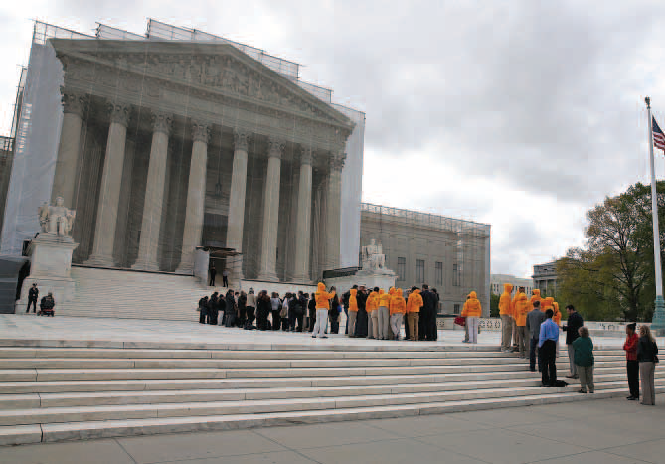
Learning Objective 10
Explain the importance of the due process clause in the criminal justice system.
Mark Wilson/Getty Images

Slide 28
Procedural Safeguards
Procedural due process is a provision in the Constitution that states that the law must be carried out in a fair and orderly manner.
Substantive due process is a constitutional requirement that laws used in accusing and convicting persons of crimes must be fair.
Role of the judicial system
Society’s best interests
National security

