Slide 1
Chapter 3
The Crime Picture: Offenders and Victims

Slide 2
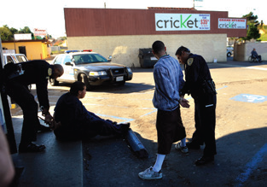
Learning Objective 1
Discuss the primary goals of civil law and criminal law and explain how these goals are realized.
Ricky Carioti/The Washington Post via Getty Images
Notes:
Police officers question two men suspected of shoplifting in National City, California. Do you think that this crime, which involves stealing items from a store while posing as a customer, should be considered a felony
or a misdemeanor? How does the value of the items stolen influence your answer? Ricky Carioti/The Washington Post via Getty Images

Slide 3
Classifications of Crime
Civil law
Civil court is concerned with responsibility.
The burden of proof is the preponderance of the evidence.
The remedy for violations of civil law is compensation.
Criminal law
Criminal court is concerned with guilt.
The burden of proof is beyond a reasonable doubt.
The remedy for violations is some form of punishment.

Slide 4
Classifications of Crime
Felonies
More serious than misdemeanors
Punishable by death or imprisonment in a penitentiary for a period of a year or longer
Misdemeanors
Less serious crimes
Punishable by a fine and/or incarceration in a local jail for up to one year

Slide 5
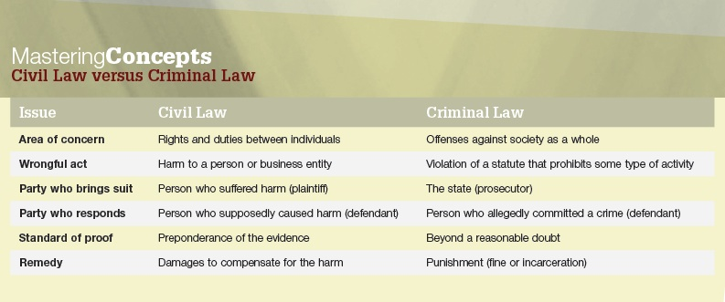
Classifications of Crime

Slide 6
Learning Objective 2
Explain the differences between crimes mala in se and mala prohibita.

Slide 7
Classifications of Crime
Mala in se
Acts that are inherently wrong, regardless of whether they are prohibited by law
Examples include murder, rape, and theft
Mala prohibita
Acts that are made illegal by criminal statute and are not necessarily wrong in and of themselves
Examples include speeding and loitering

Slide 8
Discussion Questions Drugs: To Legalize or Not?
Provide reasons why marijuana should be legalized.
What other drugs should be legalized, or not legalized, and why?
What role should the federal government play regarding drug use?

Slide 9
Learning Objective 3
Identify the publication in which the FBI reports crime data and list the two main ways in which the data are reported.

Slide 10
Measuring Crime in the U.S.
The Uniform Crime Report (UCR)
Produced by the Federal Bureau of Investigation
The UCR includes data collected from 18,400 policing agencies each year, including:
Number of arrests
Number of crimes reported
Number of police employees

Slide 11
Measuring Crime in the U.S.
Part I Offenses:
Violent crimes
Property crimes
Part II Offenses:
Includes all crimes that do not fall into the category of Part I offenses
Measured only by arrest data

Slide 12
Measuring Crime in the U.S.
Problems with UCR
Police notification
Discretion
Definition

Slide 13
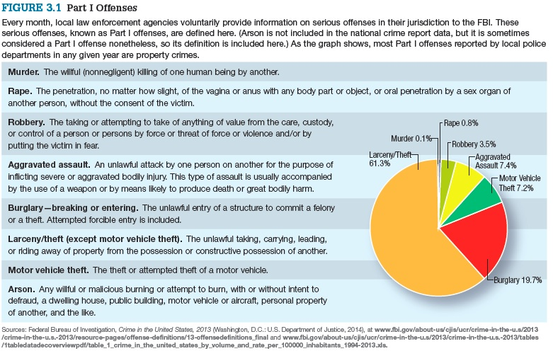
Measuring Crime in the U.S.
Notes:
Every month, local law enforcement agencies voluntarily provide information on serious offenses in their jurisdiction to the FBI. These serious offenses, known as Part I offenses, are defined here. (Arson is not included in the national crime report data, but it is sometimes considered a Part I offense nonetheless, so its definition is included here.) As the graph shows, most Part I offenses reported by local police departments in any given year are property crimes.
Sources: Federal Bureau of Investigation, Crime in the United States, 2013 (Washington, D.C.: U.S. Department of Justice, 2014), at www.fbi.gov/about-us/cjis/ucr/crime-in-the-u.s/2013
/crime-in-the-u.s.-2013/resource-pages/offense-definitions/13-offensedefinitions_final and www.fbi.gov/about-us/cjis/ucr/crime-in-the-u.s/2013/crime-in-the-u.s.-2013/tables
/1tabledatadecoverviewpdf/table_1_crime_in_the_united_states_by_volume_and_rate_per_100000_inhabitants_1994-2013.xls.

Slide 14
Measuring Crime in the U.S.
The National Incident-Based Reporting System
Expanded the UCR
Collects data on each single crime within 23 offense categories of 49 specific crimes
Four data sets:
Offenses
Victims
Offenders
Arrestees

Slide 15
Learning Objective 4
Distinguish between the National Crime Victimization Survey (NCVS) and self-reported surveys.

Slide 16
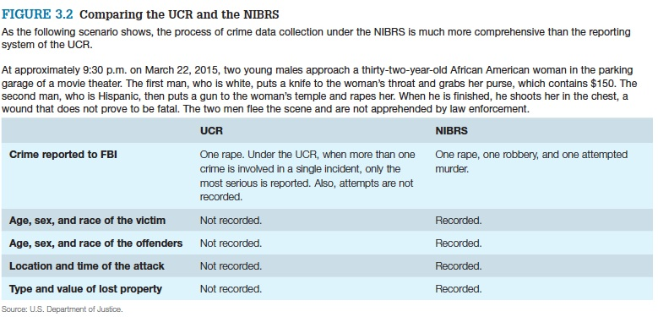
Measuring Crime in the U.S.
Notes:
As the following scenario shows, the process of crime data collection under the NIBRS is much more comprehensive than the reporting system of the UCR.
At approximately 9:30 p.m. on March 22, 2015, two young males approach a thirty-two-year-old African American woman in the parking garage of a movie theater. The first man, who is white, puts a knife to the woman’s throat and grabs her purse, which contains $150. The second man, who is Hispanic, then puts a gun to the woman’s temple and rapes her. When he is finished, he shoots her in the chest, a wound that does not prove to be fatal. The two men flee the scene and are not apprehended by law enforcement.
Source: U.S. Department of Justice.

Slide 17
Victims of Crime
Victim surveys are a method of gathering information in which citizens are surveyed directly regarding their criminal victimizations.
Victim surveys attempt to uncover the dark figure of crime.
National Crime Victimization Survey
Advantages in comparison to UCR
Self-report surveys ask respondents to tell about their criminal activities.
Self-report surveys are also an attempt to measure the dark figure of crime.

Slide 18
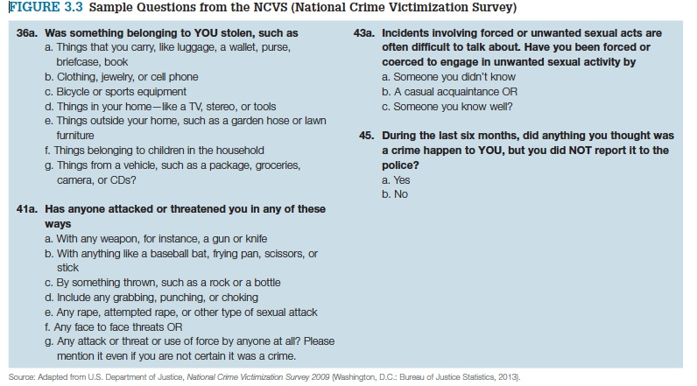
Victims of Crime
Notes:
Source: Adapted from U.S. Department of Justice, National Crime Victimization Survey 2009 (Washington, D.C.: Bureau of Justice Statistics, 2013).

Slide 19
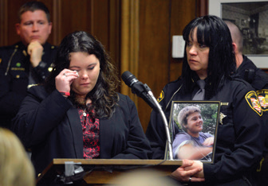
Learning Objective 5
Describe the three ways that victim’s rights legislation increases the ability of crime victims to participate in the criminal justice system.
AP Images/The News-Herald, Duncan Scott, Pool
Notes:
Crystal King, left, addresses a criminal court in Chardon, Ohio, during the sentencing of T. J. Lane for murdering her brother. Should crime victims and their families have the “right” to participate in criminal justice proceedings? Why or why not? AP Images/The News-Herald, Duncan Scott, Pool

Slide 20
Victims of Crime
Crime Victims’ Rights Act of 2004
Victims’ right to participate in the system
The right to be informed
The right to be present
The right to be heard
Enforceability of legislation
Victim services

Slide 21
Learning Objective 6
Discuss one major concern regarding victim participation in the criminal justice process.

Slide 22
Victims of Crime
The risks of victimization
Routine activities theory
Likely offender
Suitable target
Absence of capable guardian
Repeat victimization
Victim-offender connection

Slide 23
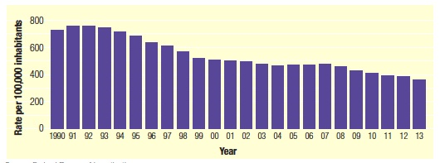
Learning Objective 7
Identify the three factors most often used by criminologists to explain changes in the nation’s crime rate.
Source: Federal Bureau of Investigation.
Notes:
FIGURE 3.5 Violent Crime in the United States, 1990–2013
According to statistics gathered each year by the FBI, American violent crime rates dropped steadily in the second half of the 1990s, leveled off for several years, and now have begun to decrease anew.
Source: Federal Bureau of Investigation.

Slide 24
Crime Trends in the U.S.
The “usual suspects” of crime fluctuation
Imprisonment
Youth populations
The economy
Continuing decreases

Slide 25
Crime Trends in the U.S.
Notes:
FIGURE 3.4 Crime Victims in the United States
According to the U.S. Department of Justice, minorities, residents of urban areas, and young people are most likely to be victims of violent crime in this country.
Source: Bureau of Justice Statistics, Criminal Victimization, 2013 (Washington, D.C.: U.S. Department of Justice, September 2014), 9, 10.

Slide 26
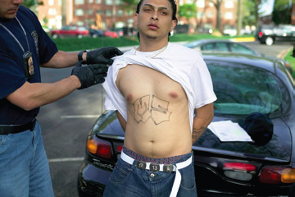
Learning Objective 8
Explain why income level appears to be more important than race or ethnicity when it comes to crime trends.
Photo by Robert Nickelsberg/Getty Images
Notes:
A member of Prince George’s County’s Anti-Gang Unit makes an arrest during a crackdown on Hispanic gangs in Langley Park, Maryland. Why is it likely that crime experts will increase their focus on issues of Hispanic offenders and victims in the United States over the next few decades? Photo by Robert Nickelsberg/Getty
Images

Slide 27
Crime Trends in the U.S.
Crime, race, and poverty
Official crime data indicate strong correlation between minority status and crime
Neighborhoods with higher levels of disadvantaged individuals have higher violent crime rates
Lack of education, a handicap faced by low-income citizens, seems to correlate with criminal activity
There is often a distinct lack of data regarding ethnicity and offending
28-30
28-30

Slide 28
Learning Objective 9
Discuss the prevailing explanation for the rising number of women incarcerated in the United States.

Slide 29
Crime Trends in the U.S.
Women and crime:
Crime is a predominantly male activity; however female offending rates are steadily increasing.
Criminal justice system is now more willing to incarcerate women.
Women as crime victims
Common crimes against women: someone known to victim; domestic violence
Increased exposure in the workplace

Slide 30
Crime Trends in the U.S.
Mental illness and crime
Risk factors for violent crime
Gun control
Drug abuse
Risk factors for victimization
Poverty because of inability to find and keep job
Homelessness
Inability to make prudent decisions in dangerous situations

