Slide 1
Chapter 2
Causes of Crime

Slide 2
Learning Objective 1
Discuss the difference between a hypothesis and a theory in the context of criminology.

Slide 3
The Role of Theory
Theory
An explanation of a happening or circumstance that is based on observation, experimentation, and reasoning
Hypothesis
A possible explanation for an observed occurrence that can be tested by further investigation
Tested using the scientific method

Slide 4
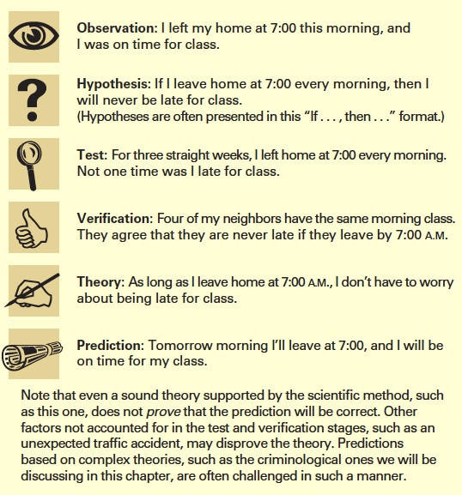
The Role of Theory

Slide 5
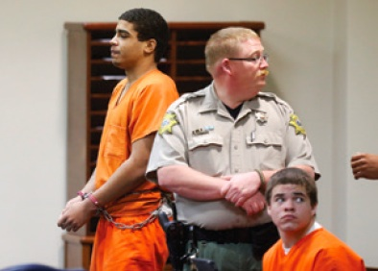
Learning Objective 2
Contrast positivism with classical criminology.
AP Images/Sue Ogrocki
Notes:
Chancey Luna, standing, and Michael Jones, sitting, are two of the three “bored” teenagers charged with fatally shooting Australian Christopher Lane in Duncan, Oklahoma, on August 16, 2013. How is the assumption that some people commit crimes for the “thrill of it” consistent with rational choice theory? AP Images/Sue Ogrocki

Slide 6
The Brain and The Body
Choice theory
Offenders make a rational choice to commit crime.
Defendant may not be punished as harshly if it can be proven that she or he lacked the ability to make a rational choice.

Slide 7
The Brain and The Body
Classical criminology
Before committing a crime, a person weighs the benefits of the crime against the costs of being apprehended.
Cesare Beccaria: Essays on Crime and Punishments
Decisions are a result of rational choices.
Fear of punishment has a deterrent effect.
Swift and certain punishment is the most powerful deterrent to criminal offending.

Slide 8
The Brain and The Body
Positivism
Criminal behavior is determined by biological, psychological, and social forces beyond the control of the individual.
Cesare Lombroso is the “Father of Criminology.”

Slide 9
The Brain and The Body
Rational choice theory
Before committing a crime, a person acts as if he/she is weighing the benefits against the costs.
If the perceived benefits are greater than the potential costs, the person is more likely to commit the crime.

Slide 10
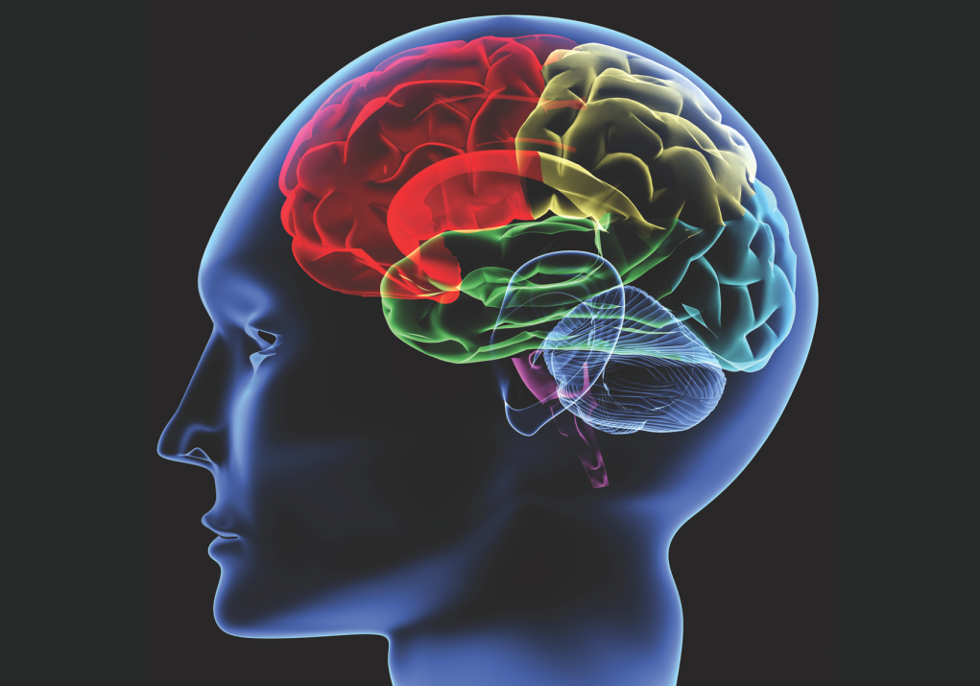
Learning Objective 3
Explain how brain-scanning technology is able to help scientists determine if an individual is at risk for criminal offending.
Yakobchuk Vasyl/Shutterstock.com

Slide 11
The Brain and The Body
Genetics: a branch of biology that deals with traits that are passed through generations
When the warrior gene is combined with history of abuse as child, there is an increased risk for violence.
Criminal activity in males is linked to elevated levels of testosterone.
Neurocriminology is the study of how genetics and brain activity influence criminal behavior.
While there may be a correlation between mental illness and violence, such illnesses cannot be said to cause violent behavior.

Slide 12
The Brain and The Body
Freud’s psychoanalytic theory
The id, ego, and superego
Social psychology
How humans relate to and influence one another
Trait theory
Biological and psychological views of criminality that suggest antisocial behavior should be identified and treated before it manifests itself

Slide 13
Learning Objective 4
List and describe the three theories of social structure that help explain crime.
Scott Olson/ Getty Images
Notes:
On November 25, 2014, a firefighter surveys the rubble of a strip mall in Ferguson, Missouri. An angry crowd destroyed the property after learning that a local white police officer would not face criminal charges for killing an African American suspect. How does social psychology explain acts of violence or disorder by large groups of people? Scott Olson/ Getty Images

Slide 14
Bad Neighborhoods and Other Economic Disadvantages
Sociological theories
The Chicago School
Social disorganization theory
Strain theory
Cultural deviance theory

Slide 15
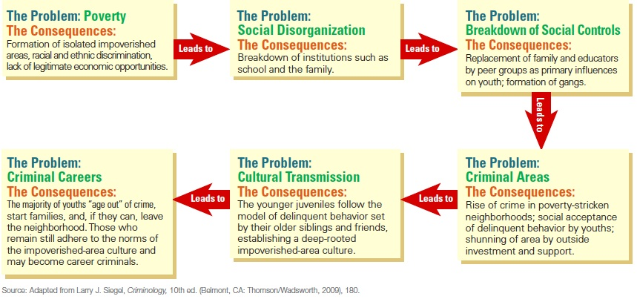
Bad Neighborhoods and Other Economic Disadvantages

Slide 16
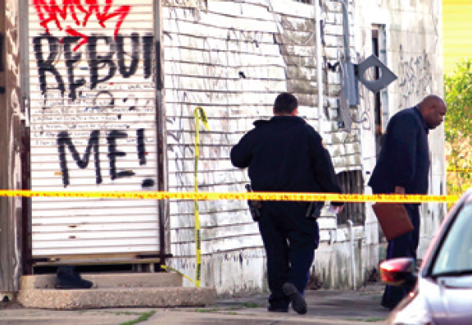
Learning Objective 5
Describe the social conflict theory known as the social reality of crime.
Michael DeMocker/The Times-Picayune/Landov
Notes:
Two law enforcement officers investigate a murder in the Desire neighborhood of New Orleans. How would a criminologist who advocates social conflict theories of criminal behavior explain high crime rates in low-income neighborhoods such as Desire?
Michael DeMocker/The Times-Picayune/Landov

Slide 17
Bad Neighborhoods and Other Economic Disadvantages
Social conflict theories
Marxism vs. capitalism
Marx believed that capitalist economic systems necessarily produce income inequality and lead to exploitation
Patterns of social justice
Issues of race and ethnicity
Racial threat theory: based on the hypothesis that, as the size of a minority group increases in population and expands geographically, members of the majority group use the criminal justice system to oppress those minority groups
Implications for public policy

Slide 18
Learning Objective 6
List and briefly explain the three branches of social process theory.

Slide 19
Life Lessons & Criminal Behavior
Social process theories
Learning theory
Control theory
Labeling theory
Social process theory and public policy
Crime prevention focuses on juvenile offenders and steering them away from offending and the system.

Slide 20
Learning Objective 7
Describe the importance of early childhood behavior for those who subscribe to self-control theory.

Slide 21
Life Lessons & Criminal Behavior
Life course theories
Self-control theory
Possibility of change
Life-course-persistent offenders
Adolescent-limited offenders
Turning points
Life course theories relate to public policy

Slide 22
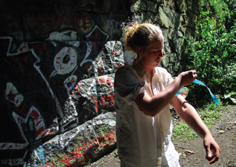
Learning Objective 8
Contrast the medical model of addiction with the criminal model of addiction.
Cheryl Senter/The New York Times/Redux
Notes:
A young woman prepares to use heroin under a bridge in Portland, Maine. Do you think that drug abusers should be treated as criminals to be punished or as ill people in need of treatment? Explain your answer. Cheryl Senter/The New York Times/Redux

Slide 23
Link between Drugs & Crime
Social disorganization theory
Control theory
Learning process
Techniques of drug use
Perception of effects of drug use
Enjoy the social experience of drug use

Slide 24
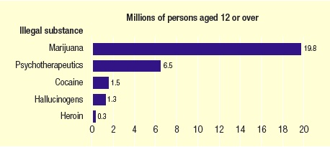
Link between Drugs & Crime
Notes:
Source: Substance Abuse and Mental Health Service Administration, Results from the 2013 National Survey on Drug Use and Health: Summary of National Findings (Washington, D.C.: National Institute of Drug Abuse, September 2014), Figure 2.1, page 16.

Slide 25
Link between Drugs & Crime
Drug addiction and dependency
Drug abuse is the use of drugs that results in physical or psychological harm to the abuser or third parties
The brain’s dopaminergic system is the key to understanding many drugs of abuse
The drug-crime relationship
Drug-defined offenses – violation of drug laws
Drug-related offenses – crimes motivated by drug abuse
Drug-using lifestyle – rely on crime for means of survival

Slide 26
Link between Drugs & Crime
Models of addiction
The medical model of addiction
Addicts are not criminals, but mentally or physically ill individuals who are forced into acts of petty crime to “feed their habit.”
Under the enslavement theory, addicts should be treated for their addiction as a disease and not be punished as criminals.
The criminal model of addiction
Illegal drug abusers and addicts endanger society with their behavior and should be punished the same as persons who commit non drug-related crimes.

Slide 27
Link between Drugs & Crime
Marijuana law trends
Legalization
Decriminalization
Issues
Edibles
Diversion

Slide 28
Learning Objective 9
Explain the theory of the chronic offender and its importance for the criminal justice system.

Slide 29
From Theory to Practice
Chronic offender
Career criminal
A small group of offenders (6%) are responsible for a disproportionate amount of crime.
Habitual offenders laws provide harsher sentences for repeat offenders.

