Slide 1
Chapter 1
Criminal Justice Today

Slide 2
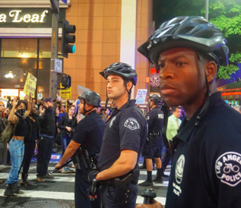
Learning Objective 1
Describe the two most common models of how society determines which acts are criminal.
Mintaha Neslihan Eroglu/Anadolu Agency/Getty Images
Notes:
On November 26, 2014, Los Angeles police officers cordon off protesters following a Missouri grand jury’s decision not to charge Ferguson police officer Darren Wilson in the shooting death of Michael Brown.

Slide 3
What is Crime?
The consensus model
Assumes that as a society is formed, its members will come to an agreement about shared norms and values
Views crimes as acts that violate this shared value system and are deemed harmful to society
Proposes that as societal norms and values about morality change, laws will change

Slide 4
What is Crime?
The conflict model
In large, diverse societies, people may not share beliefs about controversial issues.
The most politically powerful members of society have the most influence on criminal law and impose their value system on the community.
What is deemed criminal activity is determined by whichever group happens to be holding power at any given time.

Slide 5
Discussion Question: Consensus or Conflict?
Laws regarding marijuana have undergone change in recent years. Some states have decriminalized marijuana possession, while others have legalized medical use, and still others have legalized adult use.
How do the consensus and conflict models view changes in laws related to marijuana? Justify your answer.

Slide 6
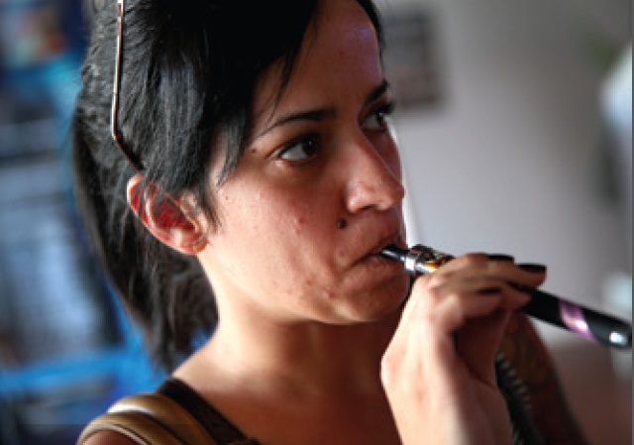
Learning Objective 2
Define crime.
Joe Raedle/Getty Images
Notes:
E-cigarettes, such as the one shown in this photo, deliver the drug nicotine to users without some of the tobacco related health risks of traditional cigarettes. Nicotine is, however, highly addictive. Why might e-cigarette use be considered deviant behavior by minors, but not by adults? Joe Raedle/Getty Images

Slide 7
What is Crime?
An integrated definition of crime
An action that is punishable under criminal law, as established by the majority or a powerful minority
Considered an offense against society as a whole and prosecuted by public officials
Punishable by statutorily-determined sanctions that bring about a loss of personal freedom or life

Slide 8
The Six Categories of Criminal Behavior
Violent crime—against persons (murder, sexual assault, assault, battery, robbery)
Property crime—for economic gain (larceny, burglary, arson)
Public order crime—”victimless” crimes (public drunkenness, prostitution, gambling, illicit drug use)
White collar crime—for business or personal advantage
Organized crime—illegal acts by illegal organizations (narcotics, loan sharking)
High-tech crime—computer crimes, cyber crimes

Slide 9
Learning Objective 3
Explain two main purposes of the criminal justice system.

Slide 10
The Purpose of the Criminal Justice System
Maintaining justice
Protecting society
To protect society from potential future crimes of the most dangerous or “risky” offenders
To determine when an offense has been committed and to provide appropriate punishment
To rehabilitate those offenders who have been punished so that it is safe to return them to the community
To support crime victims and, to the extent possible, return them to their pre-crime status

Slide 11
Learning Objective 4
Outline the three levels of law enforcement.
Source: Bureau of Justice Statistics, Justice Expenditure and Employment in the United States, 2010 (Washington, D.C.: U.S. Department of Justice, July 2013), Table 2.
Notes:
FIGURE 1.2 Local, State, and Federal Employees in Our Criminal Justice System. Source: Bureau of Justice Statistics, Justice Expenditure and Employment in the United States, 2010 (Washington, D.C.: U.S. Department of Justice, July 2013), Table 2.

Slide 12
Learning Objective 4
Outline the three levels of law enforcement.
Source: Bureau of Justice Statistics, Justice Expenditure and Employment in the United States, 2010 (Washington, D.C.: U.S. Department of Justice, July 2013), Table 2.
Notes:
FIGURE 1.2 Local, State, and Federal Employees in Our Criminal Justice System. Source: Bureau of Justice Statistics, Justice Expenditure and Employment in the United States, 2010 (Washington, D.C.: U.S. Department of Justice, July 2013), Table 2.

Slide 13
The Structure of the Criminal Justice System
Federalism is central to the structure of the criminal justice system.
Power is shared by the federal and state governments.
The criminal justice system is composed of three components.
Law enforcement agencies
Courts
Corrections

Slide 14
The Structure of the Criminal Justice System
Local law enforcement
City police agencies
County sheriffs
State law enforcement
State police
Highway patrols
Other state law enforcers such as fire marshals, wildlife wardens, alcoholic beverage control officers, etc.

Slide 15
The Structure of the Criminal Justice System
Federal law enforcement
The Department of Homeland Security
The Federal Bureau of Investigation (FBI)
The Secret Service
The Drug Enforcement Administration (DEA)
The Bureau of Alcohol, Tobacco, Firearms and Explosives (ATF)

Slide 16
The Structure of the Criminal Justice System
The courts
The United States has a dual court system – federal and state
Comprised of one federal court, fifty different state court systems, plus the District of Columbia
The criminal court and its work group
The judge, prosecutors, and defense attorneys
Charged with the weighty responsibility of determining the innocence or guilt of criminal suspects

Slide 17
The Structure of the Criminal Justice System
Corrections
Probation
Incarceration
Community-based corrections
Parole
Criminal justice process
Continuum of events
Assembly line

Slide 18
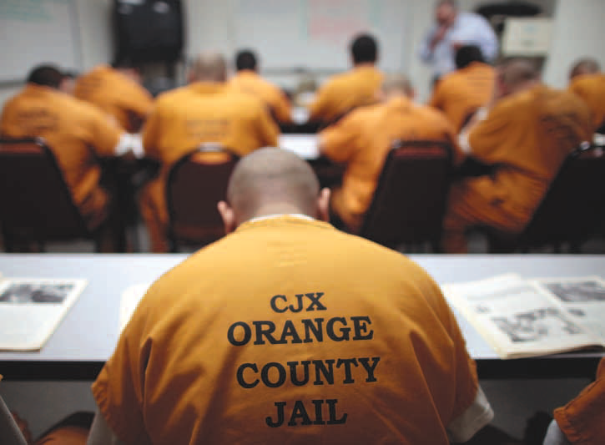
Learning Objective 5
List the essential elements of the corrections system.
Lucy Nicholson/Reuters/Landov
Notes:
On any given day, America’s jails hold approximately 730,000 inmates, including these residents of the Orange County jail in Santa Ana, California. What are the basic differences between jails and prisons? Lucy Nicholson/Reuters/Landov

Slide 19
The Structure of the Criminal Justice System
The corrections systems includes:
Jails
Prisons
Probation
Community-based corrections
Parole

Slide 20
Learning Objective 6
Explain the difference between the formal and informal criminal justice processes.
Notes:
This photo from Cole page 45 would work.

Slide 21
Formal and Informal Processes
The formal criminal justice process
Functions as an assembly-line
Entry into system a Prosecution and Pretrial Services a Adjudication a Sentencing and Sanctions a Corrections
The informal criminal justice process
Based on the use of discretion to offset the rigidity of criminal statutes and procedural rights

Slide 22
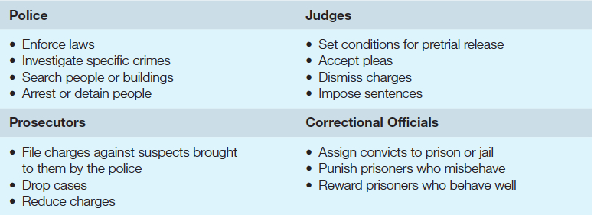
Learning Objective 7
Define ethics, and describe the role that it plays in discretionary decision making.
Notes:
FIGURE 1.4 Discretion in the Criminal Justice System
Criminal justice officials must make decisions every day concerning their duties. The officials listed below, whether they operate on a local, state, or federal level, rely heavily on discretion when meeting the following responsibilities.

Slide 23
Discretion and Ethics
Discretion: the ability of individuals in the criminal justice system to make operational decisions based on personal judgment
Discretion is sometimes used in biased ways.
Ideally, actors in the criminal justice system will make moral choices about what is right and wrong based on societal norms.
Ethics: moral principles that govern a person’s perception of right and wrong

Slide 24
Discussion Question: Exercising Discretion
Increasing numbers of cities are enacting laws that are sometimes described as criminalizing homelessness.
Vagrancy, loitering, or loafing
Sleeping, camping, begging, or storing personal belongings in public
How much discretion should patrol officers have in enforcing these laws? Why?
Notes:
Reference: http://www.nlchp.org/documents/No_Safe_Place

Slide 25
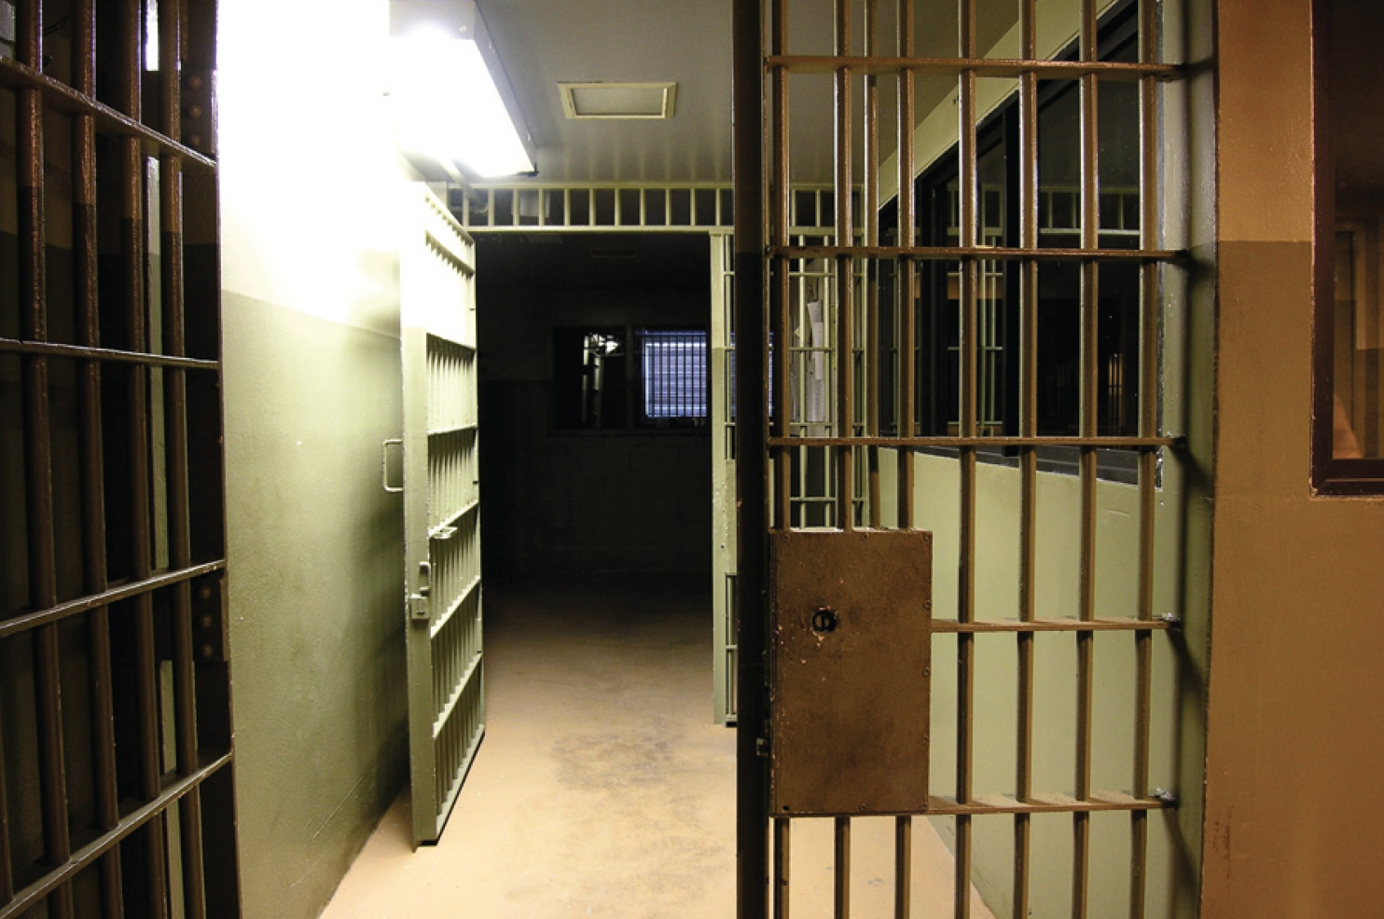
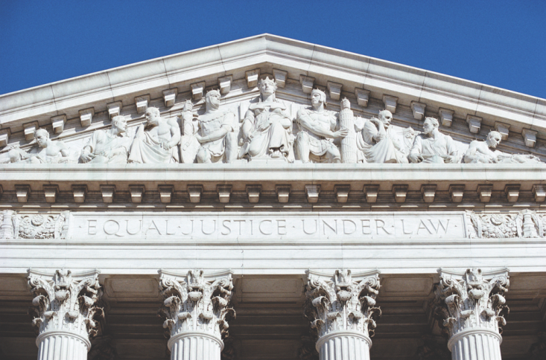
Learning Objective 8
Contrast the crime control and due process models.
Shutterstock/spiritofamerica
Shutterstock/trekandshoot

Slide 26
Criminal Justice Today
The crime control model
Primary emphasis is on punishing and repressing criminal conduct
Advocates for a quick and efficient system
Places few restrictions on ability of law enforcement to use discretion in apprehending criminals

Slide 27
Criminal Justice Today
The due process model
Primary emphasis on protecting rights of accused through formal, legal restraints on police, courts, and corrections
Relies on courts to make it more difficult to prove guilt
Rests on the belief that it is more desirable that ninety-nine guilty suspects go free than a single innocent person be condemned

Slide 28
Criminal Justice Today
Smarter policing
Proactive policing promotes more rigorous enforcement of minor offenses in order to prevent more serious crimes.
Identifying criminals
DNA profiling allows law enforcement to identify suspects from body fluid evidence or biological evidence.
Biometrics read a person’s unique physical characteristics and report identity to police.

Slide 29
Criminal Justice Today
Continuing challenges for law enforcement
Street gangs
Gun use and crime
Issues of race and public trust
Illegal drugs

Slide 30
Discussion Question: Your State System
Visit the web sites of your state corrections system and those of local, county or regional jails and see how they characterize their mission.
Which model of justice seems to predominate in your state?
What changes would you make based on these two models?

Slide 31
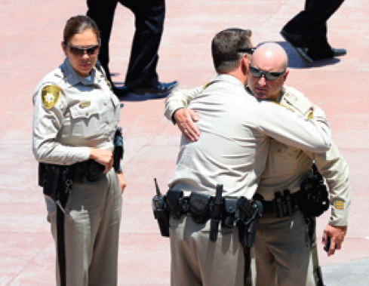
Learning Objective 9
Explain the defining aspects of a terrorist act, and identify one common misperception concerning domestic terrorism.
Ethan Miller/Getty Images
Notes:
Law enforcement agents console each other after the funeral of Las Vegas police officer Igor Soldo, who was fatally shot by Jerad Miller and his wife Amanda in June 2014. Miller, who did not survive the shootout, saw himself as an “anti-police” revolutionary and believed that “Satan runs our government.” Why is Miller considered a domestic terrorist? Photo by Ethan Miller/Getty Images

Slide 32
Criminal Justice Today
Homeland security: a concerted national effort to prevent terrorist attacks within the United States and reduce the country’s vulnerability to terrorism
Precipitated by the September 11, 2001 attacks
Terrorism: random use of staged violence to achieve political goals

Slide 33
Criminal Justice Today
Civil liberties: personal freedoms guaranteed to all Americans by the U.S. Constitution
Concerns about balancing personal freedoms and personal safety with regard to federal antiterrorism agency surveillance techniques
Domestic terrorism: acts of terror that are carried out within one’s own country, against one’s own people, and with little or no direct foreign involvement

Slide 34
Discussion Question: Identifying Domestic Terrorism
What are the defining characteristics of domestic terrorism?
Consider the Boston Marathon bombing. Was this an act of domestic terrorism?
Consider the mass shooting at the Emanuel African Methodist Episcopal Church in Charleston, S.C. Was this an act of domestic terrorism?
How did law enforcement respond to these incidents? What can be learned?

Slide 35
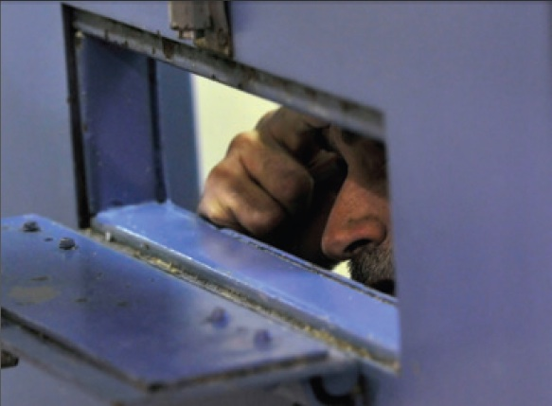
Learning Objective 10
List the major issues in criminal justice today.
Debbie Noda/Modesto Bee/ MCT via Getty Images
Notes:
An inmate suffering from mental illness speaks to his attorney through a cell door at the Stanislaus County Public Safety Center in Modesto, California. Why do many experts blame the large number of mentally ill jail and prison inmates on reductions in government spending on community mental health services? Photo by Debbie Noda/Modesto Bee/ MCT via Getty Images

Slide 36
Criminal Justice Today
Emergence of victims’ rights
Victim: any person who suffers physical, emotional, or financial harm as the result of a criminal act
Legislative efforts
Inmate population trends
The economics of incarceration
Recidivism: repeat offending on the increase

Slide 37
Criminal Justice Today
Declining use of the death penalty for capital crimes
Minority bias in incarceration rates
Inmates who are mentally ill
Those suffering from poor mental health often wind up in the “care” of the criminal justice system

