Slide 1
Chapter 6
Problems and Solutions in Modern Policing

Slide 2
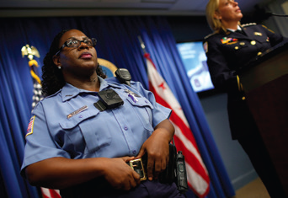
Learning Objective 1
Explain why police are allowed discretionary powers.
Win McNamee/Getty Images
Notes:
A Washington, D.C., police officer models one of her department’s new body-worn cameras, designed to record officer interactions with the public. Win McNamee/Getty Images

Slide 3
The Role of Discretion in Policing
Justification for police discretion
  Officers are considered trustworthy and are therefore assumed to make honest decisions.
  Experience and training give officers the ability to determine whether certain activity poses a threat to society and take action to investigate or prevent that activity.
  Officers are extremely knowledgeable in human, and by extension, criminal behavior.
  Officers may find themselves in harm’s way and must be allowed to take action to protect themselves.

Slide 4
The Role of Discretion in Policing
Factors in police discretion
  Nature of the criminal act
  Attitude of the wrongdoer
  Relationship between the victim and the offender
  Policy
  Mandatory arrest policies
  Body-worn cameras

Slide 5
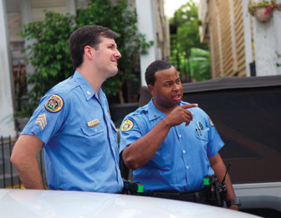
Learning Objective 2
List the three primary purposes of police patrol.
Rod Lamkey Jr/AFP/Getty Images
Notes:
Given that most patrol shifts end without an officer making a single arrest, what activities take up most of a patrol officer’s time? Rod Lamkey Jr/AFP/Getty Images

Slide 6
Police Organization & Field Operations
The purpose of patrol
  The deterrence of crime by maintaining a visible police presence
  The maintenance of public order and a sense of security in the community
  The twenty-four-hour provision of services that are not crime-related

Slide 7
Police Organization & Field Operations
Patrol activities
  Preventative patrol
  Calls for service
  Administrative duties
  Officer-initiated activities

Slide 8
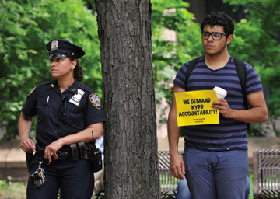
Learning Objective 3
Indicate some investigative strategies that are considered aggressive.
Timothy Clary/AFP/Getty Images
Notes:
For more than a decade, the New York Police Department (NYPD) has been persuading Muslims in the city’s jails to act as informants concerning possible terrorist activity in their communities. What is your
opinion of this strategy? Why do you think the NYPD has come under criticism, such as in the demonstration shown here, for these kinds of tactics? Timothy Clary/
AFP/Getty Images

Slide 9
Police Organization & Field Operations
Investigations:
  The responsibility of detectives
  Aggressive strategies include going undercover and working with confidential informants.
    Preventative policing to combat domestic terrorism
    Entrapment issues
    Success is measured with clearance rates, or the number of cases resulting in arrest and prosecution.

Slide 10
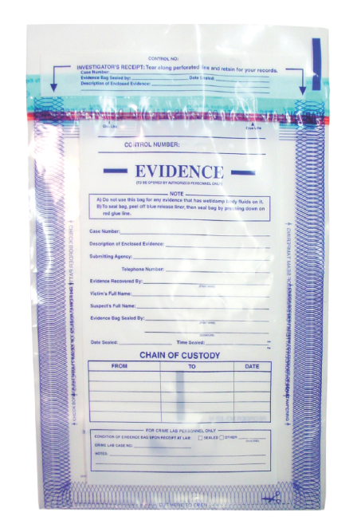
Learning Objective 4
Describe how forensic experts use DNA fingerprinting to solve crimes.
Brandon Alms/iStockphoto

Slide 11
Police Organization & Field Operations
Forensic experts determine crucial facts of a case:
  Cause of injury/death
  Time of injury/death
  Type of weapon(s) used
  Identity of crime victim
  Identity of the offender

Slide 12
Police Organization & Field Operations
The DNA revolution:
  DNA provides the genetic “blueprint” or “code” for every living organism.
  The Combined DNA Index System (CODIS) is a database that stores DNA samples from people connected to criminal activity.
  New developments
    Touch DNA
    Familial searches
    DNA fog
    Genetic witness

Slide 13
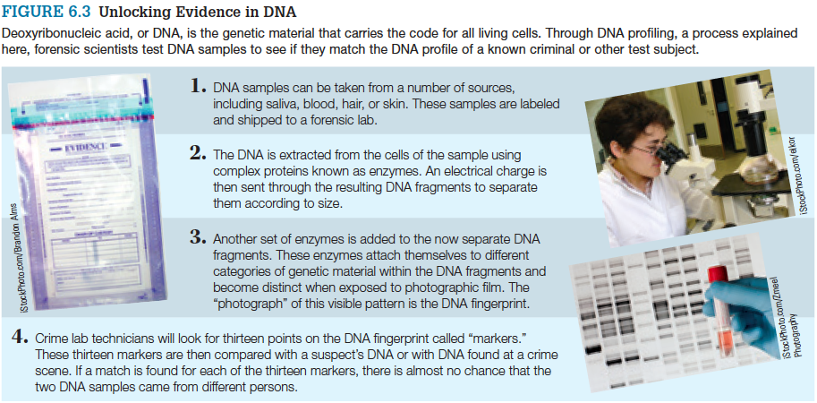
Police Organization & Field Operations

Slide 14
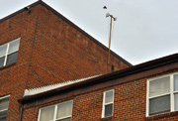
Learning Objective 5
Explain why differential response strategies enable police departments to respond more efficiently to 911 calls.
The Washington Post/Getty Images
Notes:
The Washington Post/Getty Images

Slide 15
Police Strategies
Police strategies – what works?
  Response time to 911 calls
    Incident-driven policing
    Response time as a benchmark of efficiency
  Differential response
    “Cold” calls versus “hot” calls
    Location intelligence
  Next generation 911
  Reverse 911

Slide 16
Police Strategies
Random patrol:
  Relies on officers to monitor a certain area detecting crimes in progress or preventing crimes due to their presence
  Effectiveness has been questioned since 1970s
Directed patrol:
  Designed to respond to a specific criminal activity at a specific time
  Targeted areas are labeled hot spots

Slide 17
Police Strategies
Predictive policing
  Anticipation of future crimes
  Finding hot spots
    Crime mapping
    Geographic information systems
  CompStat
  Broken windows theory

Slide 18
Learning Objective 6
Explain community policing and its contribution to the concept of problem-oriented policing.
Andrew Harnik/Washington Times/Landov
Notes:
Two Washington, D.C., police officers offer suggestions to a six-year-old during the annual “Shop with a Cop” event in the nation’s capital. How can establishing friendly relations with citizens help law enforcement agencies reduce crime? Andrew Harnik/Washington Times/Landov

Slide 19
Police Strategies
Community policing is a strategy that emphasizes community support for, and cooperation with, police in preventing crime.
Problem-oriented policing:
  A key component of community policing
  Moves beyond simply responding to incidents and attempts instead to control or even solve the root causes of criminal behavior
  May be even more effective than directed patrols in reducing “hot spot” crime

Slide 20
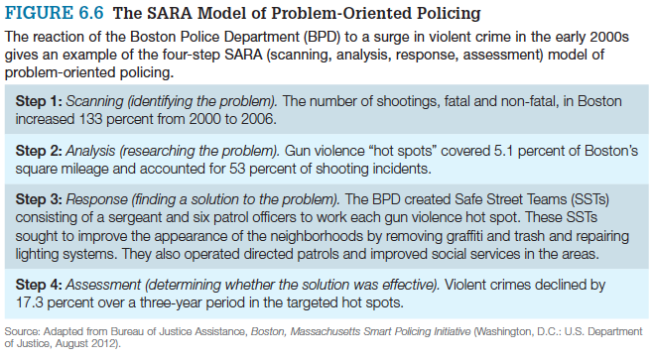
Police Strategies
Notes:
Figure 6.6 The SARA Model of Problem-Oriented Policing
The reaction of the Boston Police Department (BPD) to a surge in violent crime in the early 2000s gives an example of the four-step SARA (scanning, analysis, response, assessment) model of problem-oriented policing.
Source: Adapted from Bureau of Justice Assistance, Boston, Massachusetts Smart Policing Initiative (Washington, D.C.: U.S. Department of Justice, August 2012).

Slide 21
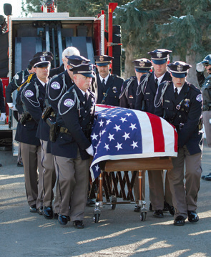
Learning Objective 7
Determine when police officers are justified in using deadly force.
George Frey/Reuters/Landov
Notes:
Fellow officers escort the casket of Ogden City, Utah, police officer Jared Francom, who was shot and
killed while trying to apprehend a suspect. How might violence against police officers contribute to the “blue curtain” between law enforcement and the public? George Frey/Reuters/Landov

Slide 22
“Us versus Them”: Issues in Modern Policing
Authority and the use of force
  Reasonable force
    The degree of force that is appropriate to protect the officer and other citizens
  Deadly force
    Force likely or intended to cause death

Slide 23
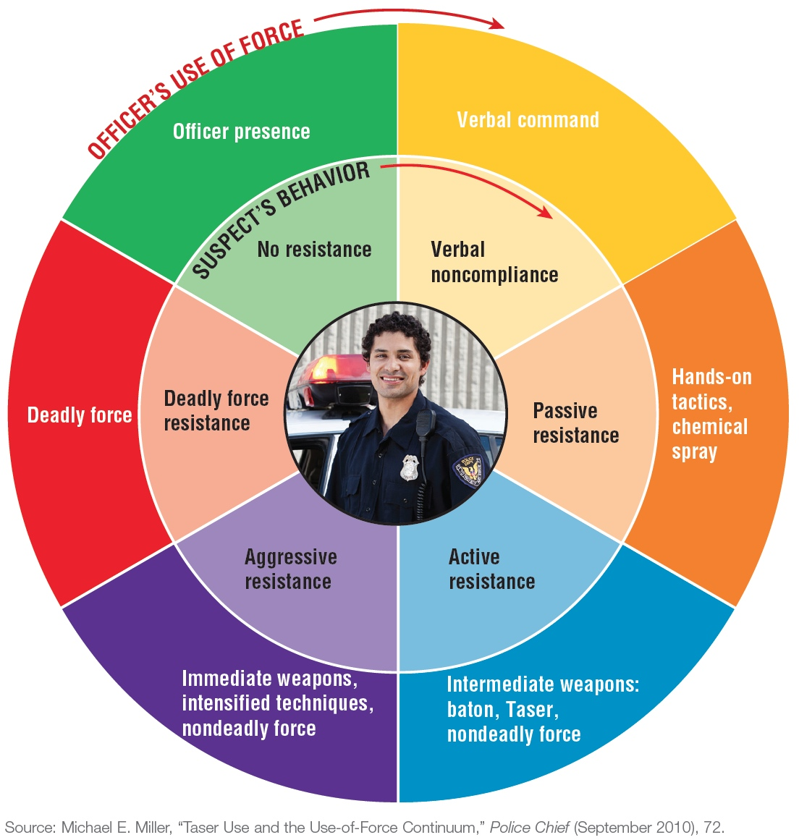
“Us versus Them”: Issues in Modern Policing
© Cengage Learning. All Rights Reserved.
Notes:
FIGURE 6.7 The Orlando (Florida) Police Department’s Use
of Force Matrix
Like most local law enforcement agencies, the Orlando Police Department has a policy to guide its officers’ use of force. These policies instruct an officer on how to react to an escalating series of confrontations with a civilian and are often expressed visually, as shown here. Source: Michael E. Miller, “Taser Use and the Use-of-Force Continuum,” Police Chief (September 2010), 72. Photo credit: iStockPhoto.com/Mie Ahmt

Slide 24
“Us versus Them”: Issues in Modern Policing
Tennessee v. Garner (1985)
  Fleeing felons
Graham v. Connor (1989)
  Reasonableness at scene
    In 2004, the Supreme Court held that an officer’s use of force could be “reasonable” even if, by objective measures, the force wasn’t needed to protect the officer or others in the area.
Less lethal weapons

Slide 25
Learning Objective 8
Identify the three consent decree requirements commonly made of local police departments that have exhibited patterns of civil rights violations.
Matt Roth/The New York Times

Slide 26
Police Misconduct & Ethics
Types of corruption
  Bribery
  Shakedowns
  Mooching
Police accountability
  Inside the department
  Outside the department
  Liability

Slide 27
Police Misconduct & Ethics
Consent decrees
  Implement policies and training to minimize use of force.
  Set up tracking system to identify and discipline officers most involved in use-of-force incidents.
  Improve community relations, especially by providing effective protocol to respond to citizen complaints.

Slide 28
Learning Objective 9
Explain what an ethical dilemma is, and name four categories of ethical dilemmas that a police officer typically may face.
Mandel Ngan/AFP/Getty Images
Notes:
Vice President Joseph Biden presents Kitsap County (Washington) deputy sheriff Krista McDonald with the Public Safety Officer Medal of Valor. McDonald earned the honor for placing herself in the line of fire to rescue two fellow deputies who had been wounded in a shootout with a suspected sex offender. What
role does the concept of duty play in a law enforcement agent’s decision, regardless of her or his own safety, to protect the life of another person? Mandel Ngan/AFP/Getty Images

Slide 29
Police Misconduct & Ethics
Ethical dilemmas are defined as a situation in which law enforcement officers:
  Do not know the right course of action
  Have difficulty doing what they consider to be right; and/or
  Find the wrong choice very tempting
Four categories of ethical dilemmas
  Discretion
  Duty
  Honesty
  Loyalty

Slide 30
Police Misconduct & Ethics
Administrators encourage ethical policing by:
  Incorporating ethics into the department’s mission statement
  Conducting internal training sessions in ethics
  Accepting “honest mistakes”
  Adopting a zero-tolerance policy towards unethical decisions when mistakes are not honest

