Slide 1
Developmental Reading Assessment
Picolata Crossing Elementary
Grades 3-5

Slide 2
Learning Goals
Teachers will be able to administer the Developmental Reading Assessment (DRA) to determine student’s reading accuracy, fluency, and comprehension.
Teachers will utilize data received from the DRA assessment to drive differentiated instruction.

Slide 3
Notes:
We want our students reading daily (increasing reading volume). In order to insure that their reading time is worth their while, we need to assess their oral reading and comprehension regularly.
Students should always know their level and how to determine if a book is too difficult. A student should read a text with 95% accuracy.

Slide 4
Read and Retell

Slide 5
When Peter's father told him that they were moving to a new town on the other side of the country, Peter felt a mix of things inside him. He was happy for the new adventure but sad to leave his friends behind. He was excited for the new things he would see and learn but scared about what he might forget, or miss, about home. It was hard to say how he felt about it.
Try it Again…

Slide 6
So, how do we determine the independent and instructional levels of our students?
Students need instruction and materials at their independent and instructional levels.
85% of everything children read should be easy for them
15% should be a bit of a challenge
0% at the difficult level because it provides no purpose for learning
Richard Allington 1996
Notes:
After discussing this, look at the DRA2 Continuum to show how the columns are labeled “emerging/ intervention, developing/ instructional, independent, and advanced”. When scoring the assessment, these will give you an idea as to where the student is on the continuum.

Slide 8
DRA Assessment Cycle
Assessing
Performance
Teaching/
Learning
Analyzing/
Reflecting
Planning
Instruction

Slide 9
Purpose of the DRA
Works in conjunction with DRA K-3
Provides classroom teachers of intermediate students
-to access levels of performance on a variety of crucial skills and strategies
-diagnose student needs and plan for instruction
-prepare students to be successful in the classroom and on state test (FSA)
-document progress across the intermediate years
-keep parents informed about the levels of student achievement
Notes:
I have placed a star by the first purpose because it is most important in my opinion.
*This is the only assessment that we have that incorporates oral reading fluency and the teacher’s ability to observe student’s oral reading habits. *

Slide 10
Benefits of DRA
Determines each student’s independent reading level
Confirms or redirects ongoing instruction
Helps teachers group students effectively for reading instruction
Documents changes in each student’s reading ability

Slide 11
DRA Assessment Tool
Should be administered twice a year at the intermediate level (3 for struggling readers).
Rubrics can be used with any text throughout the year
Continuum guides instruction
Notes:
Take a look at the continuum again and discuss how you can use the rubric to score follow-up running records throughout the school year.

Slide 12
Assesses student reading achievement in:
Wide Reading or Engagement (evidence in reading)
Self-evaluation and goal setting
Oral reading
Fluency
Comprehension skills and strategies

Slide 13
Conducting the Assessment: The Overview
Step 1: Student Reading Survey (Optional)
Step 2: One-on-One Student Reading Conference
Step 3: Independent Student Work
*For students reading DRA text Levels 20, 24, and 28 (second-
grade reading level), the teacher has two options:
-Choose to have the student dictate some or all of the response
in the Student Booklet.
*Students reading DRA text Levels 30, 34, and 38 (third-
grade reading level), will complete the accompanying Student
Booklet independently in writing (unless the student has an
I.E.P. or if writing would adversely affect the student’s level
of response, the teacher may have the student dictate his or
her responses for the Prediction and Summary.

Slide 14
Reading Engagement Survey
While the score from this portion does NOT go into the final score to determine reading level, this survey provides valuable information to the teacher in learning more about the child as a reader.

Slide 15
Oral Reading Fluency
While the student reads aloud the designated portion of the text, the teacher records all oral reading behaviors using the “Record of Oral Reading Guidelines”.
It’s important to record as much as possible as it will help in analyzing the student’s reading behaviors after the test is complete.
You will time the reading to determine the student’s oral reading fluency rate.
Notes:
Many times, this portion of the test gives valuable information in helping a student move forward in reading.

Slide 16
Oral Reading Fluency
After the student reads aloud, the teacher needs to quickly count the number of miscues (self-corrections are not considered miscues) to determine if the assessment should be continued with the student or if the text is too easy or too hard.
In order for a student to be considered independent on a level, they must score in the independent range in BOTH oral reading fluency AND comprehension.
Notes:
Look at the DRA continuum to illustrate this point.

Slide 17
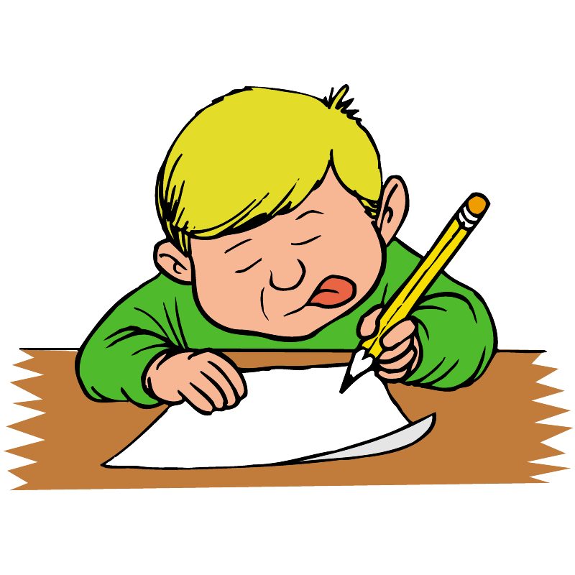
Comprehension
Students respond in writing for accurate analysis
Separate comprehension checks include –
* Prediction
* After reading response
* Summary of text
* Literal Comprehension
* Inferential comprehension
* Reflection about text
* Metacognition of comprehension strategies

Slide 18
Additional Features
DRA reflects the best practices of intermediate grade reading instruction because students –
Select the text they want to read according to their interests.
Use self-assessment forms which promote reading, thinking, and writing comprehension.
Reflect on reading strategies to develop literal and inferential comprehension, summarizing skills, and metacognition.

Slide 19
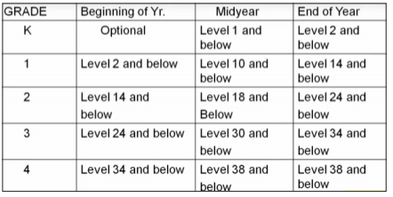
DRA2 Word Analysis
Diagnostic assessment used with struggling and emerging readers to determine strength and weakness with spoken and written words.
Intended for:

Slide 20
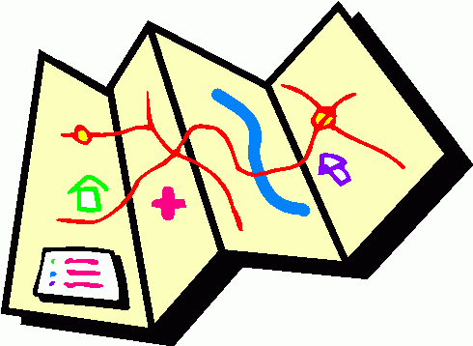
DRA Assessment Results
Provide teachers with:
An understanding of the students’ engagement in the reading process
A fluency rate based on the timed oral reading passage
An oral reading score
A comprehension score
Insight into the meta-cognitive process

Slide 21
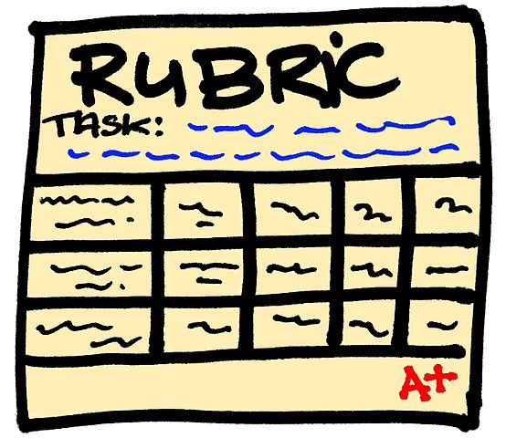
Notes on Scoring of the DRA
Teacher Guide is available in every kit to help in determining correct answers.
The Reading Engagement (survey) is not used in determining reading levels– it is purely for instructional purposes.
Students will be considered independent on the level assessed IF they score in the independent range for BOTH fluency and comprehension.

Slide 22
I’ve DRA’d, Now What?
DRA2 Focus for Instruction
Using the DRA2 Continuum, you will complete the Focus for Instruction as this will help you in forming your small groups or in conferences.
Choosing 3-5 learning and teaching activities is useful for small group differentiation.
The Class Profile Sheets are helpful with this as well because it gives you a “bird’s eye view” of where everyone scored in the different areas.
Notes:
Remember: If the assessment is important enough for our students to complete, then it is important enough for us to use the information to drive our instruction.

Slide 23
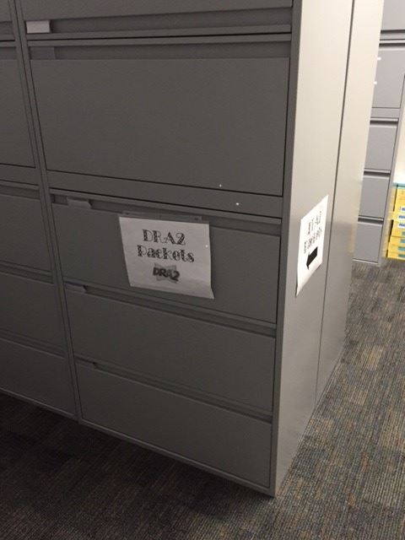
Need Packets?
Come by Room 112 in the Front Office!

Slide 24
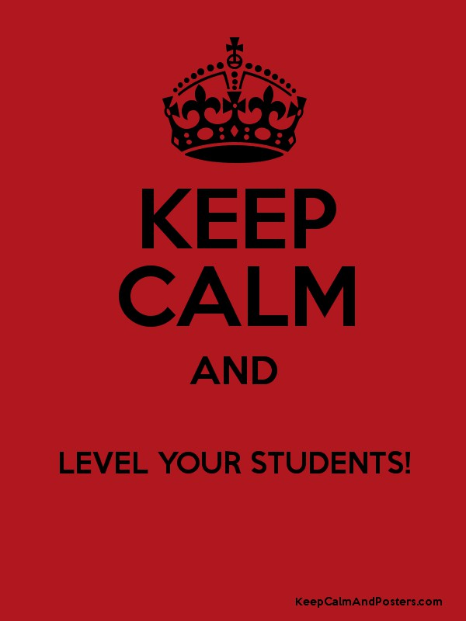
Homework and Next Steps
1. Before we meet again on November 18th, please administer the DRA to your students.
2. When we meet on November 18th, please bring the test packets to the meeting as we will be using these to look at next steps for instruction.

Slide 25
Need a Refresher on administering the DRA?
Stick Around!

Slide 26
Conducting the Assessment
Survey Says…
Student Reading Survey (Optional)
Wide Reading
Self-assessment/goal setting
A written student self-assessment of reading behaviors.

Slide 27
Conducting the Assessment
One-on-one student conference
Text selection
Oral reading and fluency
A timed oral reading passage of approximately 200-250 words that will be done in a conference with the teacher.

Slide 28
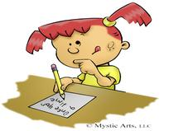
Conducting the Assessment
Independent Student Work
Prediction
Read entire text silently
Complete accompanying student booklet
-Summary
-Literal Interpretative and Reflective questions
-Metacognitive Awareness

Slide 29
Conducting the Assessment
After reviewing the students’ written responses the teacher:
Identifies statements of reading behaviors on the instructional continuum
Teacher uses statement of reading behaviors to identify the focus for instruction

Slide 30
Analyzing the Assessment
Determining the level of student responses
Selecting descriptors on the continuum
Choosing a focus for instruction

Slide 31
If you need any further help, please contact me. I am happy to come in and model the assessment and/or assist you in scoring your tests.

