Slide 1
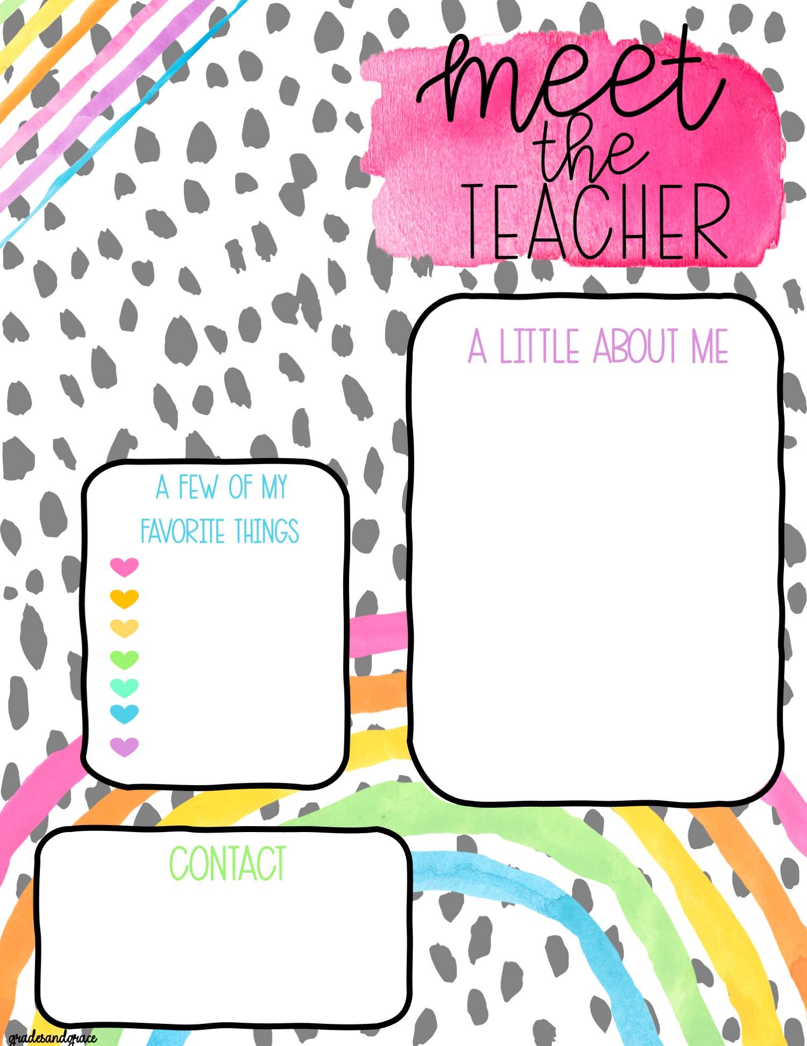
Hello! My name is Mrs. Cassandra Mauer!
“Mauer” is pronounced like “Power” but with the letter “M” instead!
I am 40 years young!
This is my 17th year teaching ART to elementary grades K-5 and my 3rd year at Valley Ridge Academy
Avid reader
Walmart
Target
AMAZON
Dick Blick
Chick-fil-a
Starbucks
Email: Cassandra.mauer@stjohns.k12.fl.us
@Hello.Hue

