Slide 1
Here’s a Gosh Dern PPT

Slide 2
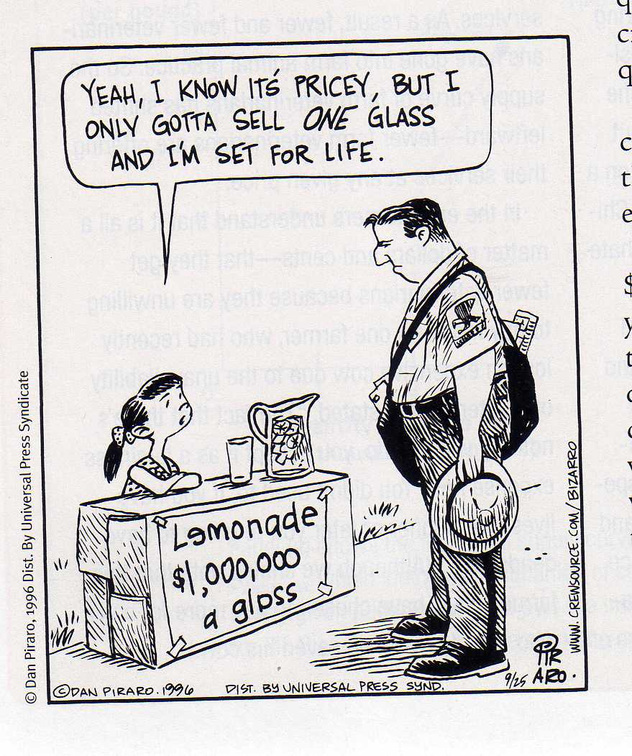
…to help you understand that explicit and implicit costs can be broken down into these categories:
Total Cost = TC
Fixed Cost = FC
Variable Cost = VC
Marginal Cost = MC
Average Fixed Cost = AFC
Average Variable Cost = AVC
Average Total Cost = ATC

Slide 3
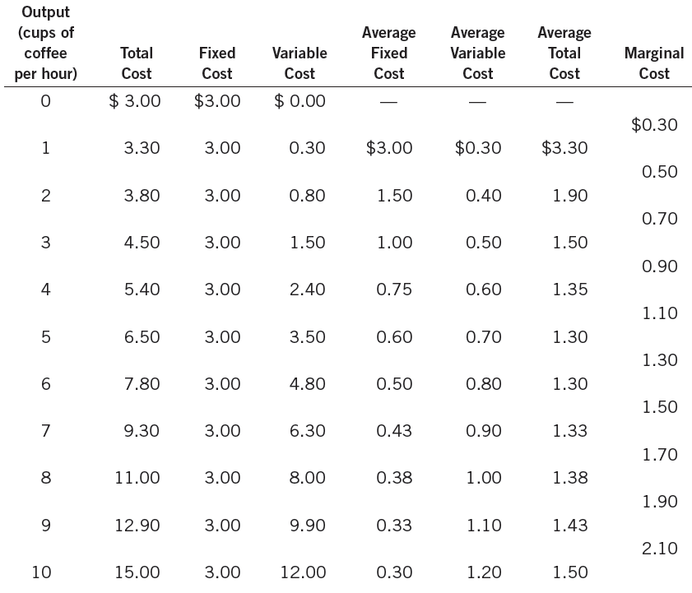
TC FC VC AFC AVC ATC MC
The Various Measures of Cost: D.B’s Coffee Shop
Quantity
FC Q
VC Q
TC Q
Change in TC Change in Q

Slide 4
Costs you put on a graph:
The Big Four Cost Curves
AFC, AVC, ATC, MC.

Slide 5
Costs you put on a graph:
The Big Four Cost Curves
AFC AVC ATC MC

Slide 6
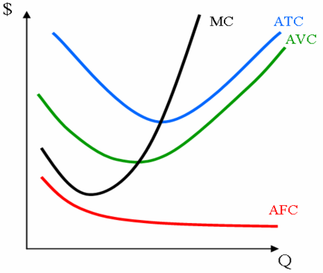
Here’s another example:
0
Q
TC
ATC
AFC
AVC
MC
0
$100
-
-
-
70
50
40
50
70
100
140
1
170
$170
$100
$70
2
220
110
50
60
3
260
86.67
33.33
53.33
4
310
77.50
25
52.50
5
380
76
20
56.00
The value of the AFC is shown as the area between AVC and ATC above
6
480
80
16.67
63.33
7
620
88.57
14.29
74.29
Notes:
6
Many students have heard the terms “cost per unit” or “unit cost” in other business courses. ATC means the same thing.

Slide 7
Comparing Types of Profit
Accounting Profit includes:
Explicit Cost = Actually paid out. This is called “accounting cost”
Accountants tabulate the following:
TR – TC (explicit only) = Accounting Profit
Economic Profit includes:
Implicit Cost = Opportunity Cost
Economists tabulate the following:
TR – TC (including explicit and implicit)= Economic Profit

Slide 8
Economic profit can be calculated as accounting profit minus which of the following?
Fixed costs
Implicit costs
Marginal costs
Explicit costs
Total costs

Slide 9
Instead of being employed at a printing company at a salary of $25,000 per year, Sally starts her own printing firm. Rather than renting a building that she owns to someone else for $10,000 per year, she uses it as the location for her company. Her costs for workers, materials, advertising, and energy during her first year are $125,000. If the total revenue from her printing company is $155,000, her total economic profit is…?

Slide 10
BTW… Thanks for Coming.
.

