Slide 1
AD/AS
Understanding the shifts

Slide 2
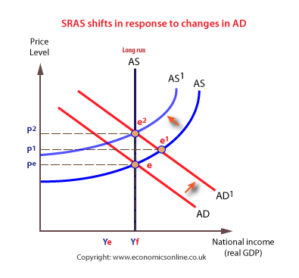
In this example, first AD shifts right (for a reason other than investment spending). Then AS shifts left because of a rising price level, but this is not necessarily stagflation since prices just move back to the long run trend

Slide 3
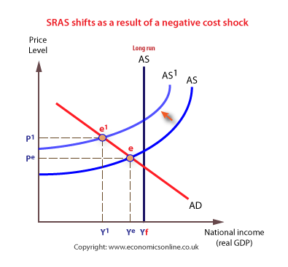
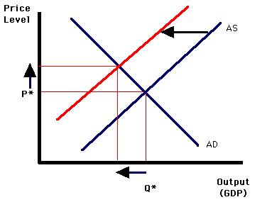
This is an example of Stagflation since prices move further away or past the long run trend.

Slide 4
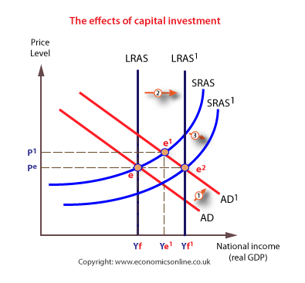
If AD shifts because of more INVESTMENT SPENDING, then AS shifts right as economic growth occurs because businesses are investing in new land, labor, capital or technology. LRAS shifts because of more or improved resources, or because of technology changes.

Slide 5
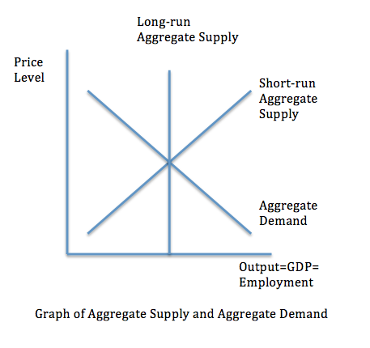
A
B
C

Slide 6
C
B
A
C

Slide 7
Bottom lines about shifts:
When AD shifts because of consumer spending or government spending or change in net exports, the AS can respond with a shift left or right depending on how price level changes. In these circumstances, LRAS will not shift.
When AD shifts because of INVESTMENT spending, AS will shift the same direction as AD, and LRAS will shift as well. If government incentivizes spending (lower interest rates, subsidies or tax credits), AD and AS both shift right. If government disincentivizes spending (higher interest rates or taxes), AD and AS both shift left.

Slide 8
Y = C + I + G + NX
The Government has a lot of influence on how and when curves shift. Let’s look at two ways the government can influence spending by C and I

