Slide 1
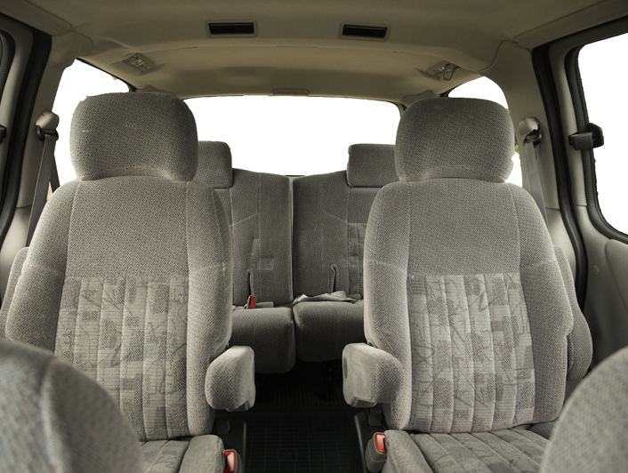
5th Grade Nature of Science

Slide 2
Question 1:
Jane is investigating to find out if bean plants grow taller in ordinary topsoil or special potting soil over a three week period. She sets up her investigation with 10 bean plants of equal size in each type of soil.
What should Jane do each day to make sure she gets valid results?
STRIKES
a. Water only the plants in special potting soil.
b. Calculate the average plant height for each soil type.
c. Move the plants in ordinary topsoil to different locations.
d. Estimate the height of each plant's stem and record the estimate.

Slide 3
Question 2:
Jonathan and Sarah have performed an experiment and are not sure their results are valid. What should they do to check their results?
STRIKES
a. average their data
b. change their lab report
c. perform a new experiment
d. repeat the same experiment

Slide 4
Question 2:
Jonathan and Sarah have performed an experiment and are not sure their results are valid. What should they do to check their results?
STRIKES
X
a. average their data
b. change their lab report
c. perform a new experiment
d. repeat the same experiment

Slide 5
Question 3:
Stephen and his classmates are going on a field trip to a nature preserve. His teacher has told the class that when they return to school, they will be required to give a report on their trip and the animals and plants they saw while walking through the preserve.
STRIKES
a. He should bring a pad and pen to write down his observations.
b. He should do research on the computer when he returns to class.
c. He should ask his classmates to help him remember what he saw.
d. He should look for a map of the nature preserve at the visitors' center.

Slide 6
Question 3:
Stephen and his classmates are going on a field trip to a nature preserve. His teacher has told the class that when they return to school, they will be required to give a report on their trip and the animals and plants they saw while walking through the preserve.
STRIKES
X
a. He should bring a pad and pen to write down his observations.
b. He should do research on the computer when he returns to class.
c. He should ask his classmates to help him remember what he saw.
d. He should look for a map of the nature preserve at the visitors' center.

Slide 7
Question 3:
Stephen and his classmates are going on a field trip to a nature preserve. His teacher has told the class that when they return to school, they will be required to give a report on their trip and the animals and plants they saw while walking through the preserve.
STRIKES
XX
a. He should bring a pad and pen to write down his observations.
b. He should do research on the computer when he returns to class.
c. He should ask his classmates to help him remember what he saw.
d. He should look for a map of the nature preserve at the visitors' center.

Slide 8
Question 4:
Jordan wants to find out if a hamster can learn a maze as quickly as a mouse can. She has researched mice and hamsters and predicts which rodent she thinks will learn more quickly. What should her next step be?
STRIKES
a. analyze hamster behavior in the maze
b. research how a rabbit would behave in a maze
c. observe the behavior of both rodents in the maze
d. make conclusions about rodent behavior in the maze

Slide 9
Question 4:
Jordan wants to find out if a hamster can learn a maze as quickly as a mouse can. She has researched mice and hamsters and predicts which rodent she thinks will learn more quickly. What should her next step be?
STRIKES
X
a. analyze hamster behavior in the maze
b. research how a rabbit would behave in a maze
c. observe the behavior of both rodents in the maze
d. make conclusions about rodent behavior in the maze

Slide 10
Question 4:
Jordan wants to find out if a hamster can learn a maze as quickly as a mouse can. She has researched mice and hamsters and predicts which rodent she thinks will learn more quickly. What should her next step be?
STRIKES
XX
a. analyze hamster behavior in the maze
b. research how a rabbit would behave in a maze
c. observe the behavior of both rodents in the maze
d. make conclusions about rodent behavior in the maze

Slide 11
Question 5:
During a recent drought, Sonya noticed some yards in her neighborhood were healthy and green, and some were mostly brown and dead. Sonya believes the difference has to do with how often her neighbors mow their grass. What should Sonya do first to find out if she is right?
STRIKES
a. Ask her neighbors to cut their grass on the same schedule.
b. Study other neighborhoods to see if there are similar problems.
c. Compare the neighbors' lawn mowers to see if there are similarities.
d. Survey her neighbors about their mowing schedule and record the details.

Slide 12
Question 5:
During a recent drought, Sonya noticed some yards in her neighborhood were healthy and green, and some were mostly brown and dead. Sonya believes the difference has to do with how often her neighbors mow their grass. What should Sonya do first to find out if she is right?
STRIKES
X
a. Ask her neighbors to cut their grass on the same schedule.
b. Study other neighborhoods to see if there are similar problems.
c. Compare the neighbors' lawn mowers to see if there are similarities.
c. Survey her neighbors about their mowing schedule and record the details.

Slide 13
Question 5:
During a recent drought, Sonya noticed some yards in her neighborhood were healthy and green, and some were mostly brown and dead. Sonya believes the difference has to do with how often her neighbors mow their grass. What should Sonya do first to find out if she is right?
STRIKES
XX
a. Ask her neighbors to cut their grass on the same schedule.
b. Study other neighborhoods to see if there are similar problems.
c. Compare the neighbors' lawn mowers to see if there are similarities.
d. Survey her neighbors about their mowing schedule and record the details.

Slide 14
Question 6:
To find out if yeast gives off a gas, Ignacio puts yeast and water in a bottle. He then places a balloon over the mouth of the bottle. What is Ignacio doing?
STRIKES
a. organizing data
b. identifying variables
c. evaluating a hypothesis
d. carrying out a procedure

Slide 15
Question 6:
To find out if yeast gives off a gas, Ignacio puts yeast and water in a bottle. He then places a balloon over the mouth of the bottle. What is Ignacio doing?
STRIKES
X
a. organizing data
b. identifying variables
c. evaluating a hypothesis
d. carrying out a procedure

Slide 16
Question 6:
To find out if yeast gives off a gas, Ignacio puts yeast and water in a bottle. He then places a balloon over the mouth of the bottle. What is Ignacio doing?
STRIKES
XX
a. organizing data
b. identifying variables
c. evaluating a hypothesis
d. carrying out a procedure

Slide 17
Question 7:
Lorna bought an outdoor solar light. She is doing an experiment to find out the best angle for sunlight to shine on the light to get the greatest charge in the least amount of time. Which is the best prediction Lorna should make before beginning the experiment?
STRIKES
a. The solar light will not charge if the angle is less than 80º.
b. On cloudy days the light will charge less than on sunny days.
c. The angle for the sunlight to hit the solar light needs to be 90º.
d. The solar light has to be on the ground to get the best charge.

Slide 18
Question 7:
Lorna bought an outdoor solar light. She is doing an experiment to find out the best angle for sunlight to shine on the light to get the greatest charge in the least amount of time. Which is the best prediction Lorna should make before beginning the experiment?
STRIKES
X
a. The solar light will not charge if the angle is less than 80º.
b. On cloudy days the light will charge less than on sunny days.
c. The angle for the sunlight to hit the solar light needs to be 90º.
d. The solar light has to be on the ground to get the best charge.

Slide 19
Question 7:
Lorna bought an outdoor solar light. She is doing an experiment to find out the best angle for sunlight to shine on the light to get the greatest charge in the least amount of time. Which is the best prediction Lorna should make before beginning the experiment?
STRIKES
XX
a. The solar light will not charge if the angle is less than 80º.
b. On cloudy days the light will charge less than on sunny days.
c. The angle for the sunlight to hit the solar light needs to be 90º.
d. The solar light has to be on the ground to get the best charge.

Slide 20
Question 8:
Saki is making a graph to show the length of time different brands of batteries lasted in a flashlight. Which type of graph would best show the data?
STRIKES
a. bar graph
b. circle graph
c. line graph
d. picture graph

Slide 22
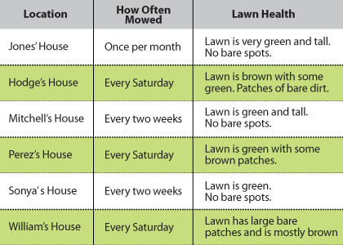
answers
Question:
Sonya wanted to know if mowing affects the health of grass
during a drought. To find out, she collected data on how often
her neighbors mowed their grass. Based on the information she
collected, what is the BEST next step?
a. Report her findings to her neighbors.
b. Develop a plan to save everyone's lawns.
c. Stop her neighbors from mowing their lawns.
d. Find out if other things might be affecting the grass.

Slide 23
answers
answers
Question:
Question:
Sonya wanted to know if mowing affects the health of grass
during a drought. To find out, she collected data on how often
her neighbors mowed their grass. Based on the information she
collected, what is the BEST next step?
a. Report her findings to her neighbors.
b. Develop a plan to save everyone's lawns.
c. Stop her neighbors from mowing their lawns.
d. Find out if other things might be affecting the grass.

Slide 24
Question 8:
Saki is making a graph to show the length of time different brands of batteries lasted in a flashlight. Which type of graph would best show the data?
STRIKES
X
a. bar graph
b. circle graph
c. line graph
d. picture graph

Slide 25
Question 8:
Saki is making a graph to show the length of time different brands of batteries lasted in a flashlight. Which type of graph would best show the data?
STRIKES
XX
a. bar graph
b. circle graph
c. line graph
d. picture graph

Slide 26
Question 9:
Patrick is researching the differences between swamps, bogs, and fens on the Internet. Which website most likely contains reliable information?
STRIKES
a. website run by a university
b. website run by a fishing magazine
c. website run by a fifth grade class at another school
d. website in which questions are asked and readers supply answers

Slide 27
Question 9:
Patrick is researching the differences between swamps, bogs, and fens on the Internet. Which website most likely contains reliable information?
STRIKES
X
a. website run by a university
b. website run by a fishing magazine
c. website run by a fifth grade class at another school
d. website in which questions are asked and readers supply answers

Slide 28
Question 9:
Patrick is researching the differences between swamps, bogs, and fens on the Internet. Which website most likely contains reliable information?
STRIKES
XX
a. website run by a university
b. website run by a fishing magazine
c. website run by a fifth grade class at another school
d. website in which questions are asked and readers supply answers

Slide 29
Question 10:
Christy’s mother observed that there are more flies this summer than there usually are. Which sequence of steps can Christy use to investigate whether this is true?
STRIKES
a. make a plan, gather information, organize data, draw a conclusion
b. gather information, make a plan, organize data, draw a conclusion
c. make a plan, organize data, draw a conclusion, gather information
d. draw a conclusion, gather information, organize data, make a plan
.

Slide 30
Question 10:
Christy’s mother observed that there are more flies this summer than there usually are. Which sequence of steps can Christy use to investigate whether this is true?
STRIKES
X
a. make a plan, gather information, organize data, draw a conclusion
b. gather information, make a plan, organize data, draw a conclusion
c. make a plan, organize data, draw a conclusion, gather information
d. draw a conclusion, gather information, organize data, make a plan
.

Slide 31
Question 10:
Christy’s mother observed that there are more flies this summer than there usually are. Which sequence of steps can Christy use to investigate whether this is true?
STRIKES
XX
a. make a plan, gather information, organize data, draw a conclusion
b. gather information, make a plan, organize data, draw a conclusion
c. make a plan, organize data, draw a conclusion, gather information
d. draw a conclusion, gather information, organize data, make a plan
.

Slide 32
Question 11:
Dora thinks that there are more frogs in the pond by her house when the water temperature is higher. She is making a chart to use as she gathers data to see whether she is correct. What data should Dora record on her chart?
STRIKES
a. time, air temperature, water temperature
b. date, time, air temperature, number of frogs
c. date, time, water temperature, number of frogs
d. date, air temperature, wind speed, number of frogs

Slide 33
Question 11:
Dora thinks that there are more frogs in the pond by her house when the water temperature is higher. She is making a chart to use as she gathers data to see whether she is correct. What data should Dora record on her chart?
STRIKES
X
a. time, air temperature, water temperature
b. date, time, air temperature, number of frogs
c. date, time, water temperature, number of frogs
d. date, air temperature, wind speed, number of frogs

Slide 34
Question 11:
Dora thinks that there are more frogs in the pond by her house when the water temperature is higher. She is making a chart to use as she gathers data to see whether she is correct. What data should Dora record on her chart?
STRIKES
XX
a. time, air temperature, water temperature
b. date, time, air temperature, number of frogs
c. date, time, water temperature, number of frogs
d. date, air temperature, wind speed, number of frogs

Slide 35
Question 12:
STRIKES
Which list shows Jupiter’s moons from largest to smallest?
a. Europa, Ganymede, Callisto.
b. Ganymede, Europa, Callisto.
c. Callisto, Ganymede, Europa.
d. Ganymede, Callisto, Europa.

Slide 36
Question 12:
STRIKES
X
Which list shows Jupiter’s moons from largest to smallest?
a. Europa, Ganymede, Callisto.
b. Ganymede, Europa, Callisto.
c. Callisto, Ganymede, Europa.
d. Ganymede, Callisto, Europa.

Slide 37
Question 12:
STRIKES
XX
Which list shows Jupiter’s moons from largest to smallest?
a. Europa, Ganymede, Callisto.
b. Ganymede, Europa, Callisto.
c. Callisto, Ganymede, Europa.
d. Ganymede, Callisto, Europa.

Slide 38
Get out of my cab!
SCORE
STRIKES
$ 0
XXX

Slide 39
Video Bonus Question
You will be given one question about the following video clip. If you get it right you double your extra credit points. If you get it wrong you lose everything!
What do you say………..do you want to play?

Slide 40
Video Bonus Question
Question: Describe the Scientific Method.

Slide 41
Video Bonus Question
Answer:
The scientific method is a process scientists use to test a hypothesis, gather and collect information, and then explain the results from their experiement.

Slide 43
Key
Question #
B
D
A
C
D
D
D
A
Red Light Question: D
9. A
10. A
11. C
12. D

Slide 44
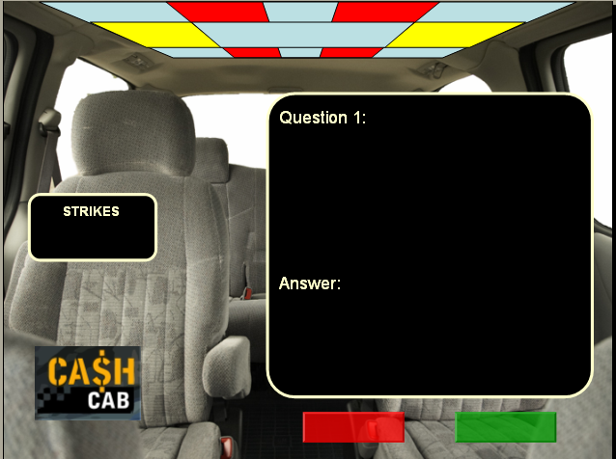
INSTRUCTIONS
Enter questions and answers for questions 1-12. You will have to copy/paste for each of numbered questions. Click once to display correct answer. If they get the question right, click green button, red if they get it wrong. Number of strikes will appear. If they get 8 right in a row, they will have a red light challenge question. If they make it all the way through 12 questions without 3 strikes, they can risk all of their extra credit on a video bonus question (double or nothing).
Right answer
Wrong answer

